Slide 1
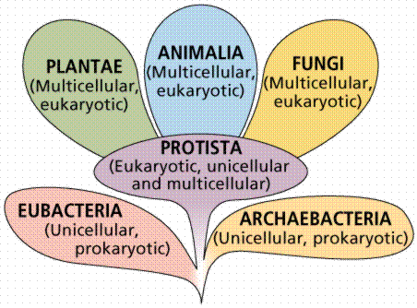
Diversity of protists (and eukaryotes)

Slide 2
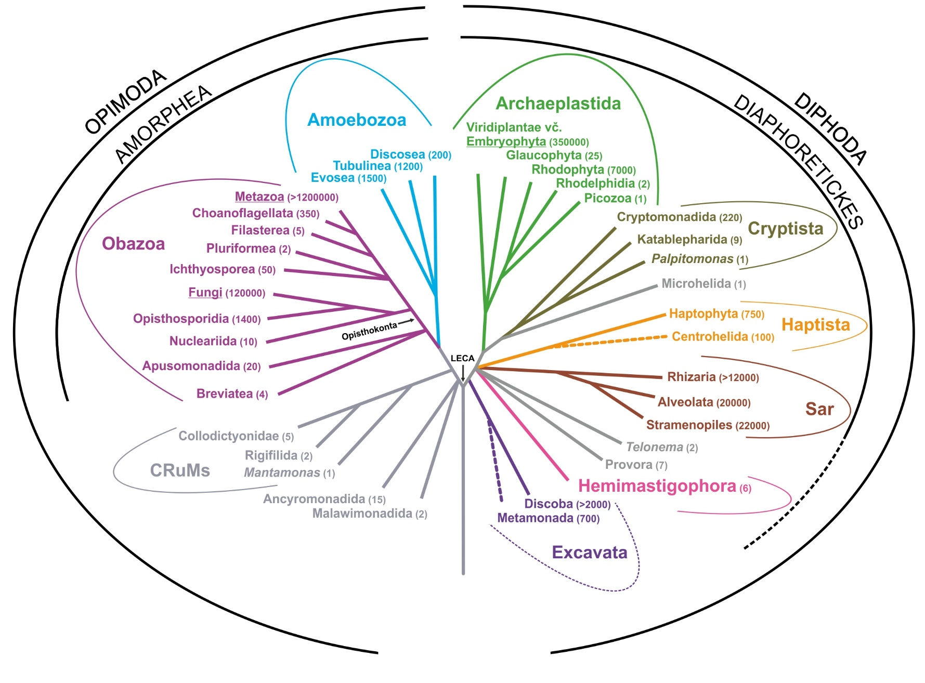
2024 – ca.10 eukaryotic supergroups
non-protist lineages

Slide 3
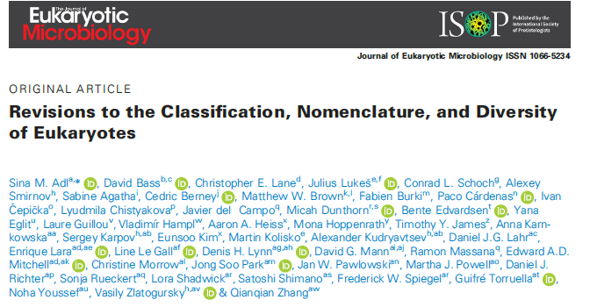
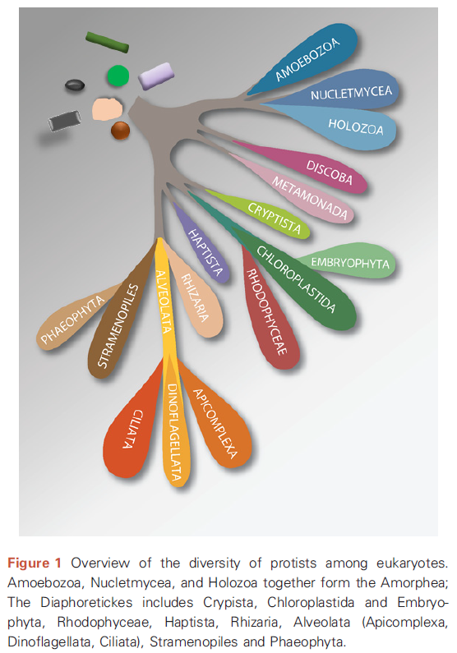
2019

Slide 4
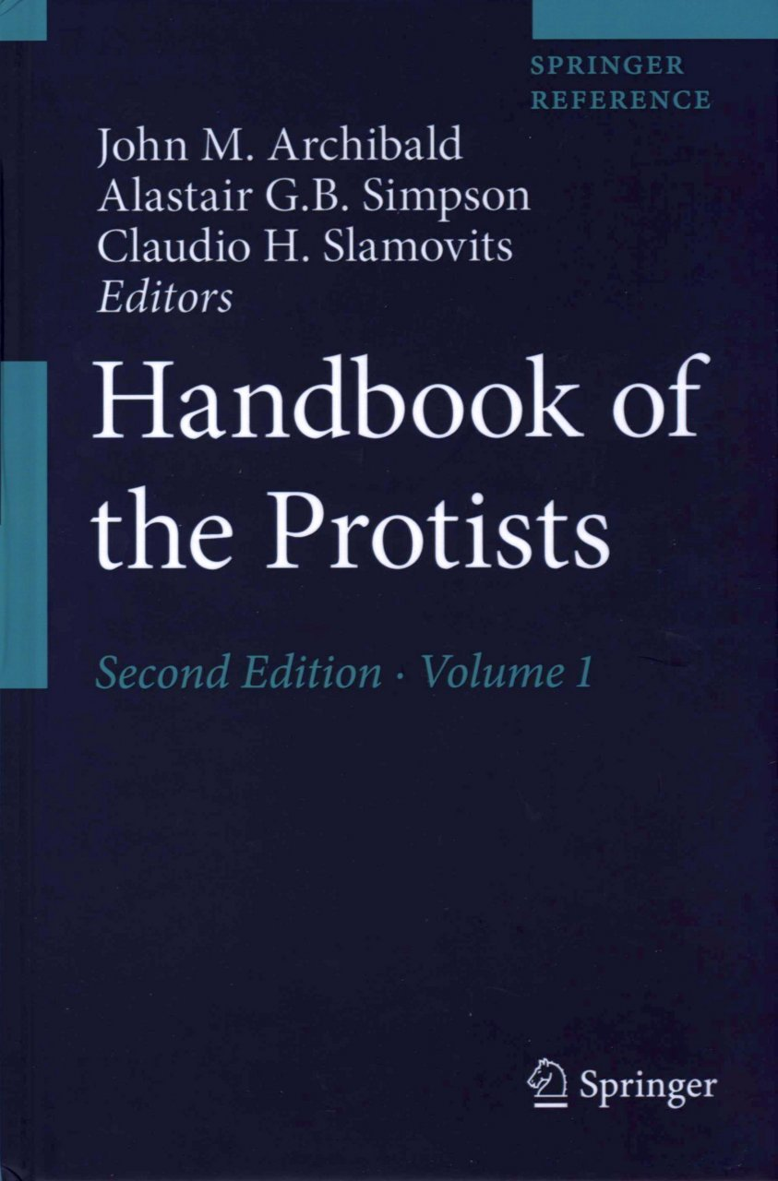
2017

Slide 5
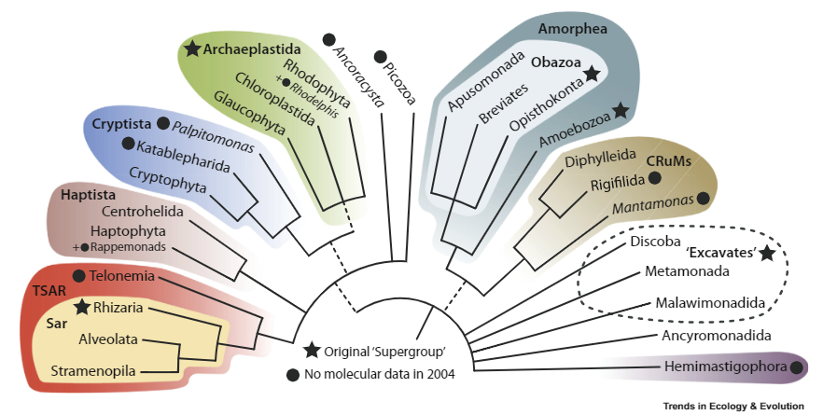
2020

Slide 6
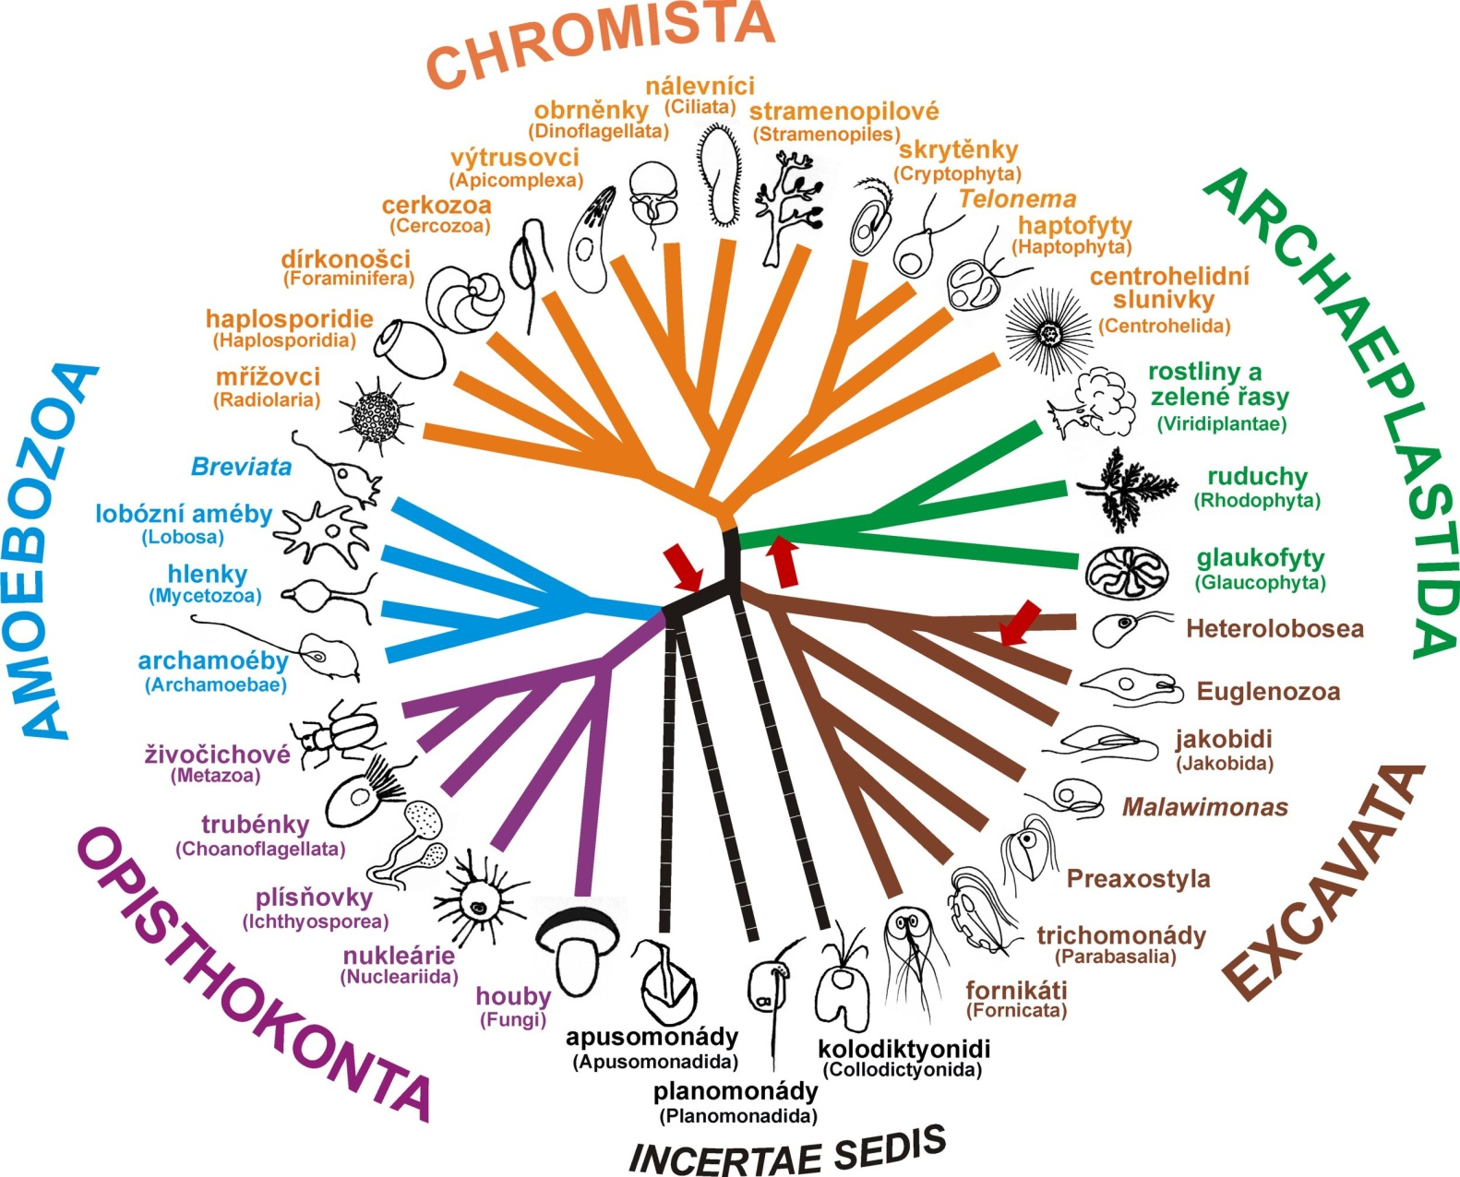
Chromista, Chromalveolata

Slide 7
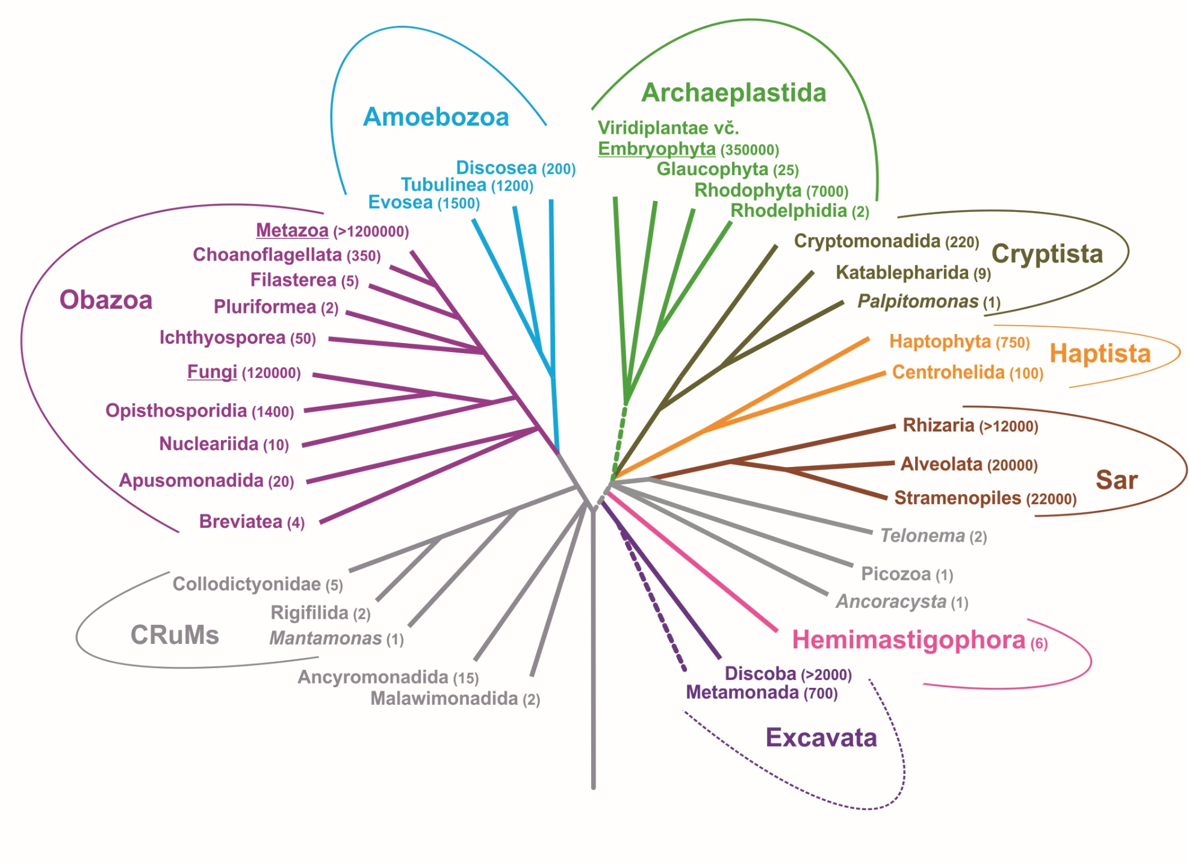

Slide 8
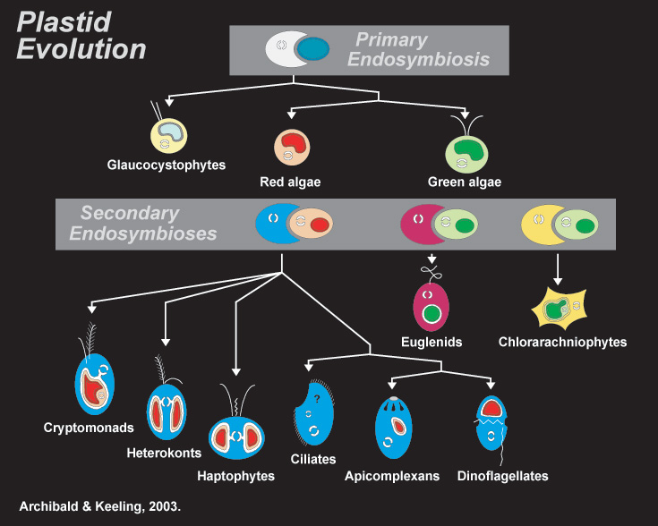
Chromalveolate hypothesis
Chromalveolata is a monophyletic taxon
Chromalveolate plastids are secondary and of a red-algal origin (except for Chlorarachiophyta, Paulinella, and certain dinoflagellates)
Secondary red symbiosis (symbiogenesis) ocurred only once, in an exclusive common ancestor of chromalveolates
But Cryptista seems to be more closely related to Archaeplastida than to other „chromists/chromalveolates“ (= there are two unrelated branches of ChrAlv)

Slide 9
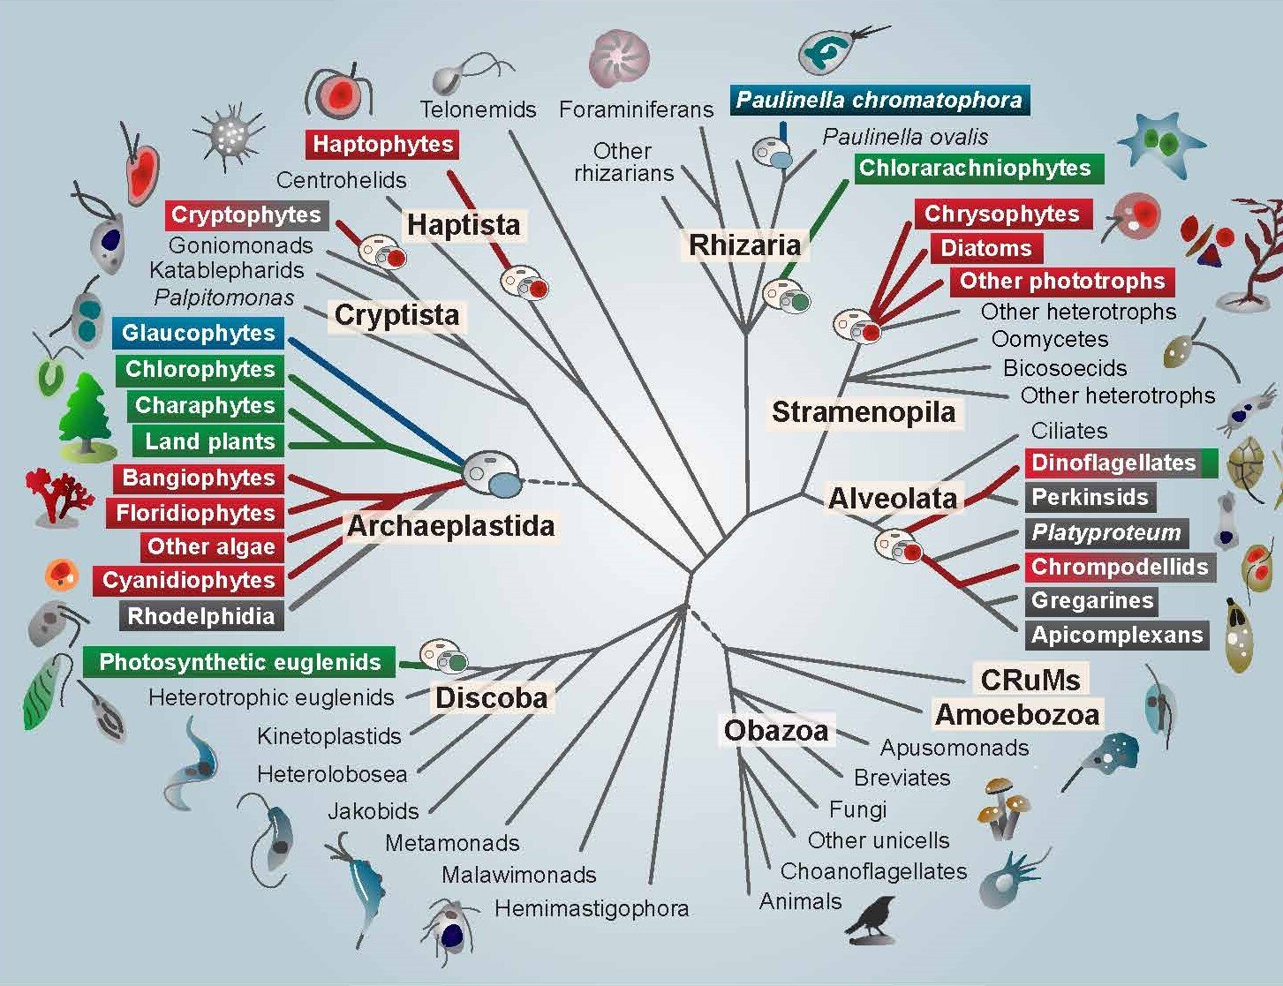
Chromalveolate hypothesis
(would require a time machine, assuming the tree topology is correct)

Slide 10
Hypothesis of at least two separate origins of ChrAlv plastids
(would involve a little bit too many convergences)

Slide 11
Serial hypotheses (many variants)
tertiary plastids
quaternary plastids

Slide 12
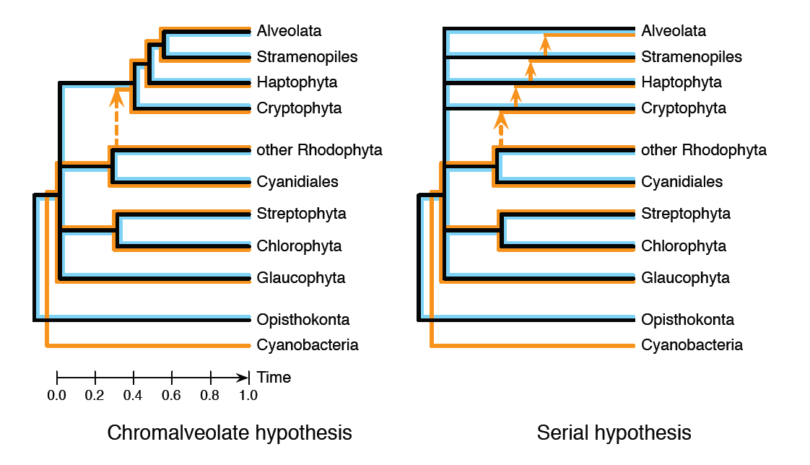

Slide 13
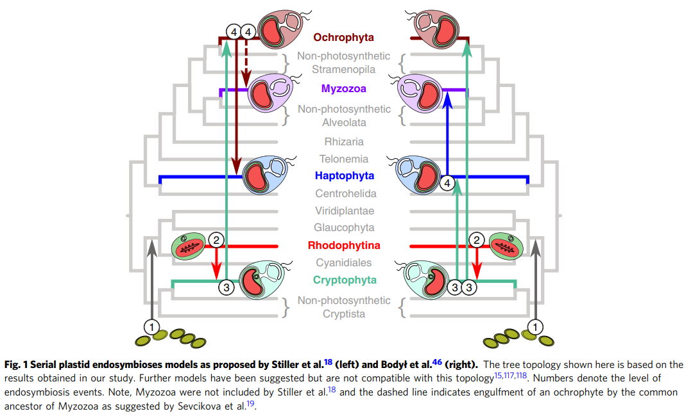
homework

Slide 15
Rhodelphidia (2019)
(phagocytotic relatives of red algae)

Slide 16
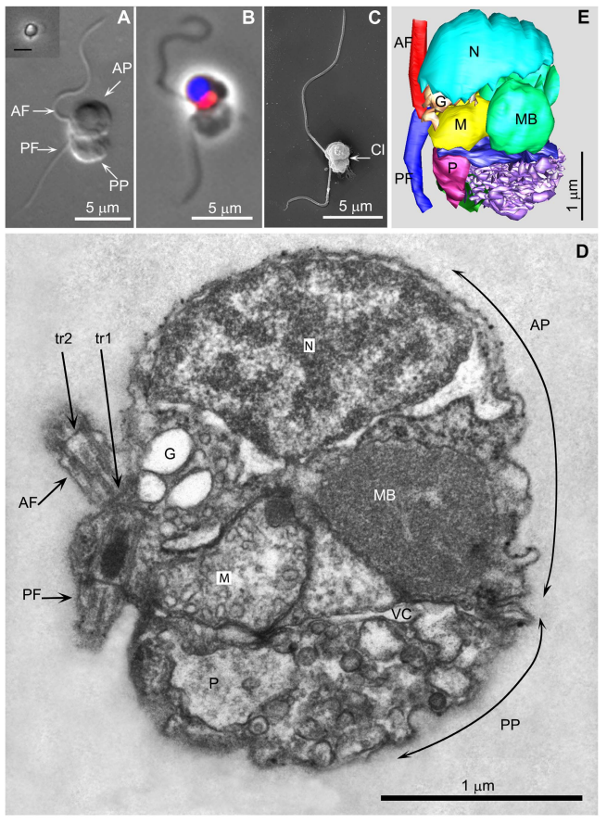
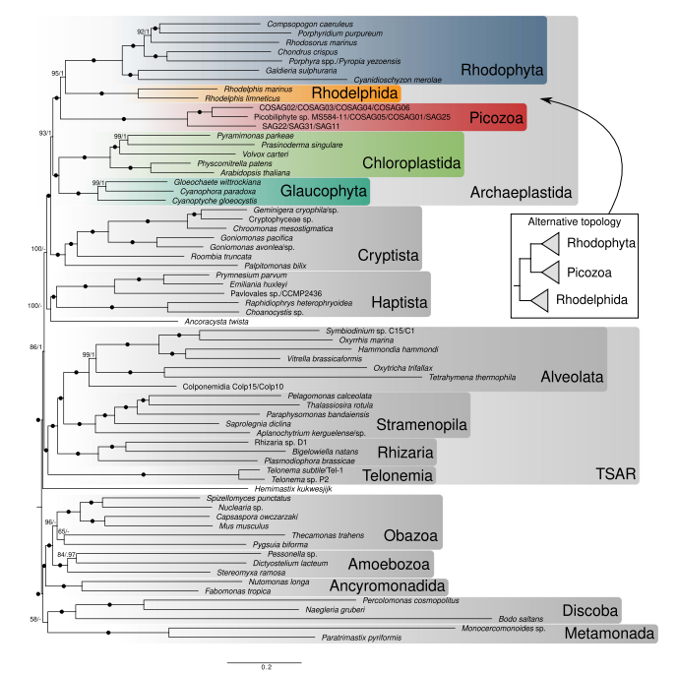
Picozoa (2021)
(aplastidic relatives of red algae)
2013

Slide 17
Amorphea
2018

Slide 18
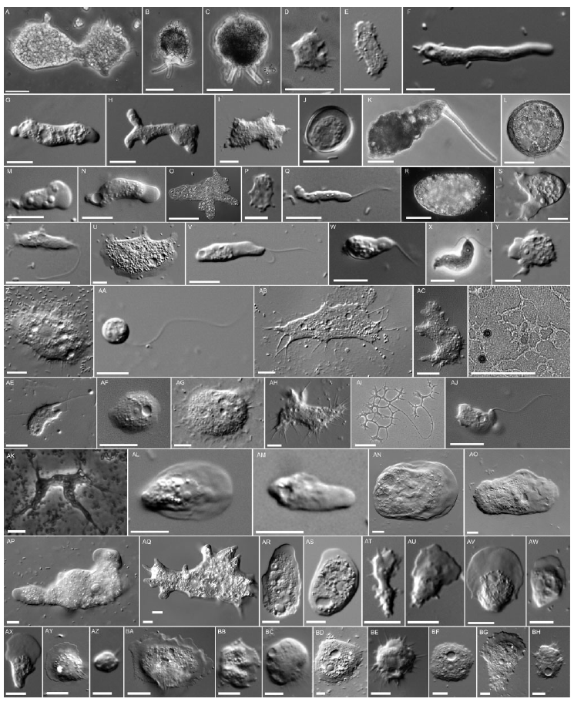
Amoebozoa
Kang S et al. (2017) Mol Biol Evol 34:2258

Slide 19
Amoebozoa
Kang S et al. (2017) Mol Biol Evol 34:2258

Slide 20
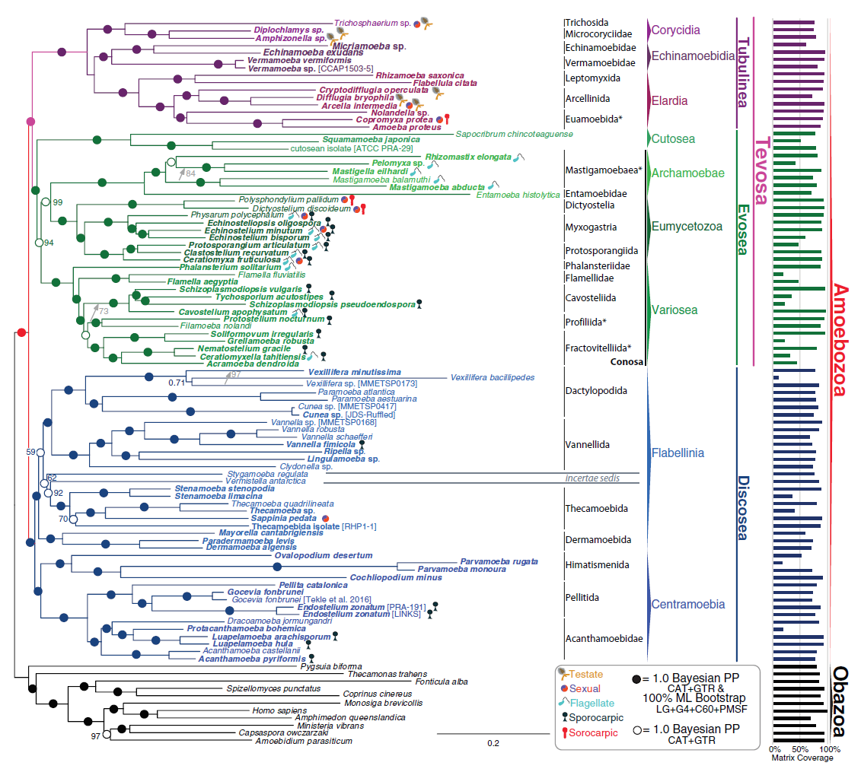
Kang S et al. (2017) Mol Biol Evol 34:2258

Slide 21
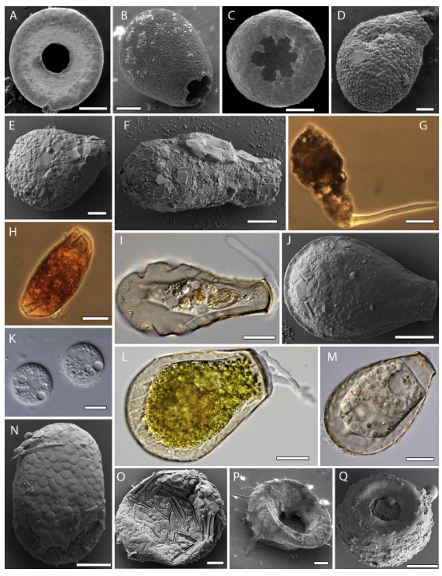
Arcellinida diversified already 730 Mya
Are approximately as old as the Metazoa
Form a terminal branch in the tree of the Amoebozoa

Slide 22
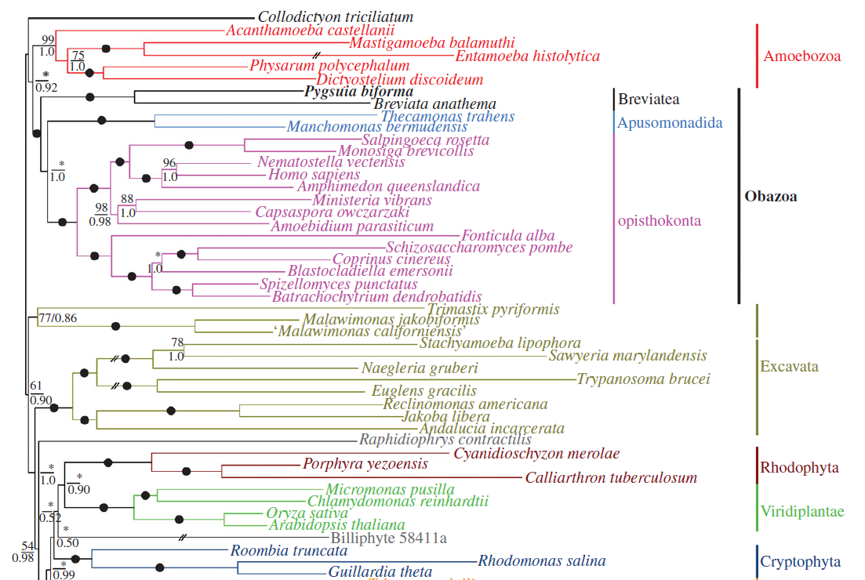
Obazoa (Opisthokonta, Breviatea, Apusozoa)
Brown MW et al. (2013) Proc R Soc B 280: 20131755

Slide 23
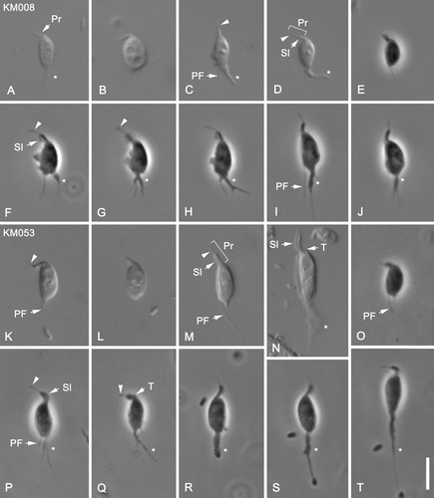
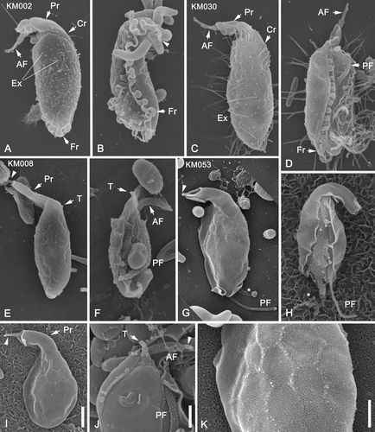
Apusomonadida
Chelonemonas
Multimonas, Chelonemonas
Heiss et al. (2015) J Eukaryot Microbiol 62:637

Slide 24
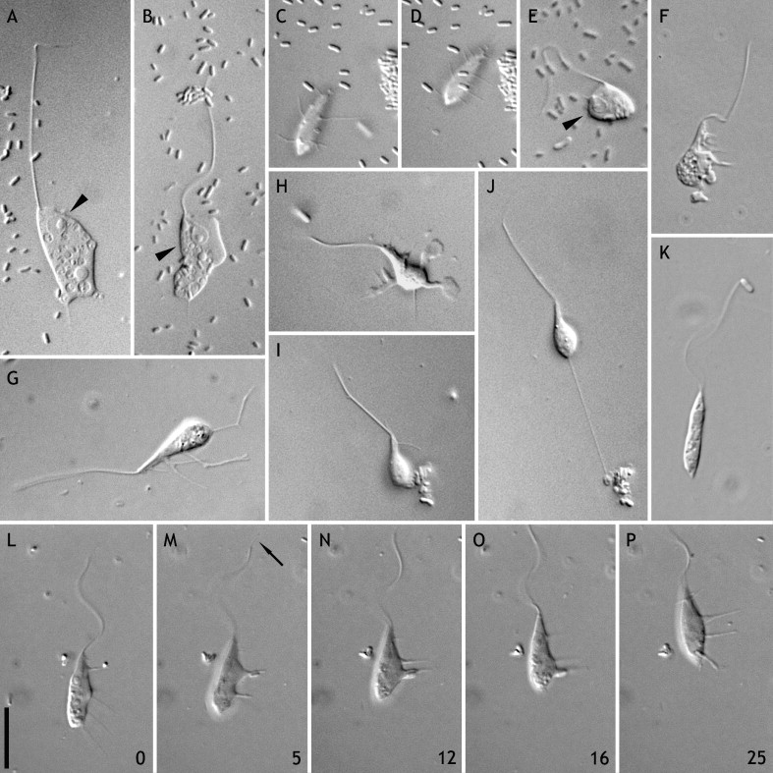
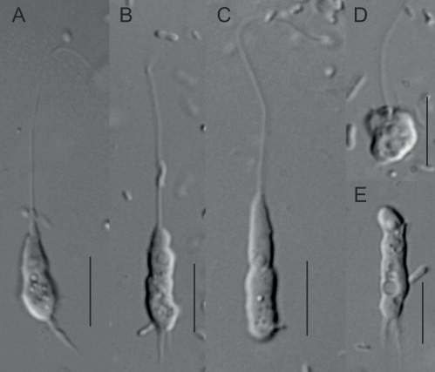
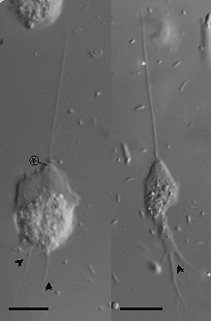
Mastigamoeba (Amoebozoa)
Ptáčková E et al. (2013) Protist 164: 380
Creneis
(Discoba)
Pánek T et al. (2014)
Protist 165: 542
Breviata (Breviatea)
Heiss AA et al. (2013) Eur J Protistol 49: 354

Slide 25
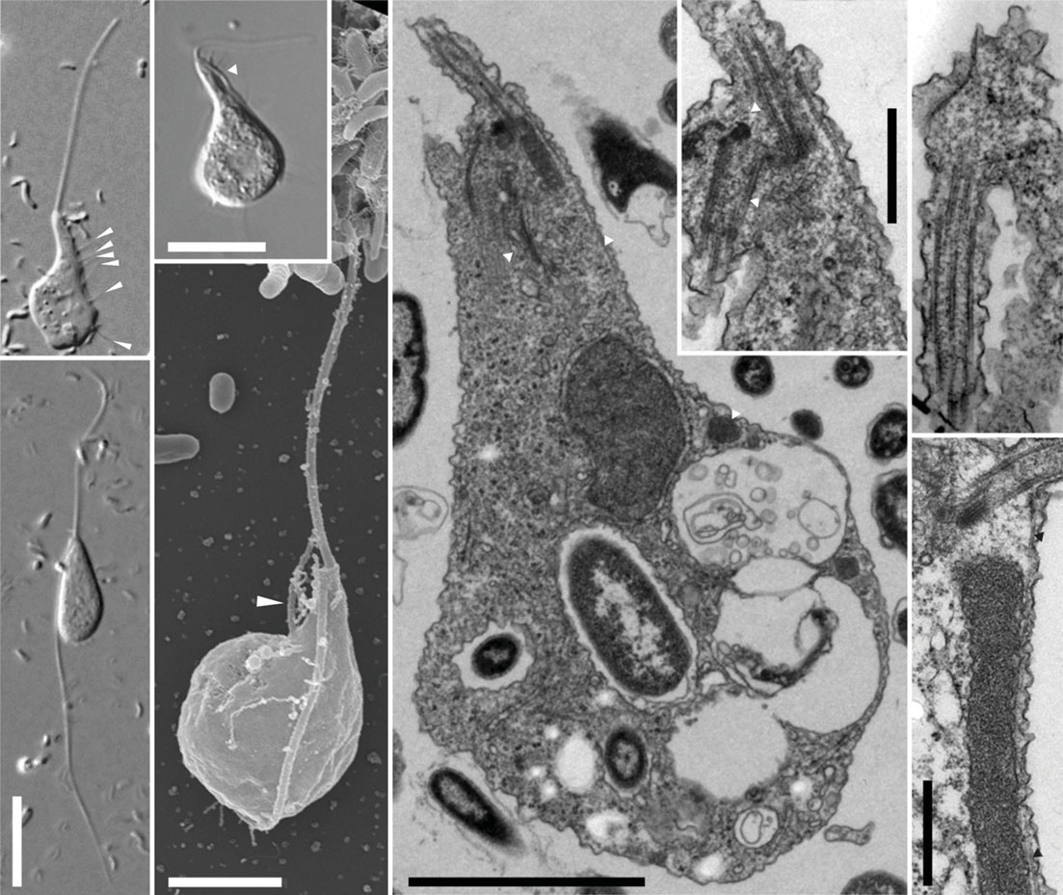
Pygsuia (Breviatea)
Brown MW et al. (2013) Proc R Soc B 280: 20131755

Slide 26
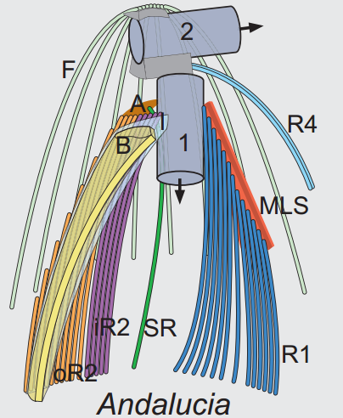
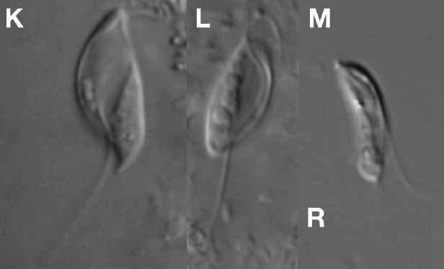
LECA (last eukaryotic common ancestor)
Velundella Pánek et al. 2016

Slide 27
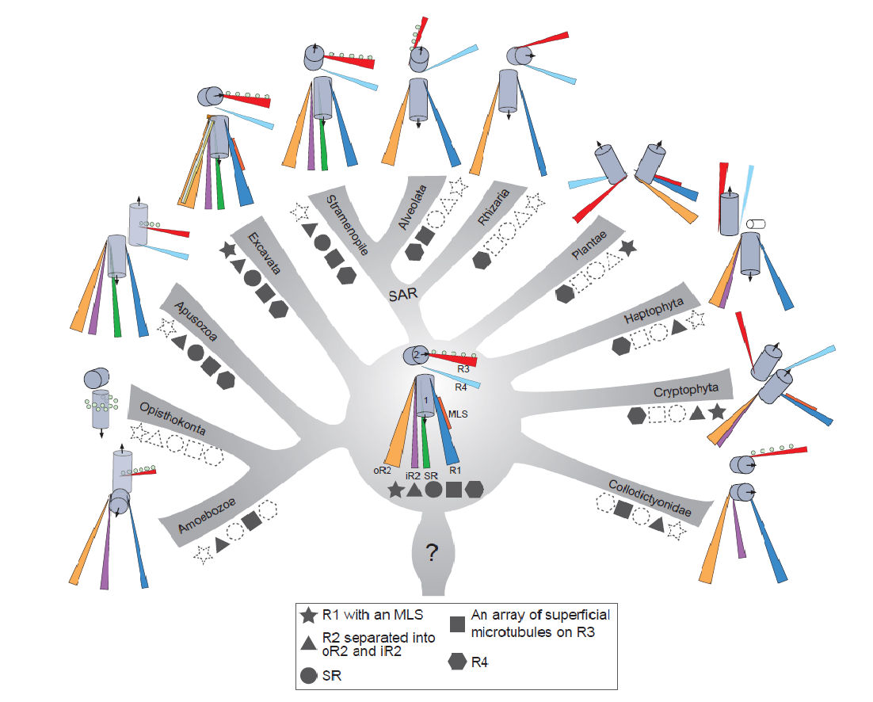
Evolution of microtubule organizing centers across the tree of eukaryotes
The Plant Journal Volume 75, Issue 2, pages 230-244, 22 MAR 2013 DOI: 10.1111/tpj.12145 http://onlinelibrary.wiley.com/doi/10.1111/tpj.12145/full#tpj12145-fig-0007
Notes:
Illustrations of the inferred ancestral traits for the flagellar apparatus in all 11 eukaryotic groups mapped onto a modern molecular phylogenetic context. The five traits mapped onto the tree are represented by different shapes: microtubule root 1 (R1) with a multilayered structure (MLS), R2 involved with phagotrophy, R3 with an array of superficial microtubules, a singlet root (SR) that helps support the ventral feeding groove and R4. Solid shapes refer to the presence of a trait; dashed outlines of shapes refer to the loss of a trait. The inferred ancestral flagellar apparatus for the most recent ancestor of eukaryotes is best represented by the traits found in typical excavates. The most recent common ancestor of the Apusozoa, Opisthokonta and Amoebozoa lost an MLS on R1; R4 was lost in the most recent common ancestor of the Opisthokonta and Amoebozoa. An MLS on R1 was also lost in the most recent common ancestor of the SAR (Stramenopiles, Alveolata and Rhizaria) clade.
© This slide is made available for non-commercial use only. Please note that permission may be required for re-use of images in which the copyright is owned by a third party.

Slide 28
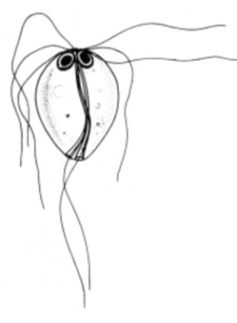
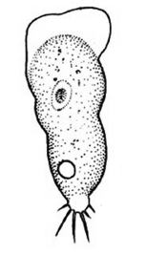
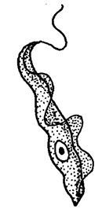
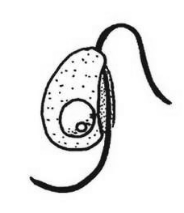
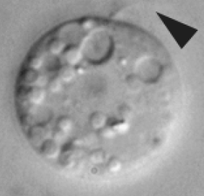
“excavates” (≠ Excavata!)
Malawimonadida
Metamonada
Jakobida
Heterolobosea
Euglenozoa
Tsukubamonas
Discoba

Slide 29
2018
?

Slide 30
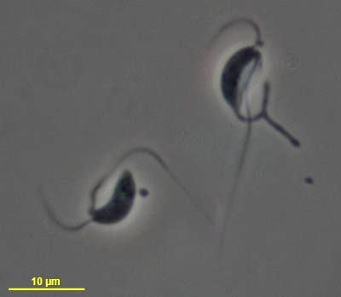
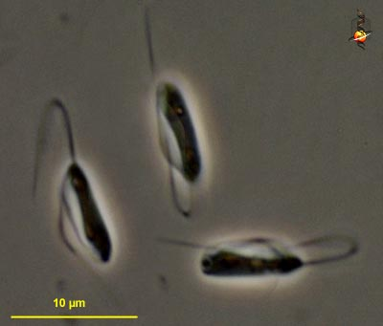
Malawimonas
(Malawimonadida)
Jakoba
(Jakobida)
… also, strikingly similar structure of the flagellar apparatus

Slide 31
Excavata = Eukaryota?
… complicated, Excavata-like cytoskeleton known also (e.g.) from Stramenopiles (Diaphoretickes) and apusomonads (Amorphea)

Slide 32
Recently recognized supergroups
2022 (2017)
2018
2018
(2024)

Slide 33
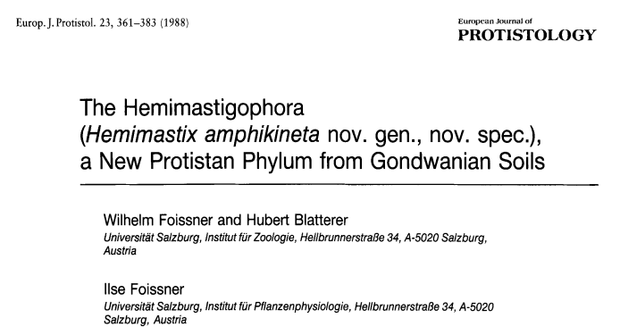
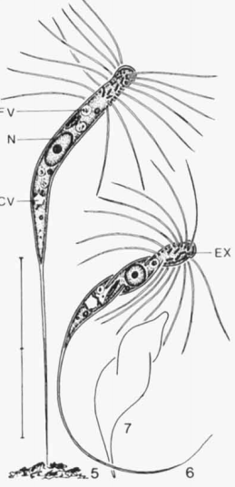
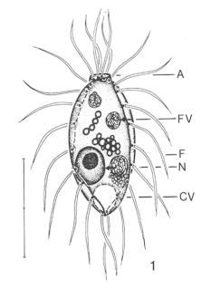
Other deep-branching Diaphoretickes include Ancoracyta, Telonema, and Picomonas

Slide 34
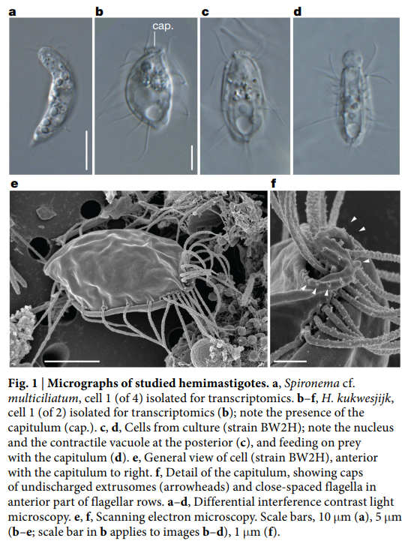
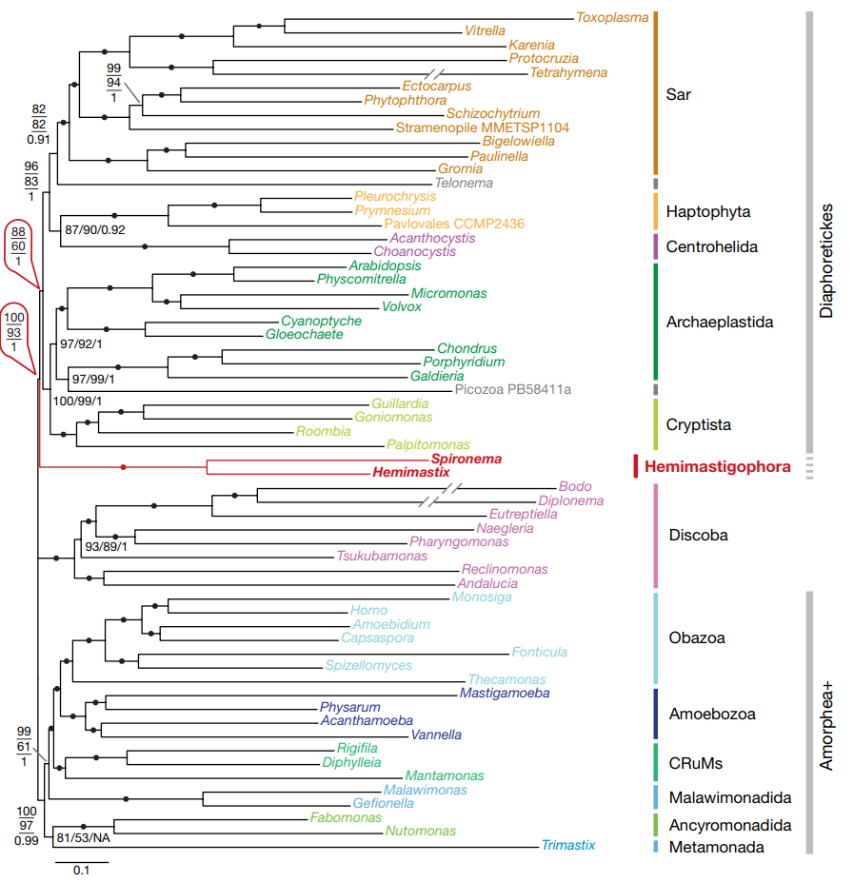

Slide 35
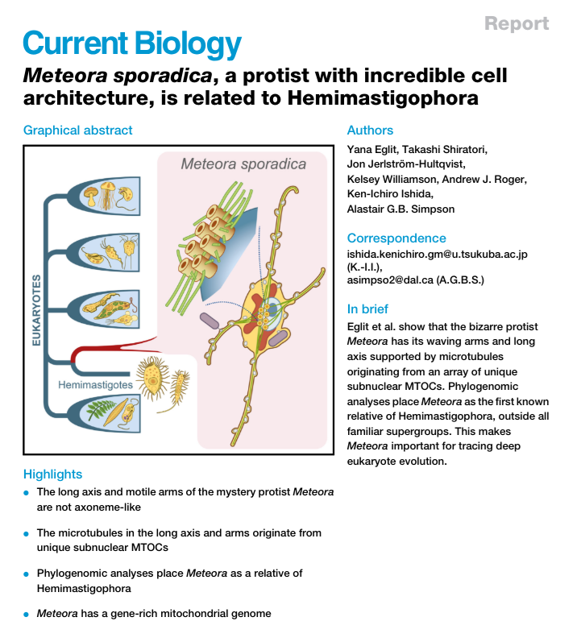

Slide 37
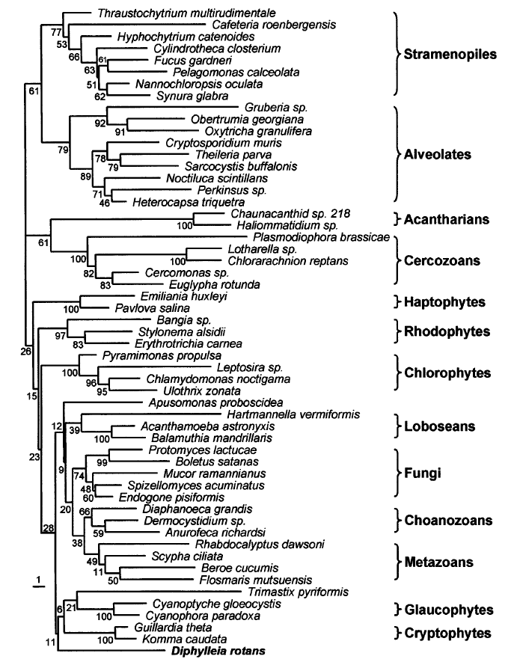
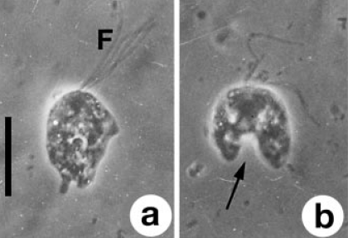
CRuMs (= Collodyctionida, Rigifilida, Mantamonadida)
(close to Amorphea)
Collodictyon (Diphylleida)
Brugerolle G et al. (2002) Protist 153: 59

Slide 38
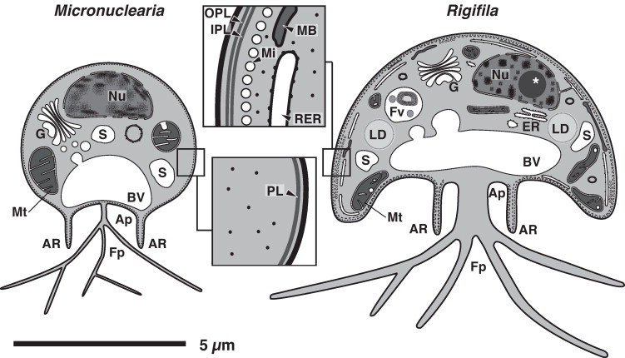
Yabuki A et al. (2013) Protist 164: 75
Mantamonas
Glücksmann E et al. (2011) Protist 162: 207

Slide 39
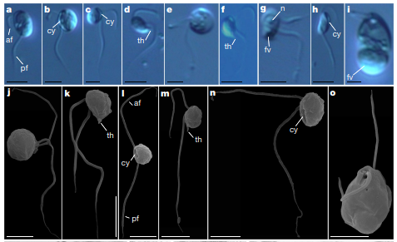
Provora

Slide 40
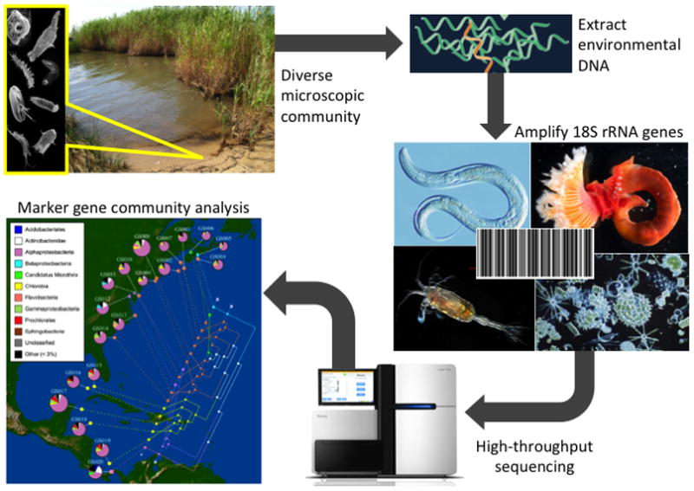
Environmental sequencing

Slide 41
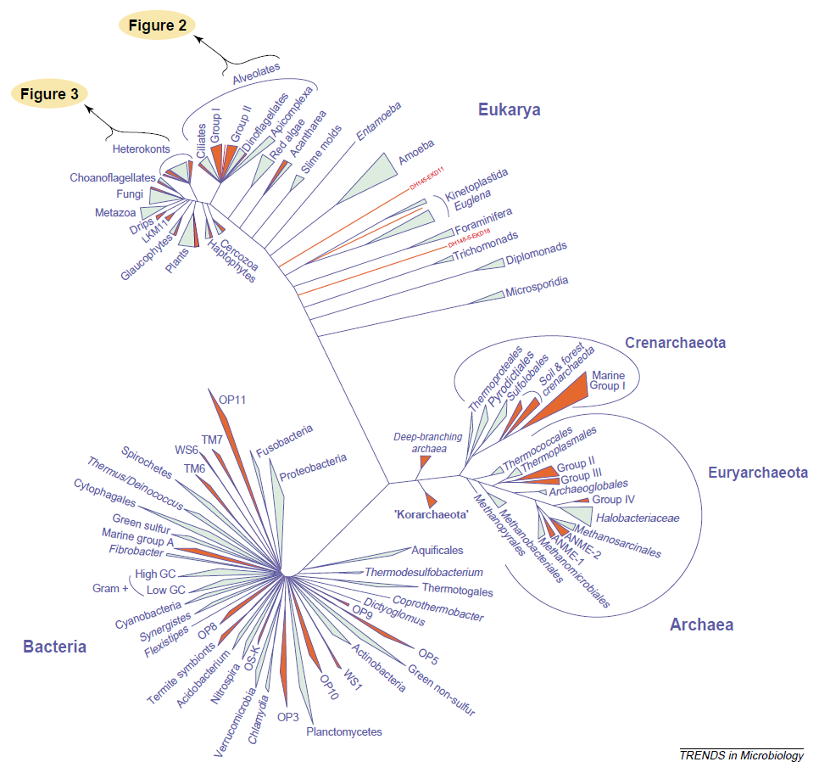
Environmental diversity
Moreira D & López-García (2002) Trends Microbiol 10: 31

Slide 42
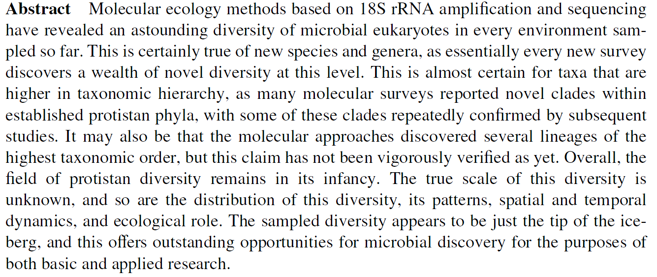

Slide 43
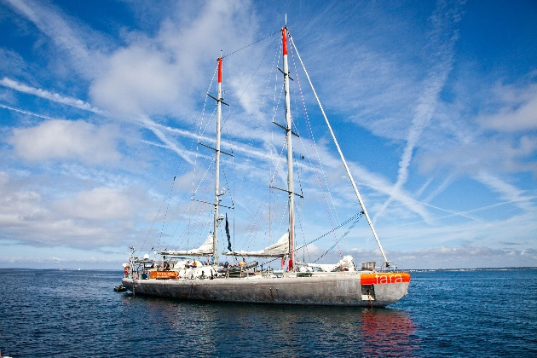
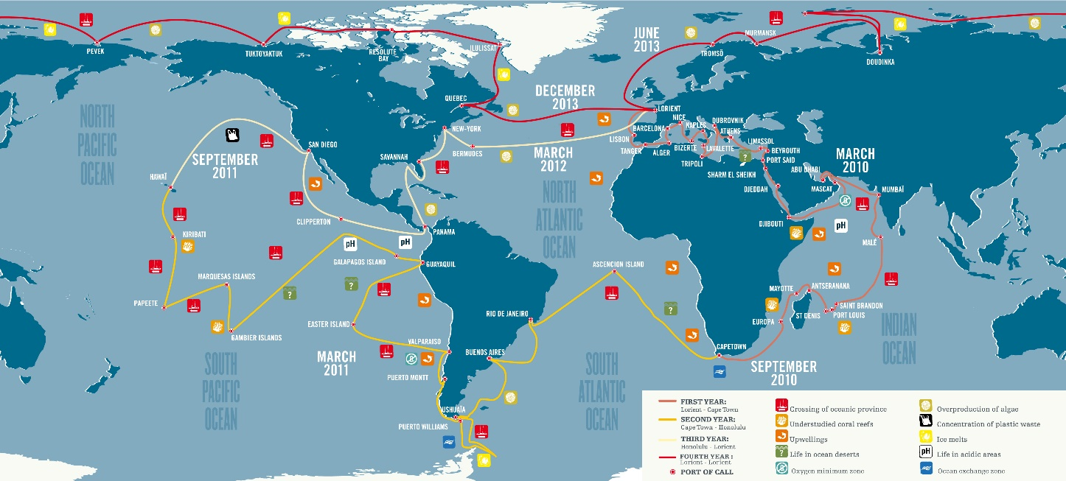
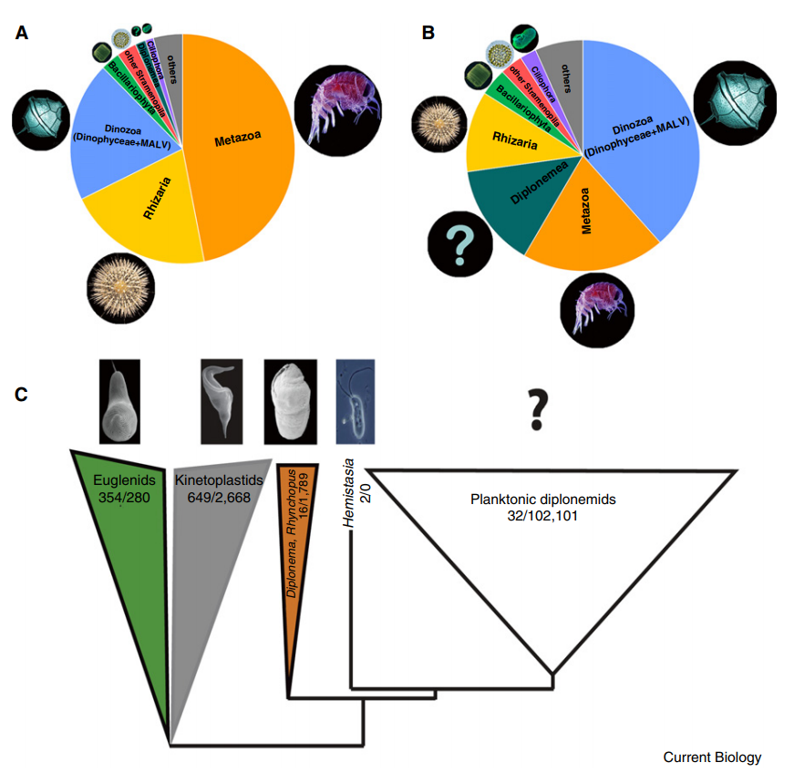
https://commons.wikimedia.org/
w/index.php?curid=7875429
Flectonema neradi
Tashyreva D et al. (2010) Protist 169: 158-179
Diplonemea
Lukeš J et al. (2015) Curr Biol 25: R702-R704

Slide 44
Edgcomb VP et al. (2002) PNAS 99: 7658

Slide 45
Simpson AGB et al. (2008) Mol Phylogenet Evol 47: 366

Slide 46
Pánek T et al. (2015) Front Microbiol 6: 1288

Slide 47
MArine Stramenopiles
Kolodziej K & Stoeck T (2007)
Appl Env Microbiol 73: 2718

Slide 48
Gómez F et al.

Slide 49
MAST-12
Kolodziej K & Stoeck T (2007)
Appl Env Microbiol 73: 2718

Slide 51
Groisillier A et al. (2006)
Aquat Microb Ecol 42: 277
Marine alveolates
(MALV I - V)

Slide 54
Nováková L (2011)

Slide 55
Science 332: 714
Picobiliphyta
(Picozoa)
Not F et al. (2007)
Science 315: 253

Slide 58
Stoeck T et al. (2010) Mol Ecol 19: S1 21

Slide 59
Stoeck T et al. (2009) BMC Biol 7: 72

Slide 61
Epstein S & López-García P (2008) Biodivers Conserv 17: 261

Slide 62
Stoeck T et al. (2010) Mol Ecol 19: S1 21
+ různá variabilita mezi liniemi
+ vnitrogenomová variabilita
+ různé počty kopií
+ různě konzervované u různých linií

Slide 63
Rappemonads
Kim E et al. (2011)
PNAS 108: 1496

Slide 67
Howe A et al. (2009) Protist 160: 159-189
Bass D et al. (2007) BMC Evol Biol 7: 162

Slide 68
Tetratrichomonas gallinarum
1
1
1
1
2
1
3
2
1
1
19

Slide 70
Species in protists
In sexual lineages, the biospecies concept should theoretically work, but it is difficult to apply it (proxy criteria are usually employed)
Asexuals do not have a satisfactory species concept, but “species cohesion” exists here as well

Slide 71
Paramecium aurelia
Originally considered a single species with many “mating types”
Split into 15 species (P. aurelia, biaurelia, triaurelia … quindecaurelia)
Hybrids – either conjugating cells die, or F1 generation is sterile
These species seem to be morphologically and ecologically identical (and they may be both sympatric and syntopic)
„The distinguishing characters of each of the species include its mating reactions, breeding relations, and mode of inheritance of mating type“ (Sonneborn 1975).
An excellent example of the biospecies
concept application.
But…

Slide 72
But…
Catania F et al. (2009) Mol Biol Evol 26: 421-431

Slide 73
Morphospecies
Should be considered a proxy for biospecies.
What is a morphologal feature?
Is a nucleotide sequence a morphological feature?
Intraspecies variability is often neglected…

Slide 74
How many nucleotides is enough?
De Jonckheere JF, Brown S (2006) Acta Protozool 41: 91-96

Slide 75
Strategy “new isolate – new species”
Harpagon schusteri
Harpagon descissus
Pánek T & Čepička I (2012)
De Jonckheere JF, Brown S (2005) Protist 156: 89-96

Slide 76
Secondary structure of RNA
Poulíčková A et al. (2010) Protist 161: 353-369

Slide 77
CBC – Compensatory Base Changes
Cao R et al. (2022) Plants 11: 929

