Slide 1
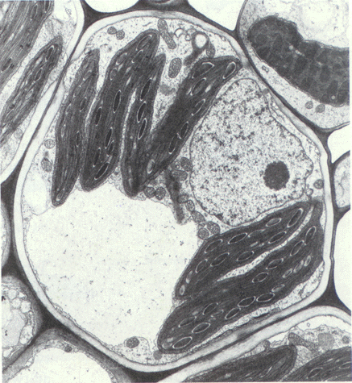
Semiautonomous organelles
Evolved from prokaryotic or (much more often) eukaryotic organisms (symbionts, prey…) by the process of symbiogenesis
Are surrounded by at least 2 membranes
Cannot be assembled de novo, arise only by division
Often (but not always) with a genome and proteosynthetic apparatus
Their genome is almost always highly reduced (but see, e.g., plastid genome of Paulinella)
Import proteins from the cytoplasm (result of past LGTs)
Textbook facts for kids

Slide 2
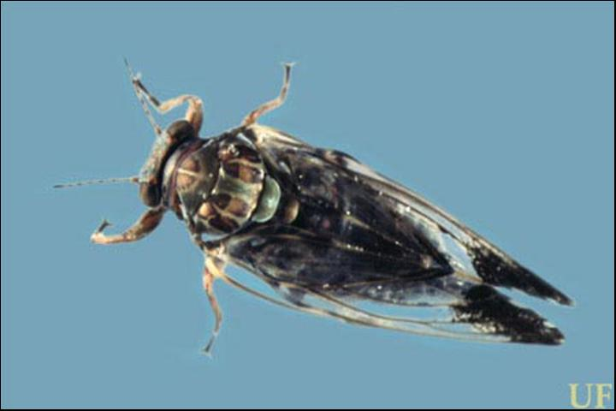
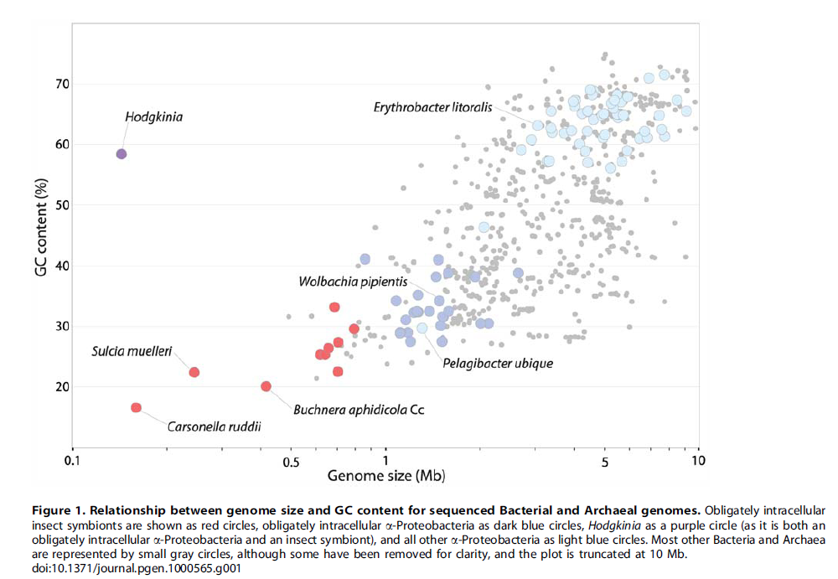
Symbiont or organelle?
“Genome reduction in obligately intracellular bacteria is one of the most well-established patterns in the field of molecular evolution”
Pachypsylla venusta
(jumping plant lice)
Nasuia 112 kb
Tremblaya 139 kb
Hodgkinia 144 kb
Carsonella 160 kb
Sulcia 245 kb
Nanoarchaeum 491 kb
McCutcheon JP et al. (2009) PLoS Genetics 5: e1000565

Slide 3
Symbiont or organelle?
Organelles import proteins from the cytoplasm to the organelle. Symbionts do not. The problem is that we usually have no idea what is going on…
Pachypsylla venusta
(jumping plant lice)
Nasuia 112 kb
Tremblaya 139 kb
Hodgkinia 144 kb
Carsonella 160 kb
Sulcia 245 kb
Nanoarchaeum 491 kb
McCutcheon JP et al. (2009) PLoS Genetics 5: e1000565

Slide 4
Symbiont or organelle?
The symbioses are often multipartite
Pachypsylla venusta
(jumping plant lice)
Nasuia 112 kb
Tremblaya 139 kb
Hodgkinia 144 kb
Carsonella 160 kb
Sulcia 245 kb
Nanoarchaeum 491 kb
McCutcheon JP et al. (2009) PLoS Genetics 5: e1000565

Slide 5
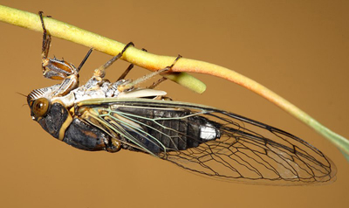
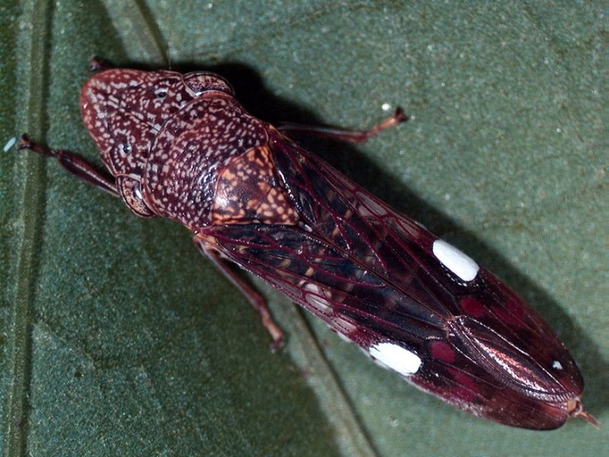
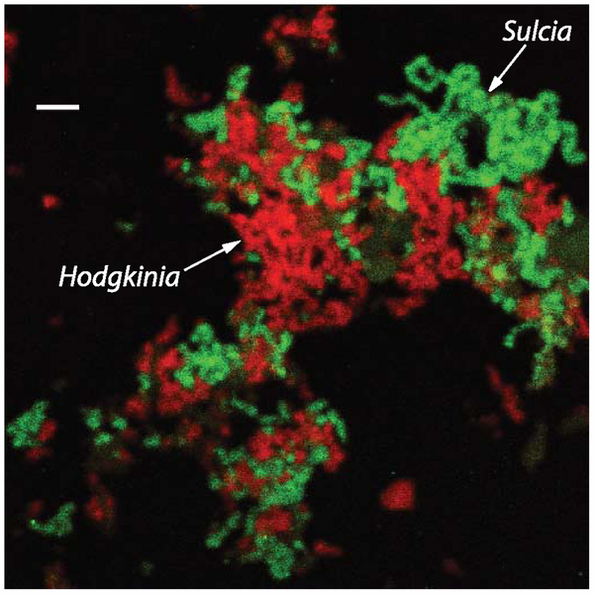
Auchenorrhyncha (cicadas, leafhoppers…)
Diceroprocta semicincta
Sulcia muelleri (Bacteroidetes)
Hodgkinia cicadicola (α-proteo)
Homalodisca vitripennis
Sulcia muelleri (Bacteroidetes)
Baumannia cicadellinicola (γ-proteo)
McCutcheon JP et al. (2009) PLoS Genetics 5: e1000565

Slide 6

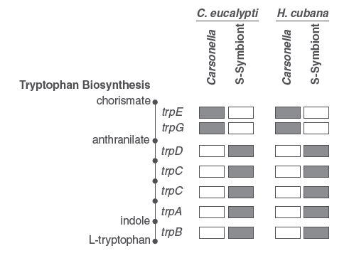
(jumping plant lice, „mery“ in Czech)
Sloan DB & Moran DA (2012) Mol Biol Evol 29: 3781

Slide 7
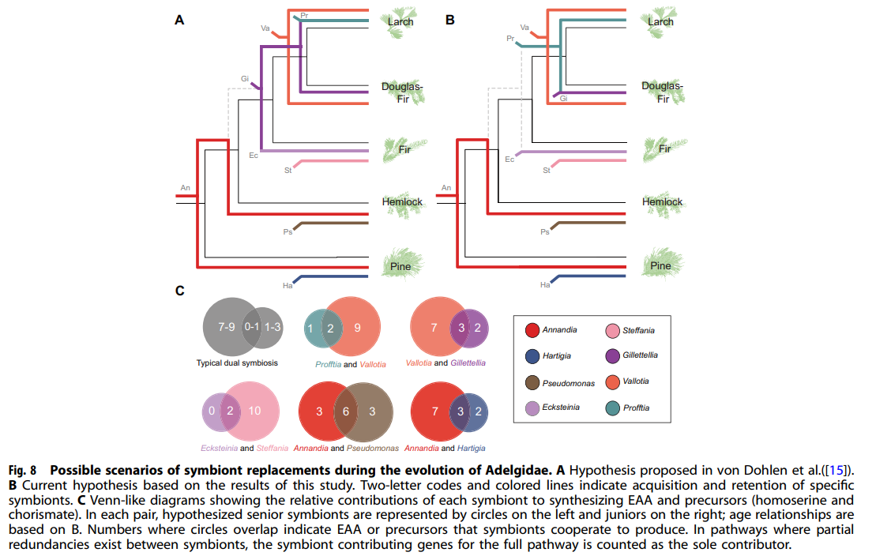
EAA = essential amino acids
Dial DT et al. (2022) ISME J 16: 642

Slide 8
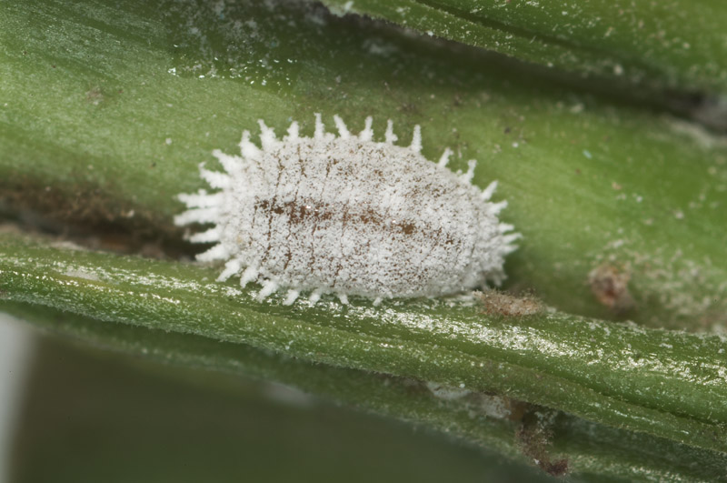
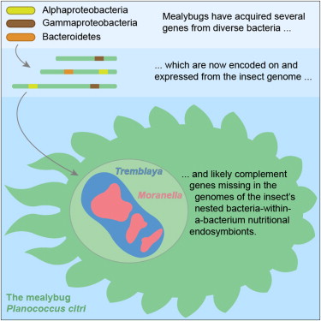
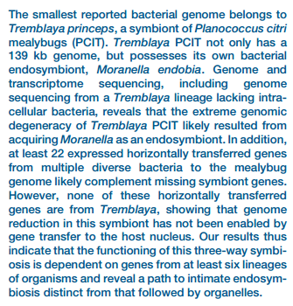
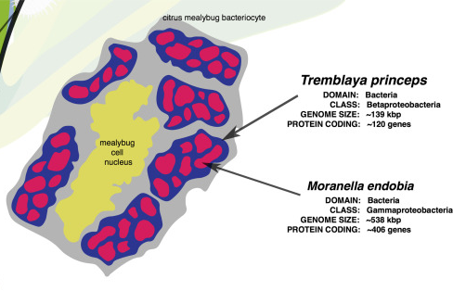
http://www.bnhs.co.uk/focuson/scales/images/Planococcus%20citri%201.jpg
Planococcus citri (scale insect, „červec“)
Husnik F et al. (2013) Cell 7: 1567
Hoaglandella=
Sieber KB et al. (2017) Exp Cell Res 358: 421

Slide 9
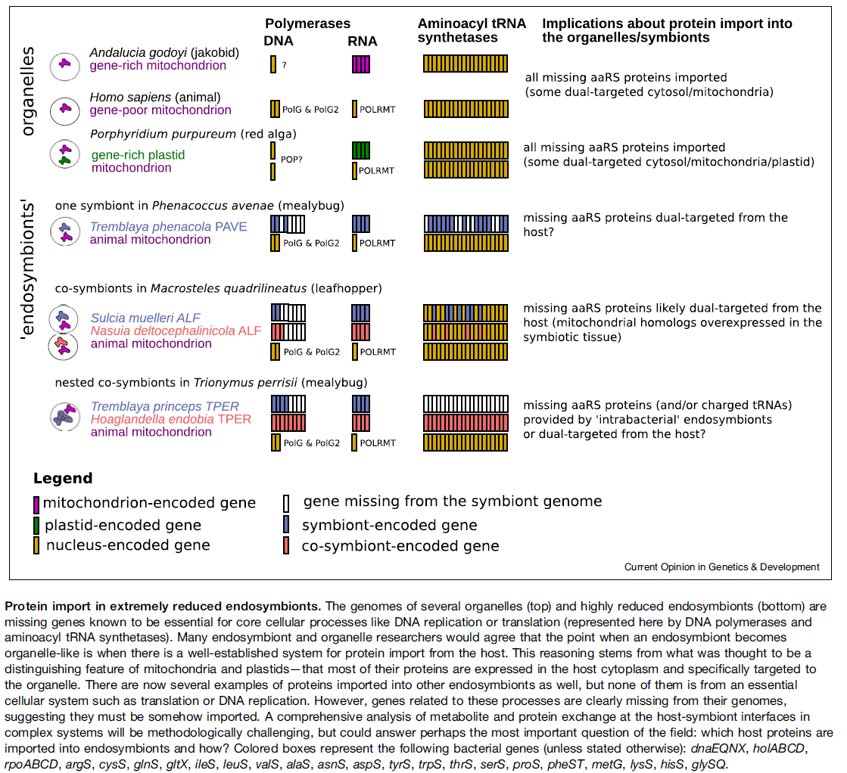
Husnik F & Keeling JP (2019)
Curr Opin Genet Develop 58: 1

Slide 10
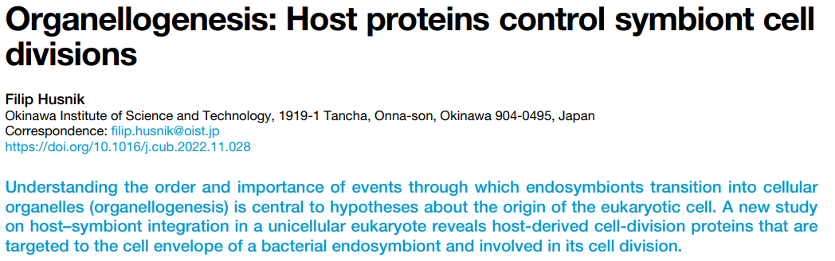
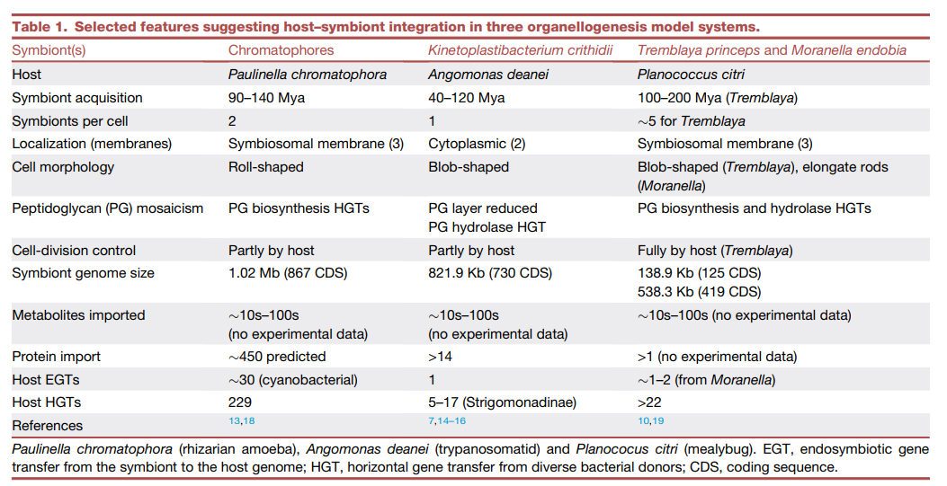
Homework!

Slide 11
Symbiont vs. organelle
The arbitrary line does not work for all cases.
Is the origin of mitochondria and (primary) plastids as straightforward as usually assumed?
Pachypsylla venusta
Hodgkinia 144 kb
Carsonella 160 kb
Sulcia 245 kb
Buchnera 450 kb
Nanoarchaeum 491 kb
McCutcheon JP et al. (2009) PLoS Genetics 5: e1000565

Slide 12
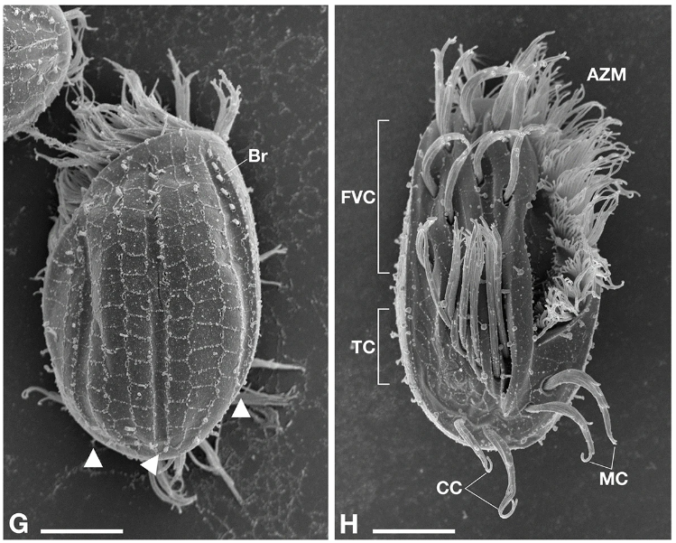
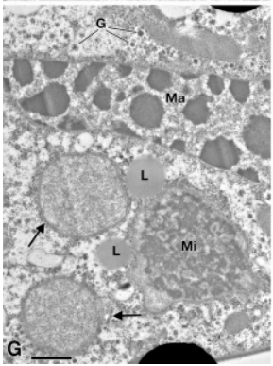
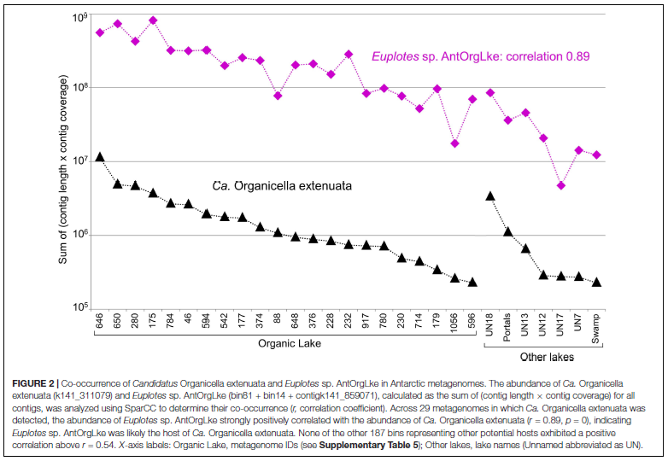
Ciliates Euplotes spp. And their reduced bacterial symbionts
Ca. Pinguicoccus supinus (Verrucomicrobia)
genome size ~ 163 kbp)
Serra V et al. (2020) Sci Rep 10:20311
Ca. Organicella extenuata (Verrucomicrobia)
genome size ~ 158 kbp)
Williams TJ et al. (2021) Front Microbiol 12:674758

Slide 13
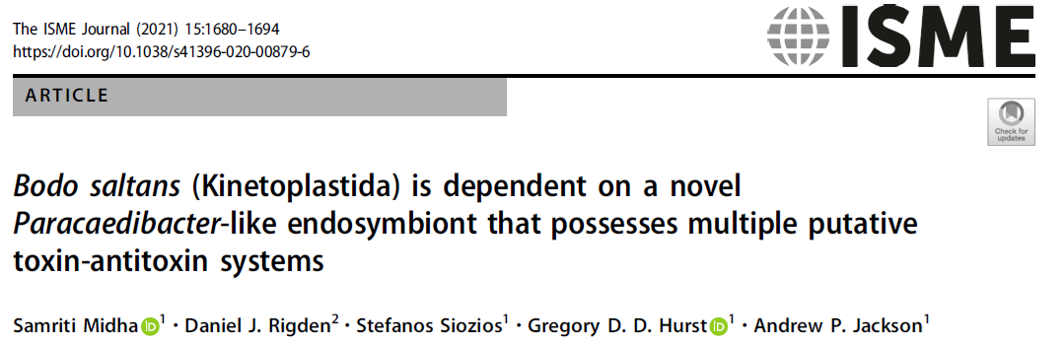
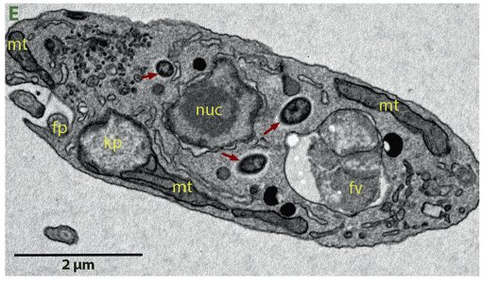
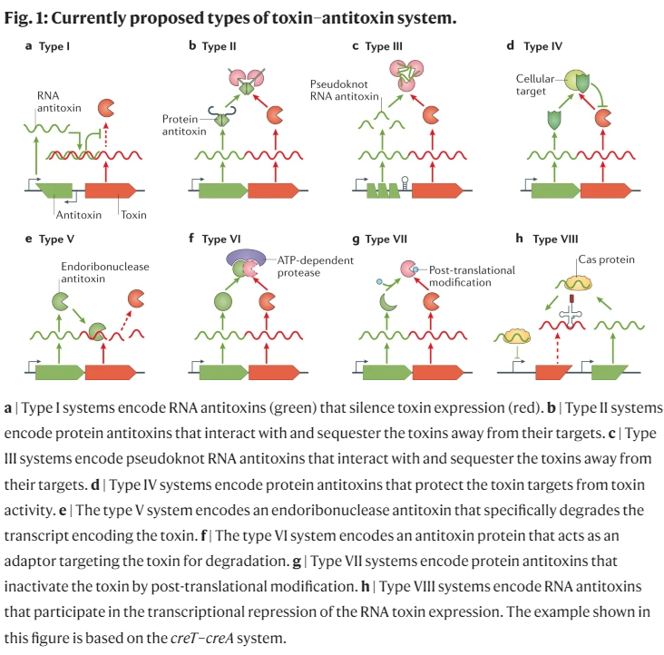
Bodo is addicted to its α-proteobacterial symbiont (three separate TA systems)
Jurėnas D (2022) Nat Rev Microbiol 20: 335

Slide 14
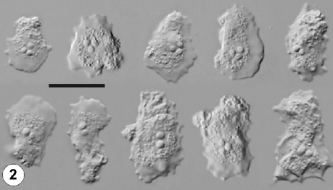
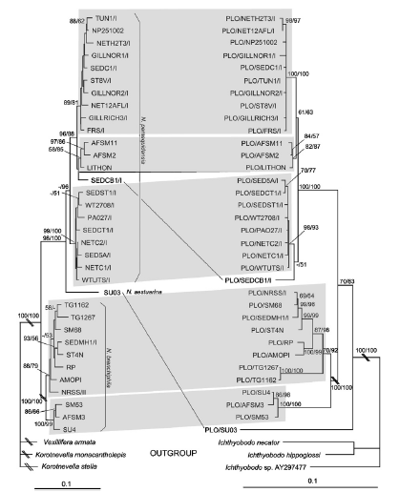
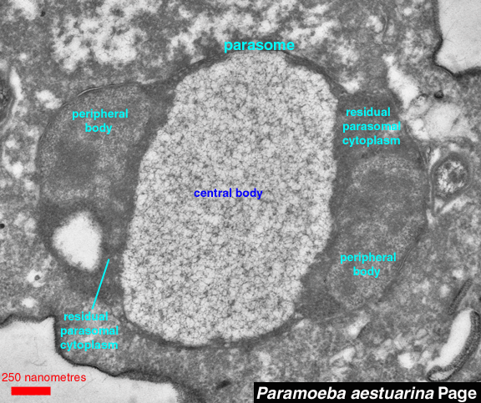
Reduction happens to the eukaryotic endosymbionts as well
Dyková I et al. (2008) Eur J Protistol 44: 269-277

Slide 15
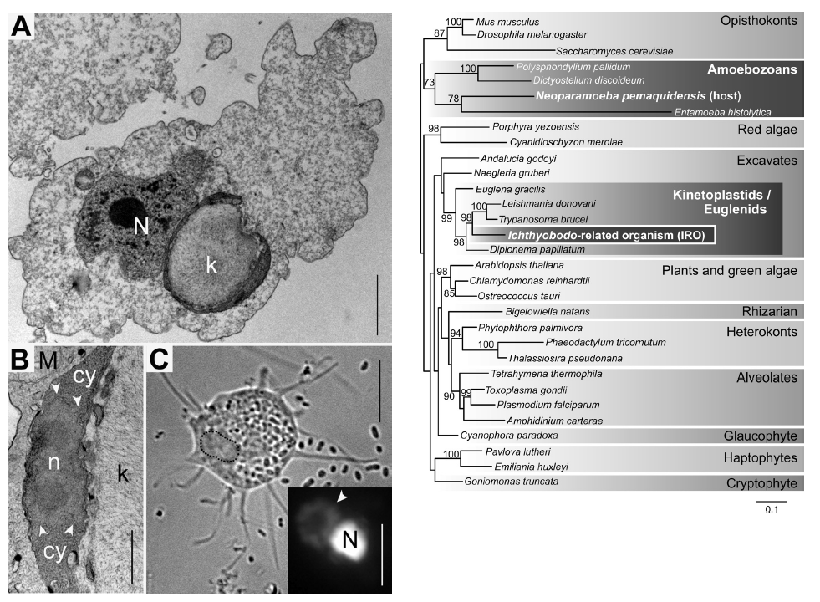
Tanifuji G et al. (2011) Eukaryot Cell 10: 1143-1146

Slide 16
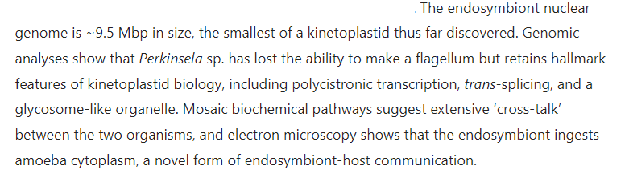
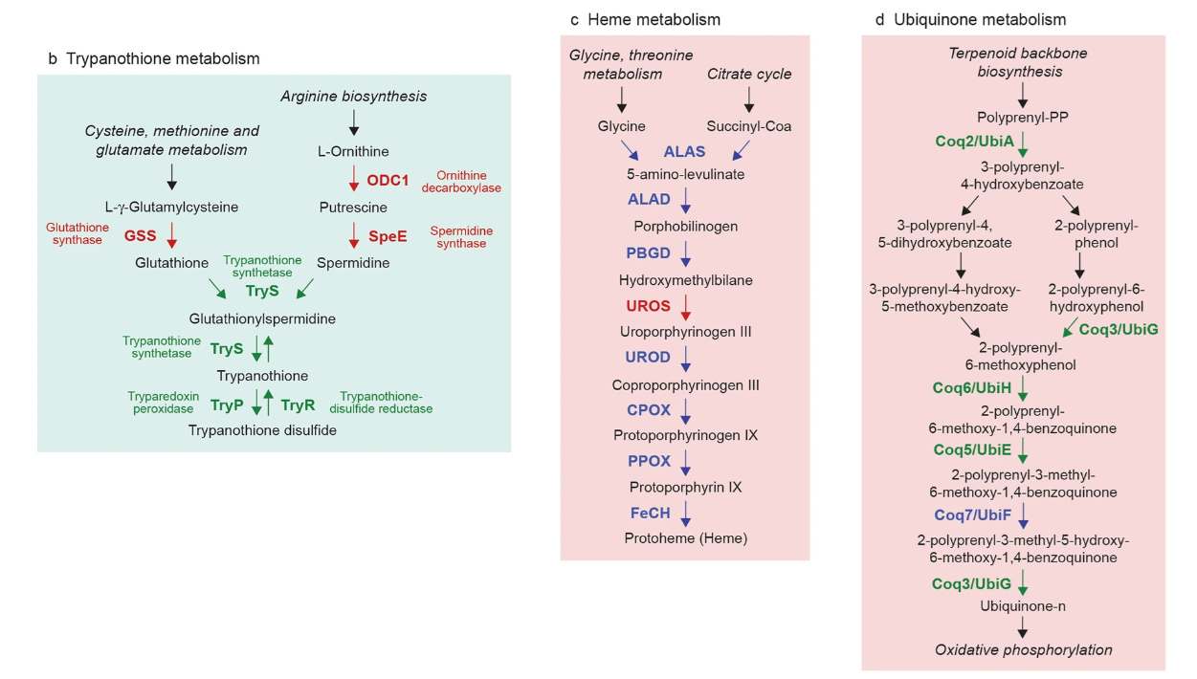
Tanifuji G et al. (2017) Sci Rep 7: 11688

Slide 17
How many different s.o.?
(those of prokaryotic origin underlined)
mitochondrion
primary plastid of Archaeplastida
primary plastid of Paulinella spp.
secondary plastid of Chlorarachniophyta
secondary eulenid plastid(s?)
“secondary” plastids of “chromalveolates” (likely of several separate origins)
secondary green plastid of dinoflagellates I
secondary green plastid of dinoflagellates II (2020)
secondary green plastid of dinoflagellates III (2020)
“tertiary” plastid of dinoflagellates I
“tertiary” plastid of dinoflagellates II
“plastids” of dinotoms (organelles? symbionts?)
(not sure whether symbionts, „true“ plastids, or kleptoplastids in some cases)

Slide 18
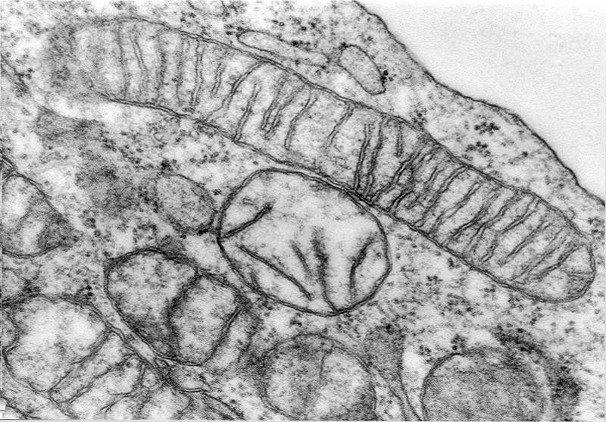
Mitochondrion

Slide 19
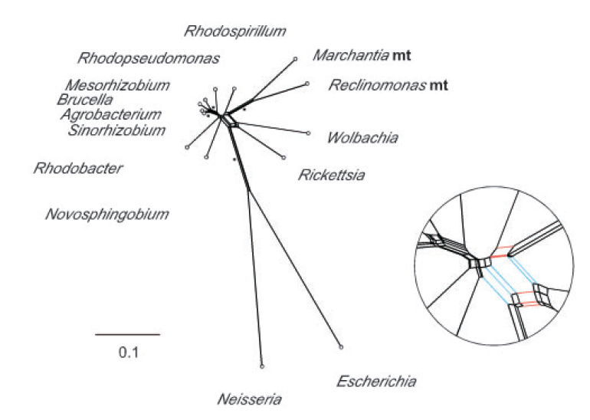
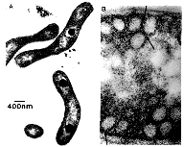
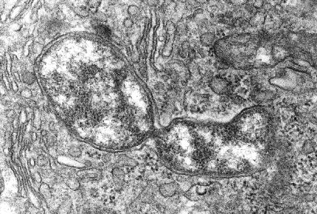
Enigmatic origin of mitochondria
Rhodospirillum
Rickettsia
Esser C et al.(2004) Mol Biol Evol 21: 1643

Slide 20
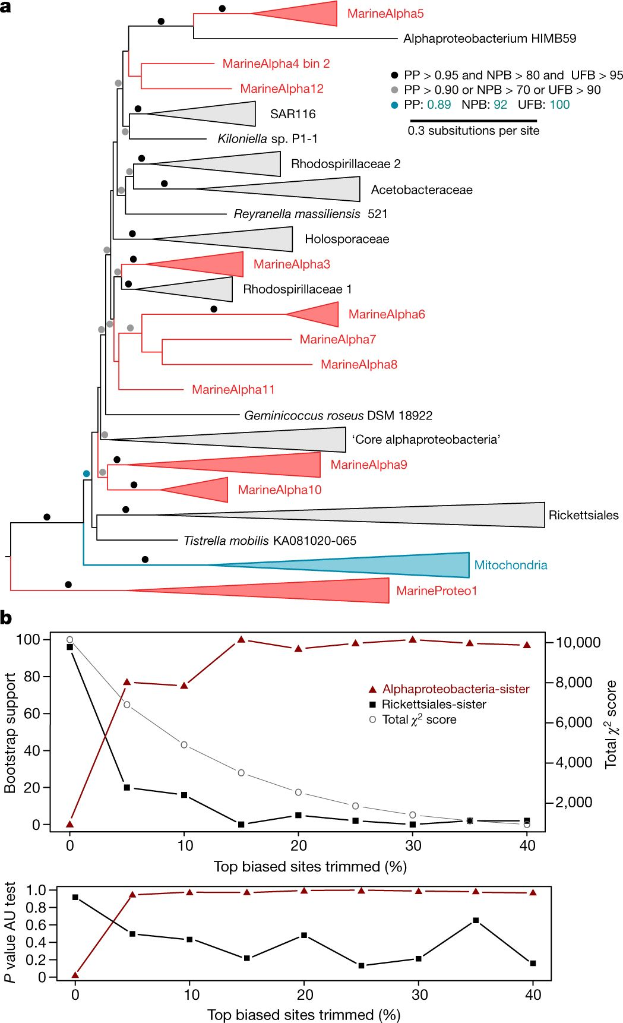
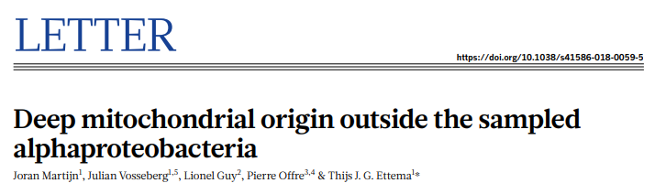
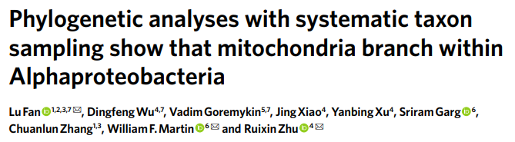
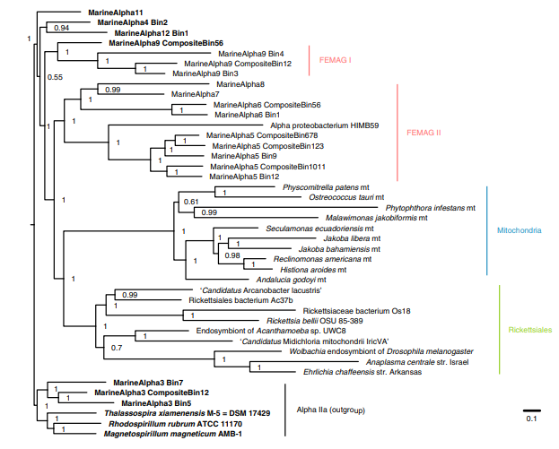
2018
2020

Slide 21
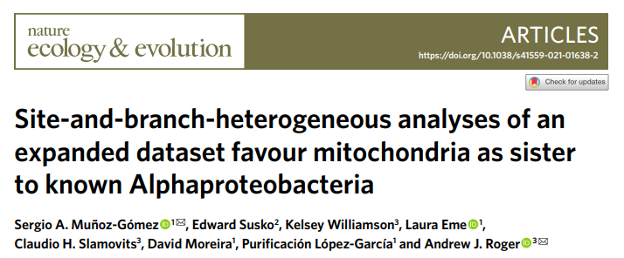
2018
2020
2022

Slide 22
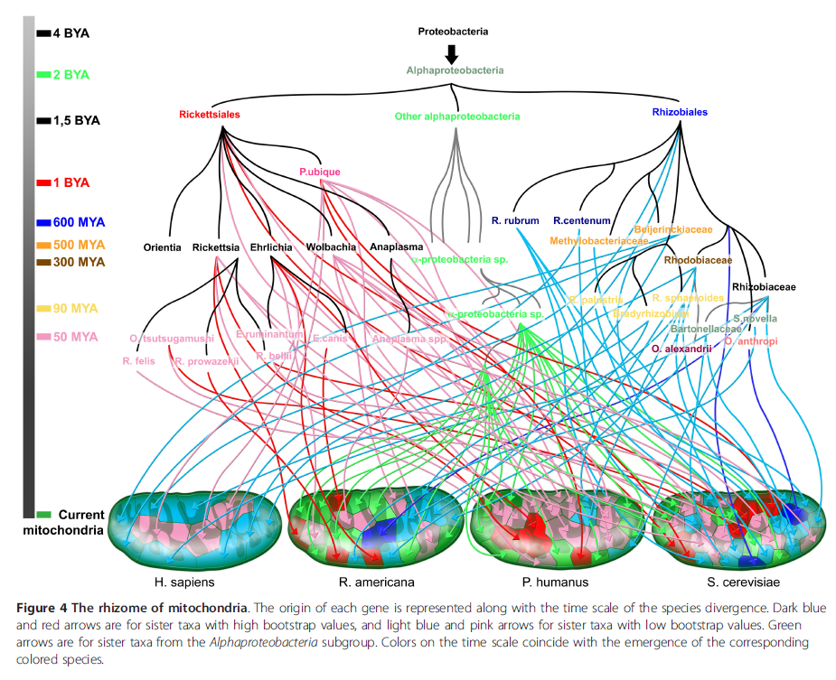
Georgiades K & Raoult D (2011) Biol Direct 6: 55

Slide 23
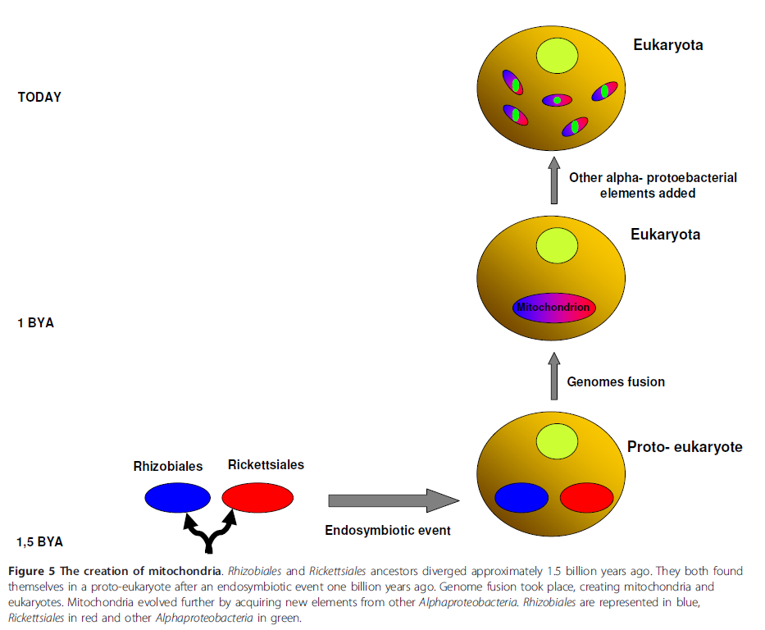
Georgiades K & Raoult D (2011) Biol Direct 6: 55
not widely accepted

Slide 24
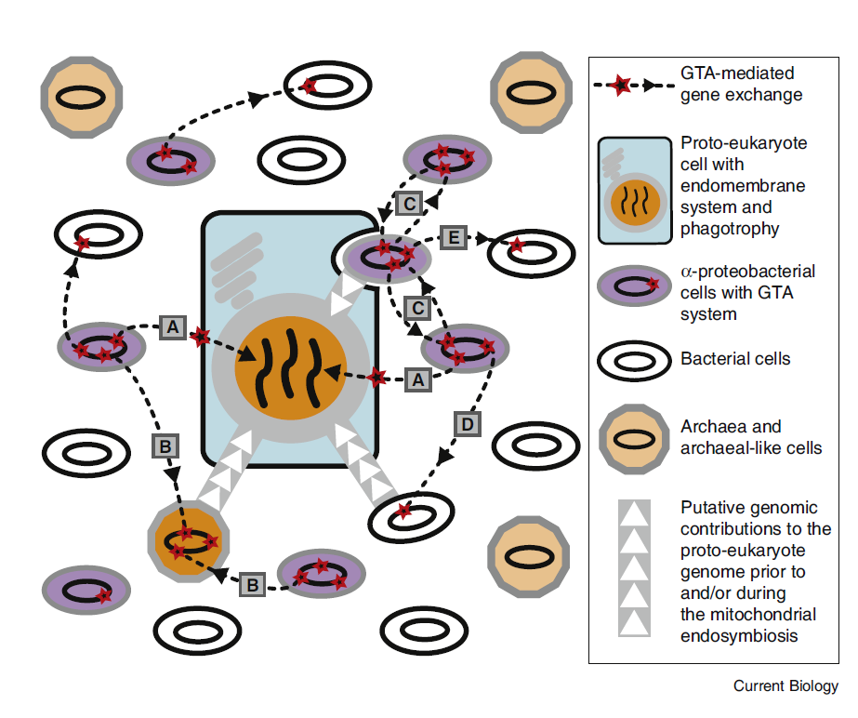
GTA – gene transfer agents
Richards TA & Archibald JM (2010) Curr Biol 21: R113

Slide 25
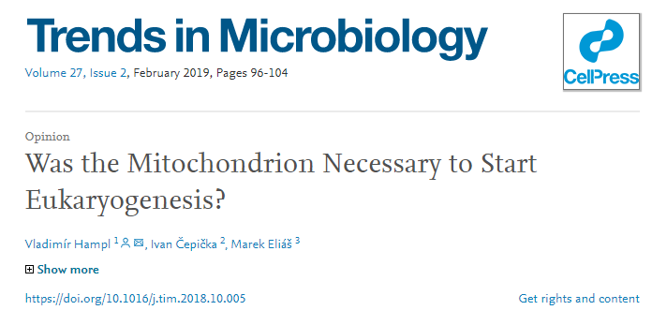
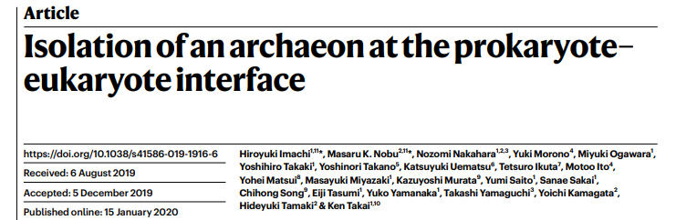
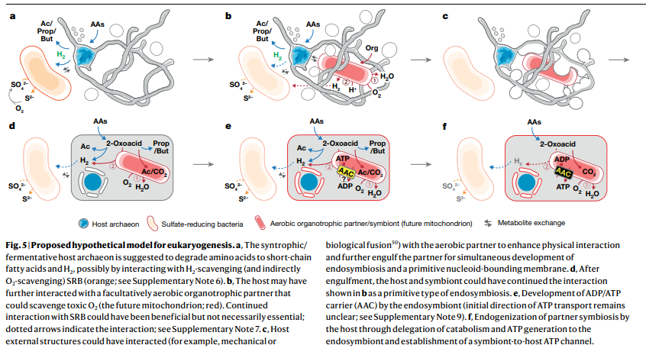
Early vs. late mitochondrion hypotheses
(e.g., hydrogen vs. Archezoa hypothesis)
entangle–engulf–endogenize (E³) model

Slide 26
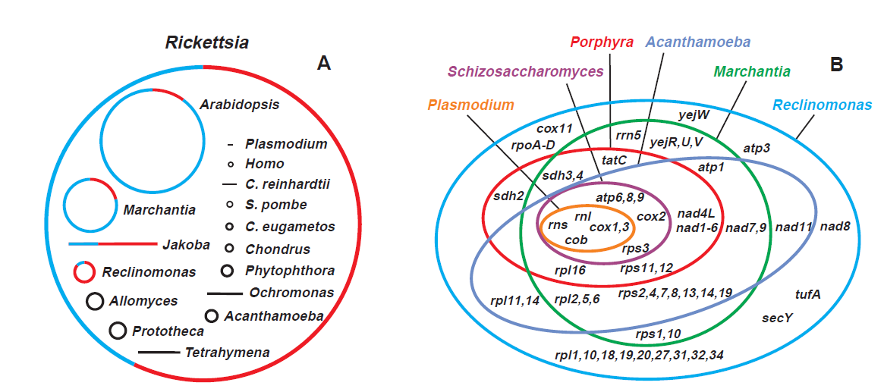
Mitochondrial genomes
0 (e.g., Trichomonas) – 6 kb (Plasmodium) – 360 kb (Arabidopsis) – 4 Mb (Trypanosoma)
0 (e.g.,. Trichomonas) – 5 (Plasmodium) – 94 (Reclinomonas) genes
Gray MW et al.(1999) Science 283: 1476-1481

Slide 27
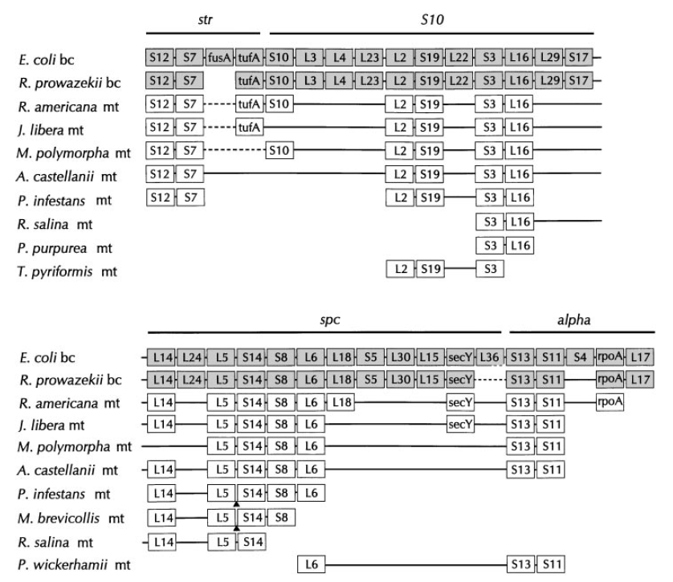
Jakobida
Lang BF et al.(1999) Annu Rev Genet 33: 351-397

Slide 28
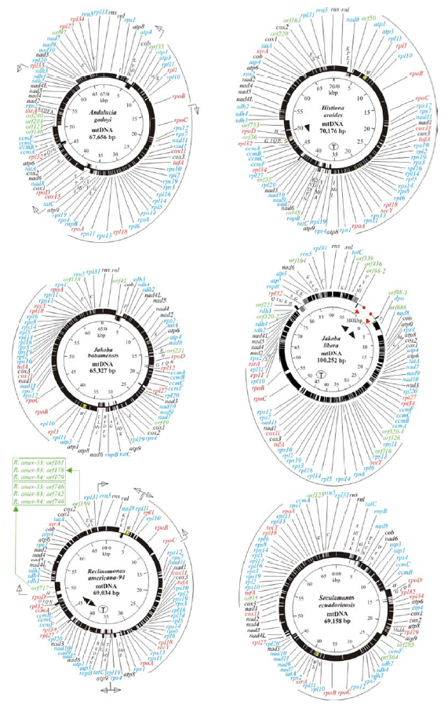
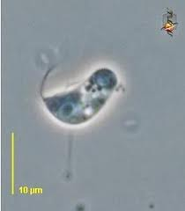
Jakobida (Excavata: Discoba)
What about the root of the euakryotic tree?
Burger G et al. (2013) Genome Biol Evol 5: 418

Slide 29
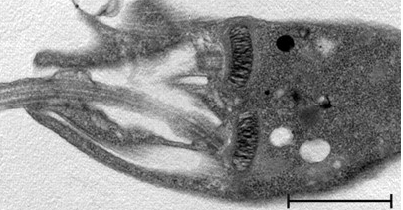
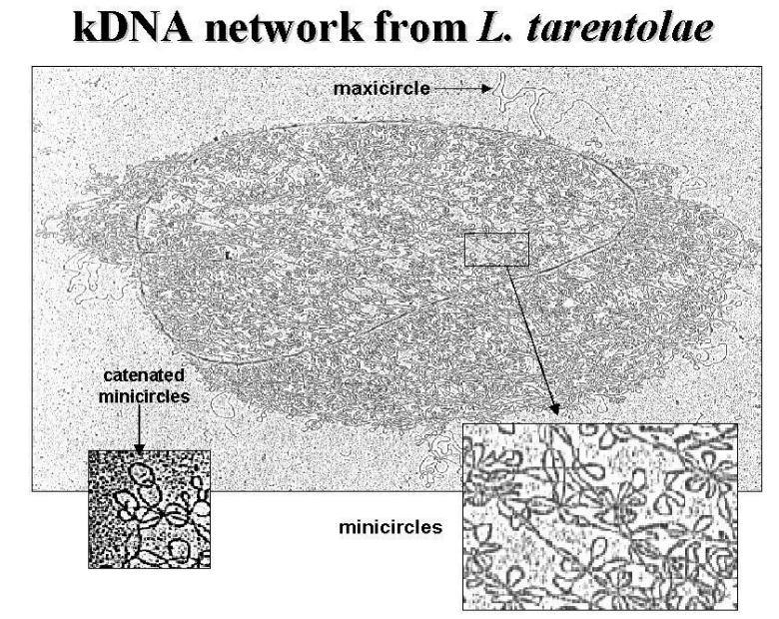
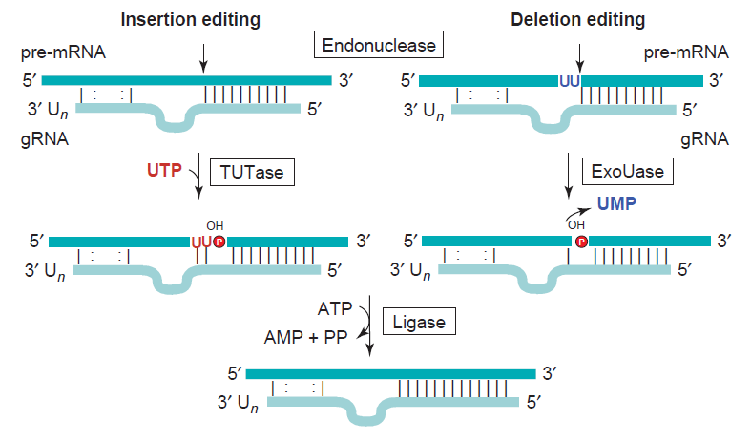
Kinetoplast
Svobodová M et al. (2007) IJSEM 57: 423
Stuart KD et al. (2005) Trends Biochem Sci 30: 97

Slide 30
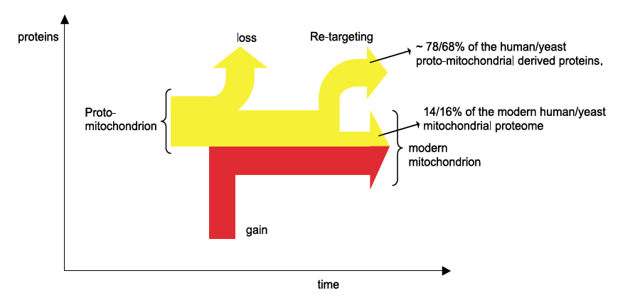
Mitochondrial proteome
650 proteins
50 proteins
(15 proteins)
200 proteins of eukaryotic origin
150 proteins of unknown origin
Gabaldón T & Huynen MA (2004) BBA-Bioenergetics 1659: 212-220

Slide 31


Gabaldón T a Huynen MA (2007) PLOS Comp Biol 3: e219
Gray MW (2015) PNAS 112: 10133

Slide 32


Protein import into the mitochondrion

Slide 33

Cavalier-Smith T(2013) Eur J Protistol, in press.

Slide 34



Slide 35


Slide 36

Functions of the mitochondrion
energetic metabolism (TCA cycle, oxidative phosphorylation, β-oxidation…)
biosynthetic pathwys (Fe-S clusters, haem, steroids)
oxygen detoxification
heat production (brown fat)
signalization (induction of apoptosis…)
regulation of metabolism, cell cycle, membrane potential…
…

Slide 37



Slide 38


Slide 39

Mitochondrial genome of Homo sapiens
Amorim A (2019) PeerJ 31428537

Slide 40

Mitochondrion-related organelles
Anaerobic mitochondrion
Hydrogen-producing mitochondrion
Hydrogenosome
Mitosome
oxymonads
Howe CJ (2008) Curr Biol 18: R429-R431

Slide 41



MROs (mitochondrion-related organelles)
(hydrogenosome of Trichomonas)

Slide 42




HOMEWORK
(several MROs were shown to produce H2 but not ATP)

Slide 43




K čemu jsou mitochondrie, které neumí syntetizovat ATP
metabolismus jednouhlíkatých sloučenin
Syntéza Fe-S center
aktivace síranů

Slide 44




Genome Evol Biol, accepted
Hartikainen H et al. 2014 Curr Biol 24:807

Slide 45



Curr Biol (2018) 28: 2536

Slide 46


Respiratory complexes are important for the biogenesis of mitochondrial cristae

Slide 47



Mitochodnrial genome has been lost also in a parasitic, aerobic dinoflagellate

Slide 48


Curr Biol 26:1274 (2016)
Monocercomonoides exilis
(Preaxostyla: Oxymonadida)

Slide 49

Plastids

Slide 50


Primary, secondary, tertiary,
quaternary … plastids

Slide 51
Archaeplastida
(Plantae)
almost universaly accepted
“Chromalveolata”
(“Chromista”)
not widely accepted today

Slide 52

Primary plastids
Two independent origins – Archaeplastida and Paulinella spp. (Rhizaria)

Slide 53

Origin of primary plastids?

Slide 54


Mol Biol Evol (2011) 28: 3019

Slide 55



Slide 56


Slide 57

Genomes of primary plastids
A few non-photosynthetic,
plastidic lineages without
a plastid genome…
(in contrast to mitochondria)
Rogers MB et al. (2007) MBE 24: 54-62

Slide 58

Proteome of a primary plastid
Jarvis P (2004) Curr Biol 14: R317-R319

Slide 59

Dyall SD et al.(2004) Science 304: 253

Slide 60


Slide 61


Trends Plant Sci (2013) 18: 680

Slide 62


Paulinella chromatophora
Lara E et al. (2007) Protist 158: 229-237

Slide 64




Slide 65

Nowack EMC et al. (2007) Curr Biol 18: 410-418

Slide 66

Nowack ECM et al. (2012) PNAS 109: 5340
120 Mya
450 genes

Slide 67

Nowack ECM et al. (2012) PNAS 109: 5340

Slide 68


Rhopalodia gibba
Spheroid body

Slide 69

PNAS (2014) 111: 11407

Slide 70

“Secondary” plastids (complex plastids)

Slide 71
Plastid genomes (except for dinoflagellates)
Rogers MB et al. (2007) MBE 24: 54-62

Slide 72

Janouškovec J et al. (2010)
PNAS 107: 24

Slide 73

Protein import into complex plastids

Slide 74

Nucleomorphs
Cryptophyta (red)
Chlorarachiophyta (green)
dinoflagellate TGD (green)
dinoflgellate MGD (green)
(dinotoms) (ochrophyte-derived)

Slide 75

Nucleomorphs

Slide 76



Slide 77

Nature (2012) 492: 59

Slide 78


Slide 79
Chromalveolate hypothesis

Slide 80
Chromalveolate hypothesis

Slide 81


Slide 82



Slide 83


Nat Comm 12: 1879 (2021)
Homework!

Slide 84

Genome Biol Evol (2012) 3: 1220

Slide 85


Venn diagram showing the number of overlapping genes between this study and Woehle et al.
Burki F et al. Genome Biol Evol 2012;4:evs049
© The Author(s) 2012. Published by Oxford University Press on behalf of the Society for Molecular Biology and Evolution.
Notes:
Venn diagram showing the number of overlapping genes between this study and Woehle et al. (2011). The filled circles correspond to the genes recovered in this study.

Slide 86



Ochrophyta, Haptophyta
(Dorrell RG et al. (2017) eLife 6: e23717)
Euglenids (Novák Vanclová AMG et al. (2020) New Phytologist 225: 1578)
Chlorarachiophyta, euglenids
(Ponce-Toledo RA et al. (2018) Mol Biol Evol 35: 2198)

Slide 87

Morozov AA & Galachyants YP (2019) Marine Genom 45: 72

Slide 88
„Tertiary“ (quaternary?) plastids

Slide 89



Dinotoms
Imanian B a Keeling PJ (2007) BMC Evol Biol 7: 172

Slide 90


Slide 91


Eukaryot Cell (2014) 13: 246

Slide 92


Slide 93
Plastid functions
Photosynthesis
Biosynthetic pathways (aromatic compounds, haem, Fe-S clusters, aminoacids, terpenoids…)
Gravireception
Energy storage
Signalization (chromoplasts…)
Regulation of various processes
Oxygen detoxification (carotenoids)
…

Slide 94


Slide 95


Slide 96


Leontynka pallida (Chlorophyta: Chlamydomonadales)
Pánek T et al. (2022) BMC Biol 20:66
(only several known complete losses of the plastide genome)

Slide 97



Non-photosynthetic plastids
Euglena
Orobanche
Toxoplasma

Slide 98



Apicoplast

Slide 99

Perkinsus atlanticus
Teles-Grilo ML et al. (2007) Eur J Protistol 43: 163-167

Slide 100


Perkinsus atlanticus
Teles-Grilo ML et al. (2007) Eur J Protistol 43: 163-167

Slide 101



Helicosporidium

Slide 102



Nature Communications (2021) 12:6651
Seenivasan R et al. (2013)
PLoS One 8:e59565

Slide 103


