Slide 1
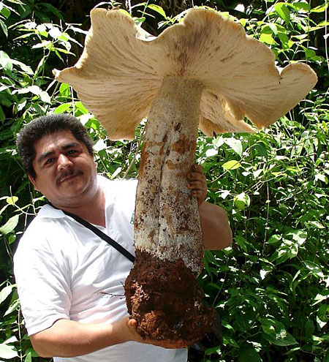
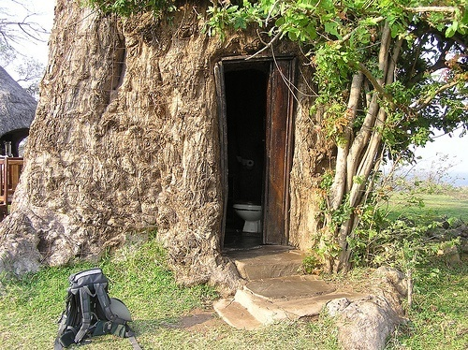
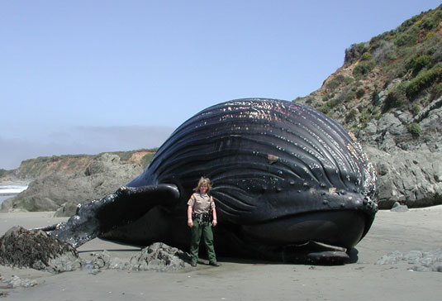
Multicellularity

Slide 2
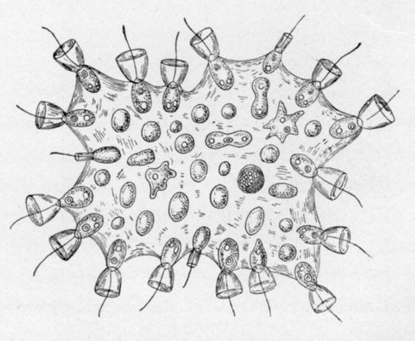
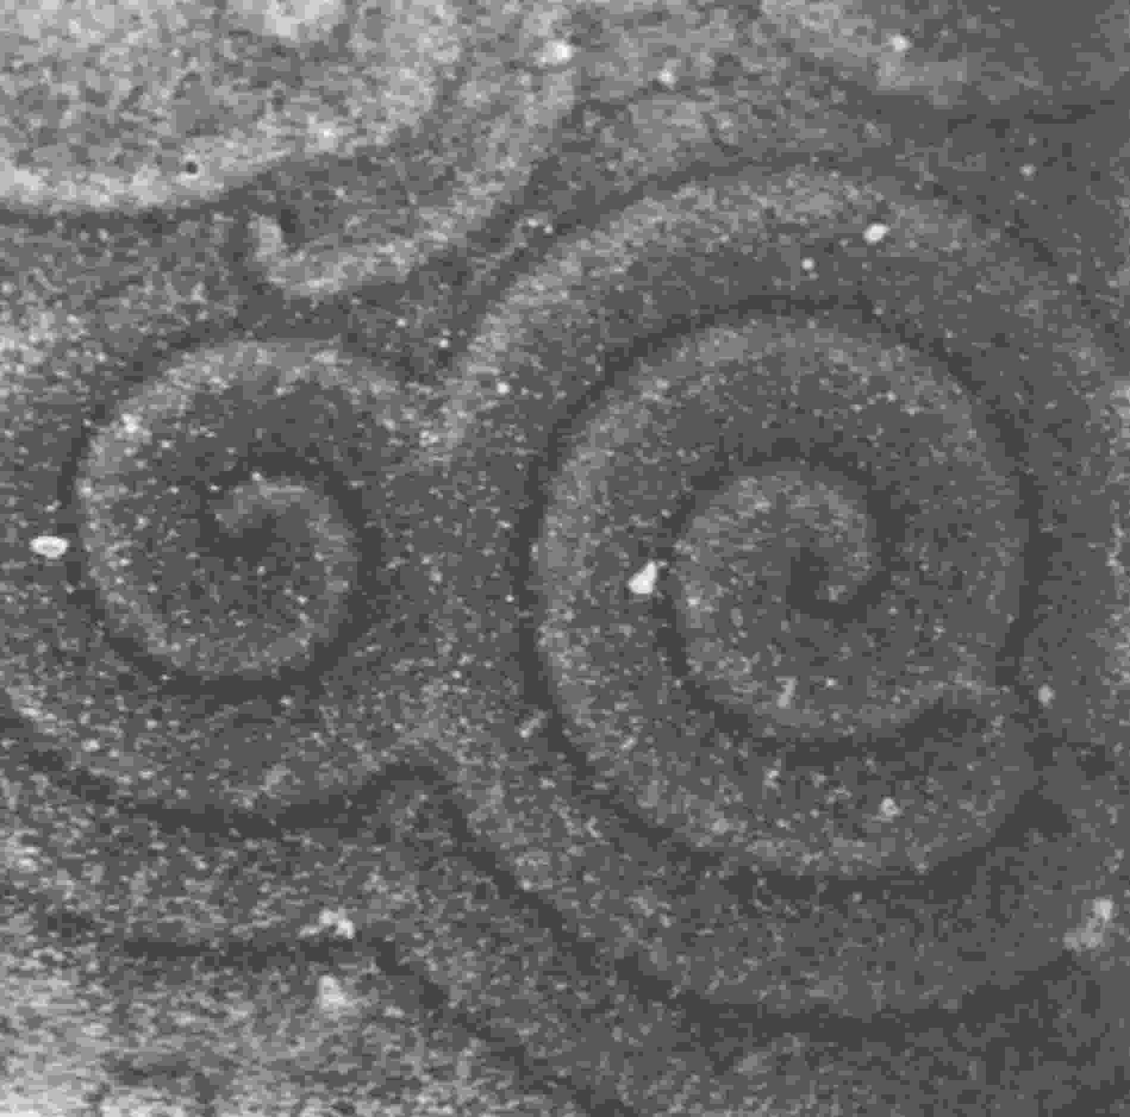
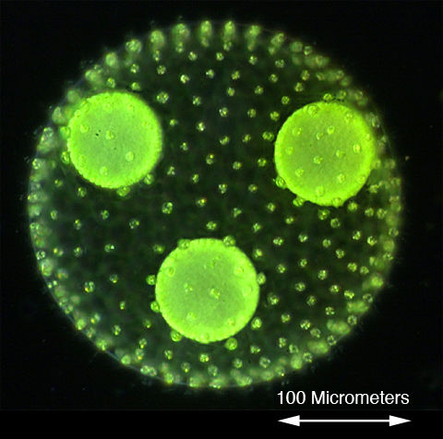
Which organisms are multicellular?

Slide 3
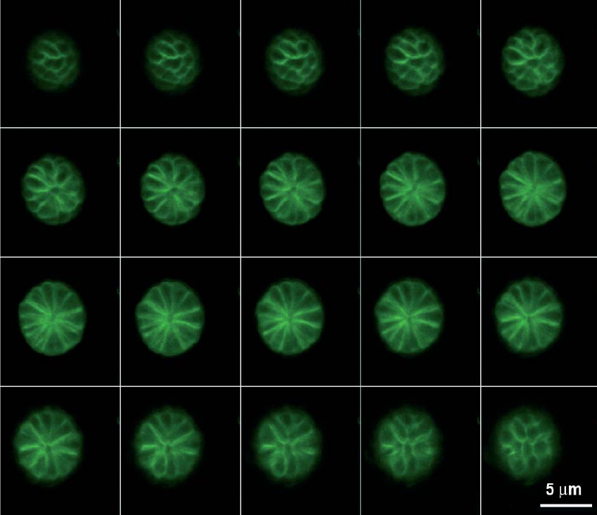
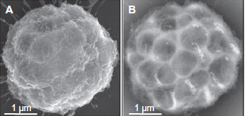
Do multicellular prokaryotes exist?
Wenter R et al. (2009)
Env Microbiol 11: 1493-1505
MMPs
nMMPs
Abreu F et al. (2006) Int Microbiol 9: 267-272

Slide 4
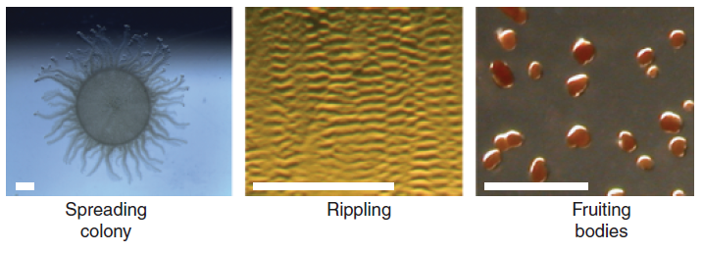
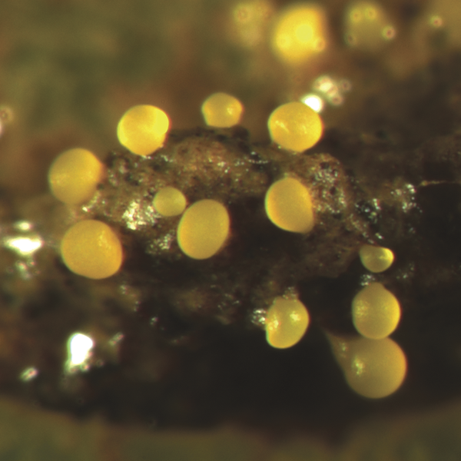
Myxococcus xanthus
Konovalova A et al. (2010) FEMS Microbiol Rev 34: 89-106
Huge genomes are not absolutely necessary for multicellularity…
(many consider biofilms multicellular)

Slide 5
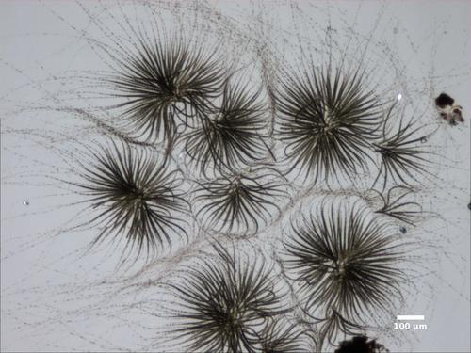
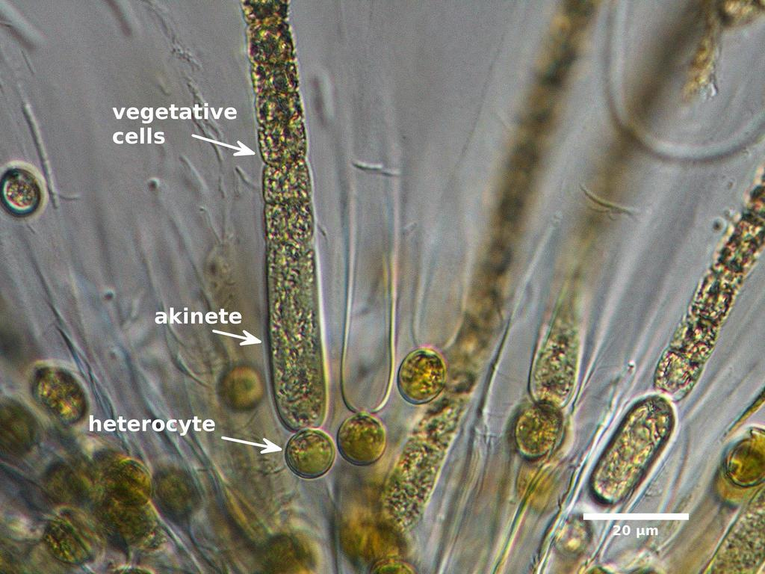
Gloeotrichia
a cyanobacterium with cell differentiation

Slide 6
Multicellularity
Evolutionary forces work at the whole multicellular body level (and there is heritability of multicellular traits)
Further possibility of body compartmentalization (labor division, more efficient utilization of resources)
higher spreading ability (in some cases)
Antipredatory strategy (Chlamydomonas…)
Cell adhesion, communication, (differentiation)
The important though underestimated role of ECM
How to reproduce a multicellular body?
How to form a multicellular body during ontogenesis?
How to cope with cheater cells?

Slide 7
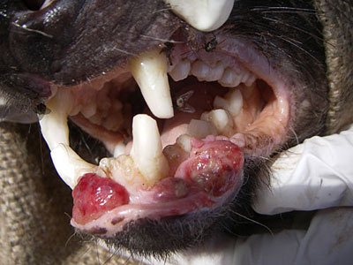
De-evolution of multicellularity; and cheaters
DFTD
(devil facial tumor disease)
CTVS
(canine transmissable venereal tumor)

Slide 8
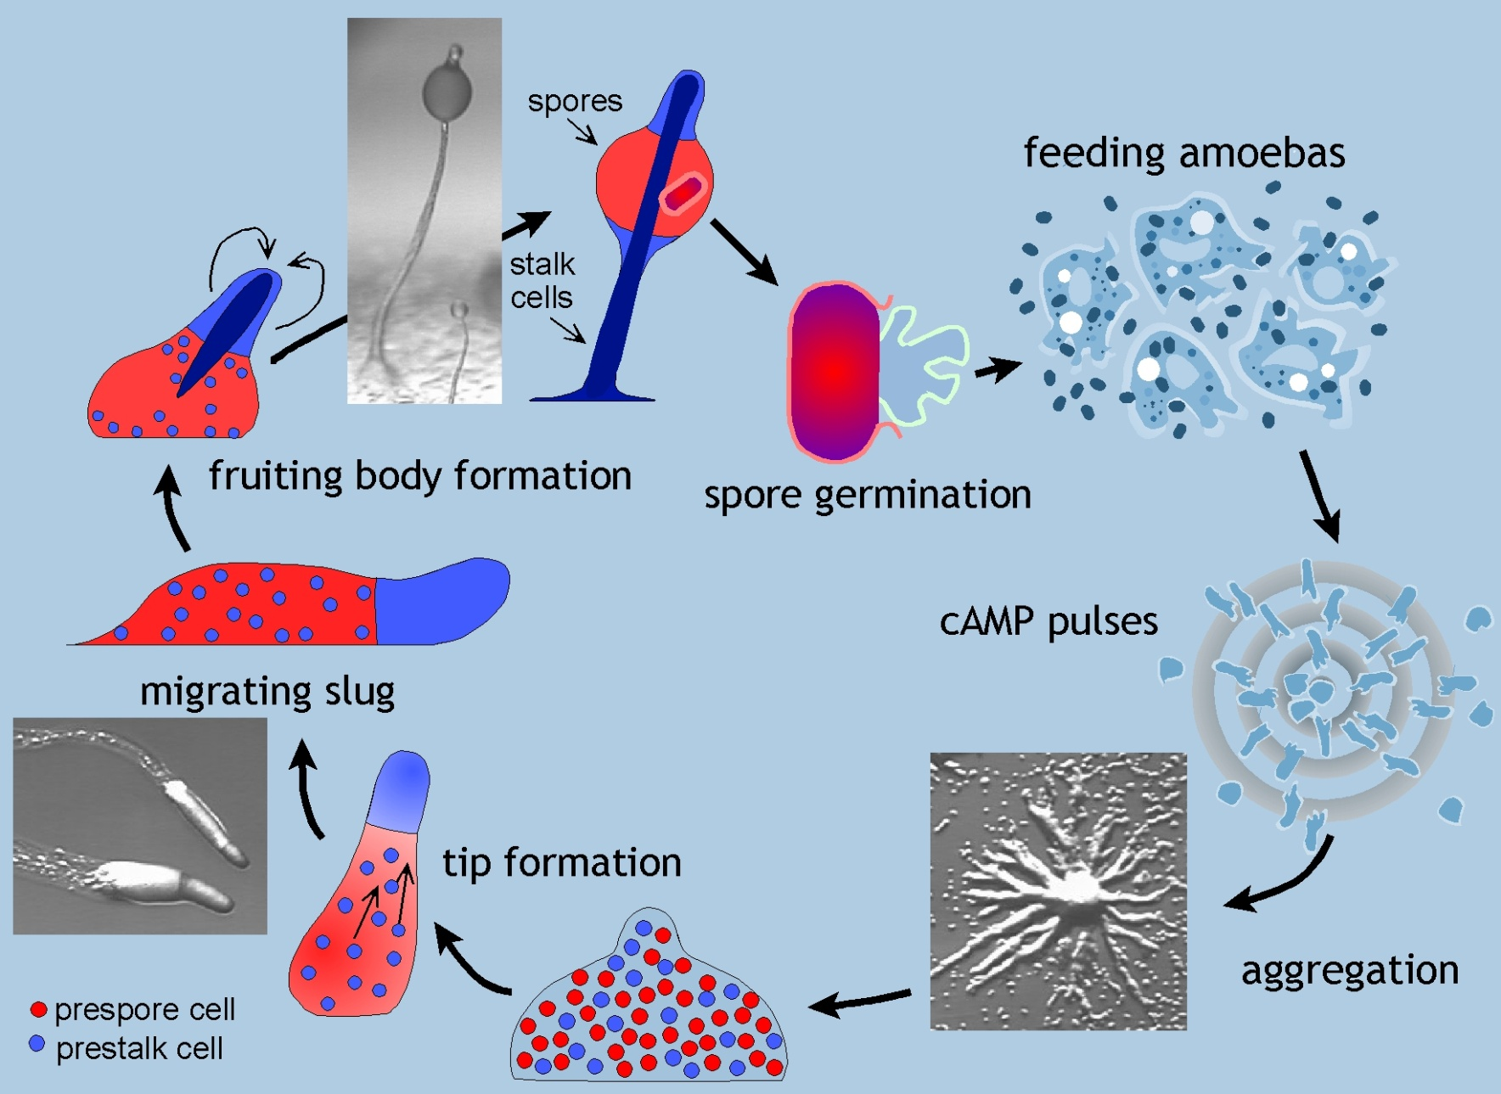
Dictyostelium discoideum (Amoebozoa: Eumycetozoa)

Slide 9
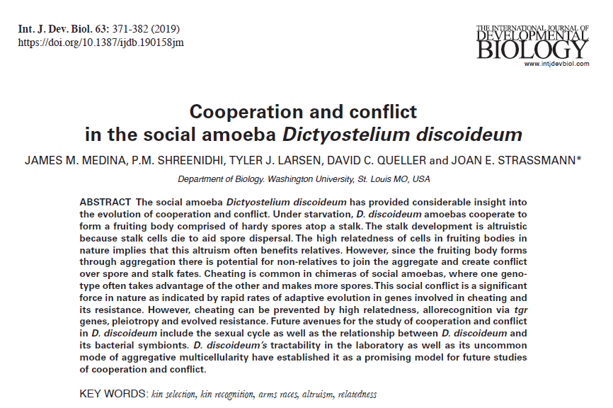
HOMEWORK

Slide 10
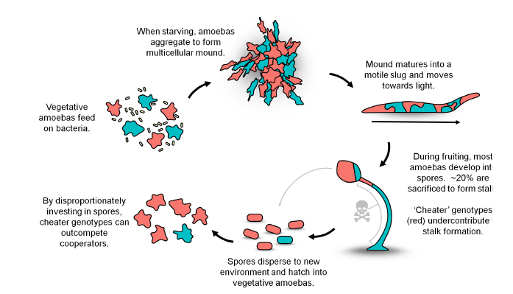

Slide 11
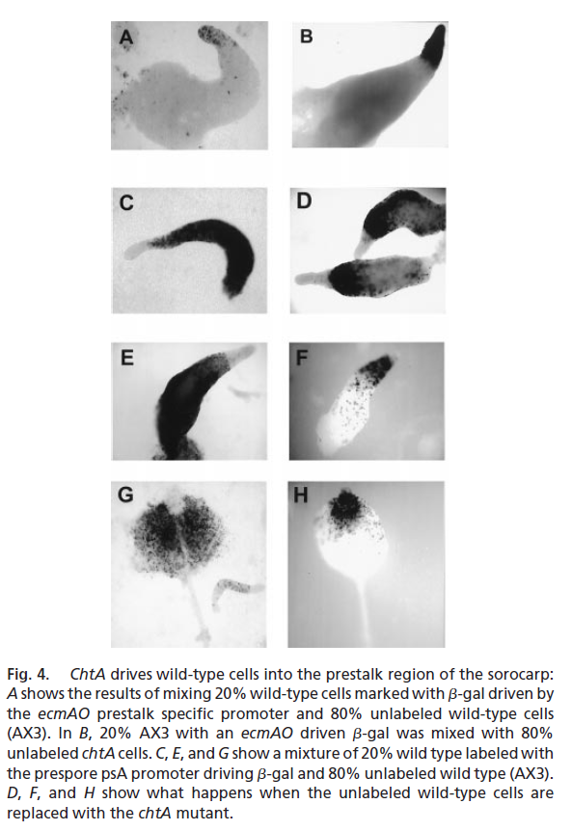
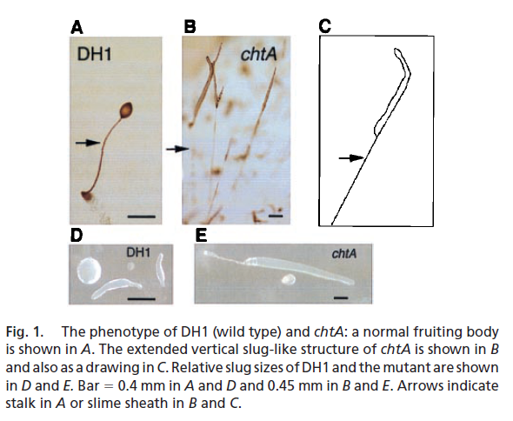
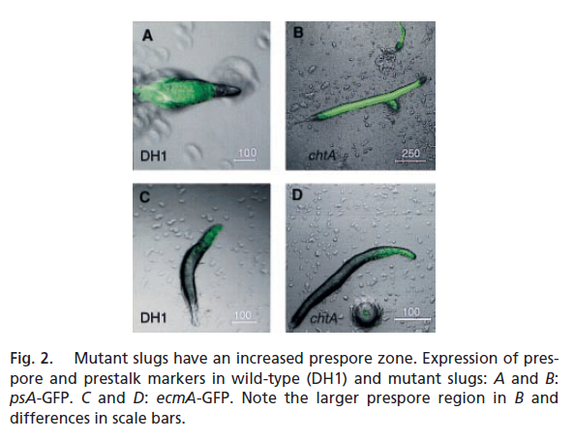
Cheaters in Dictyostelium
Ennis HL et al. (2000) PNAS 97: 3292-3297

Slide 12
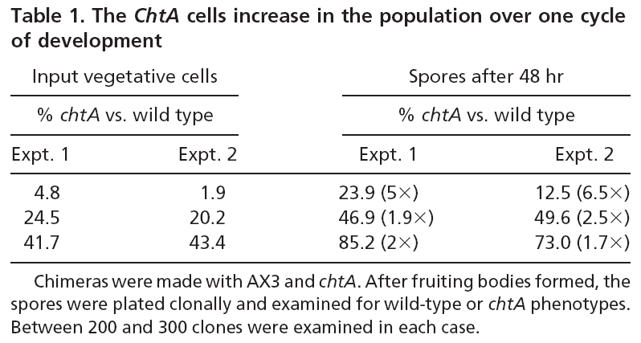
Ennis HL et al. (2000) PNAS 97: 3292-3297

Slide 13
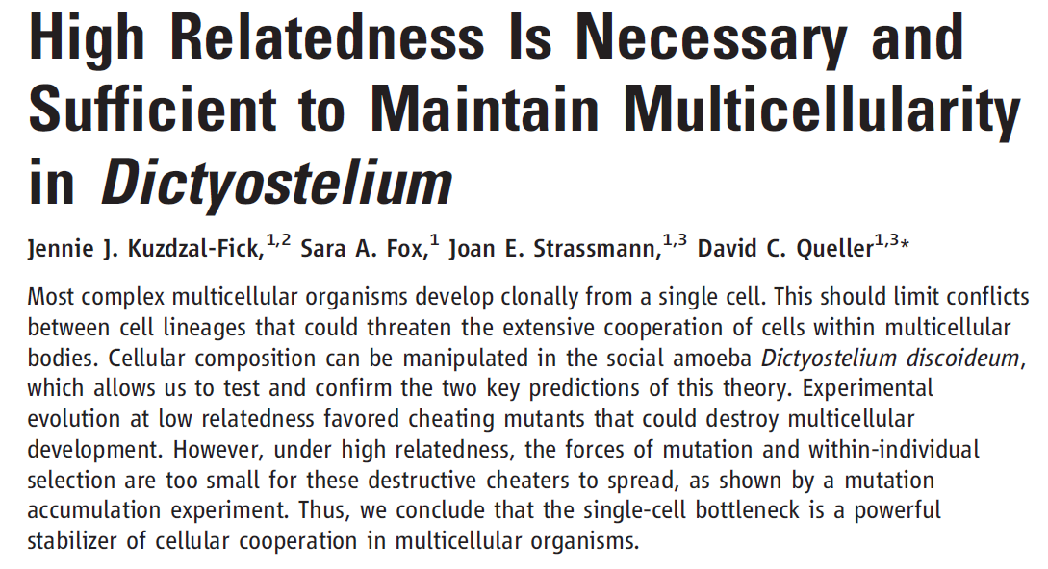
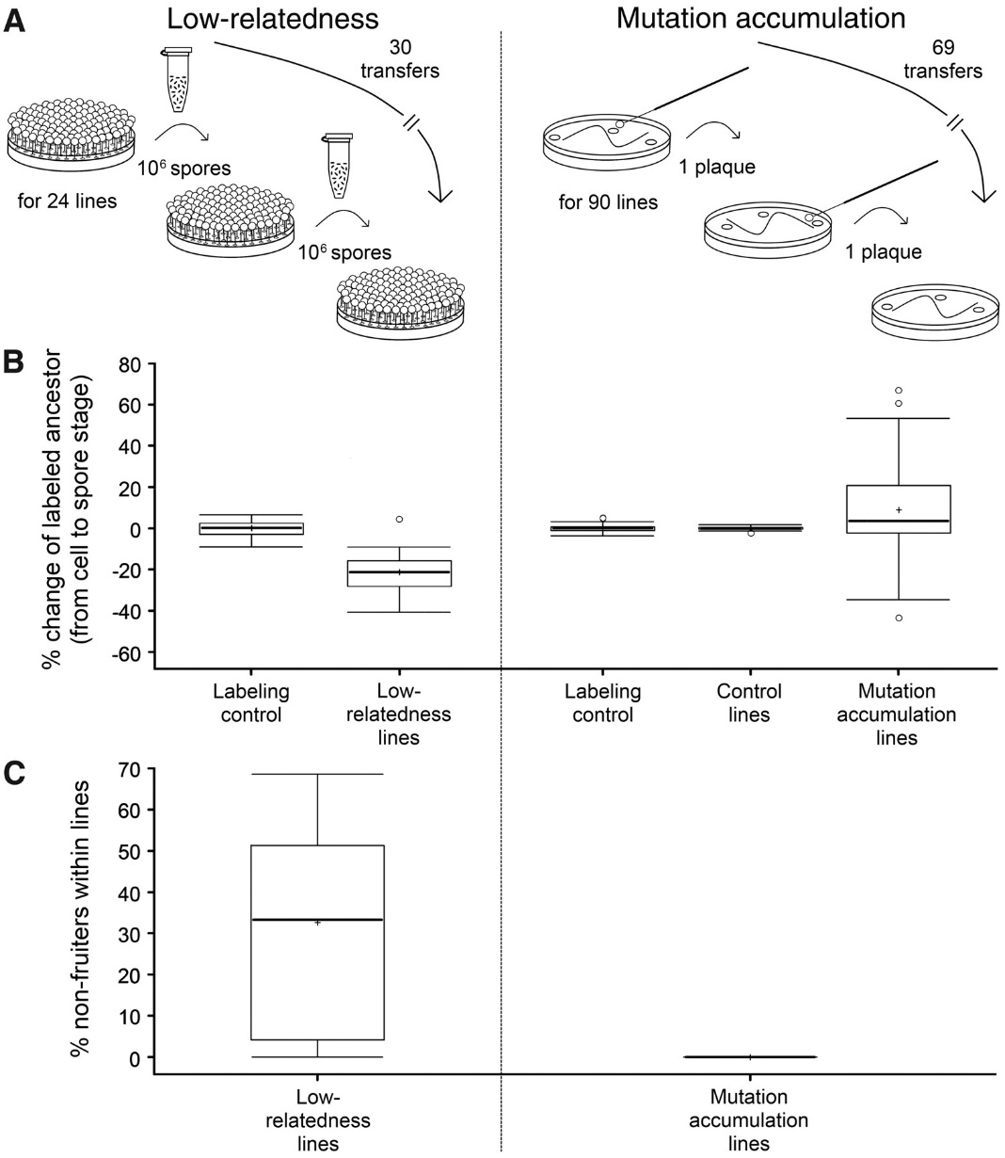
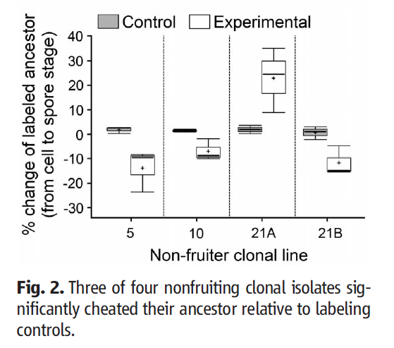
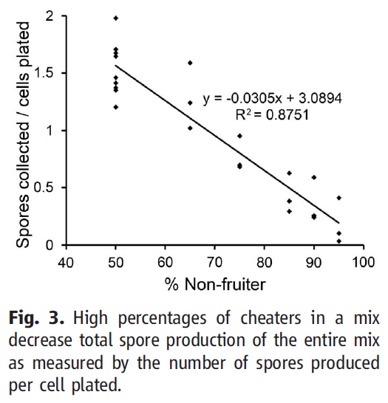
I did a few modifications to Objective 5 and added an extra citation. I hope the methodology is now concise enough, if it exceeds your word limit, please let me know.
Also, if the PCR primers you chose will capture a broader range of archaea (not only methanogens), you might like to use the curated ribosomal operon database that was recently published (https://academic.oup.com/femsmicrobes/article/doi/10.1093/femsmc/xtac002/6515944?login=true). It does contain two Methanoregula spp. operons and several Methanobacterium spp. operons. I am attaching the database as well for your reference. Please let me know if anything else is needed.
Science 334: 1548 (2011)

Slide 14
Science 334: 1548 (2011)

Slide 15
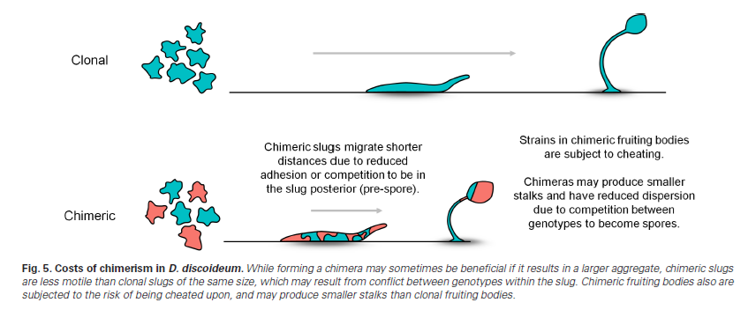

Slide 16
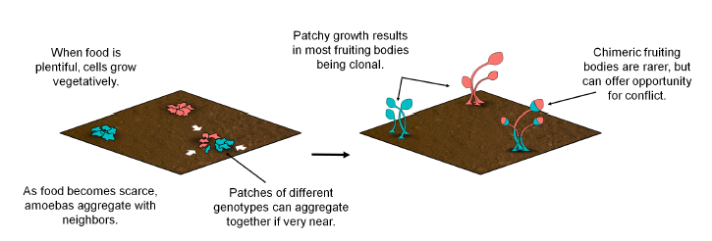

Slide 17
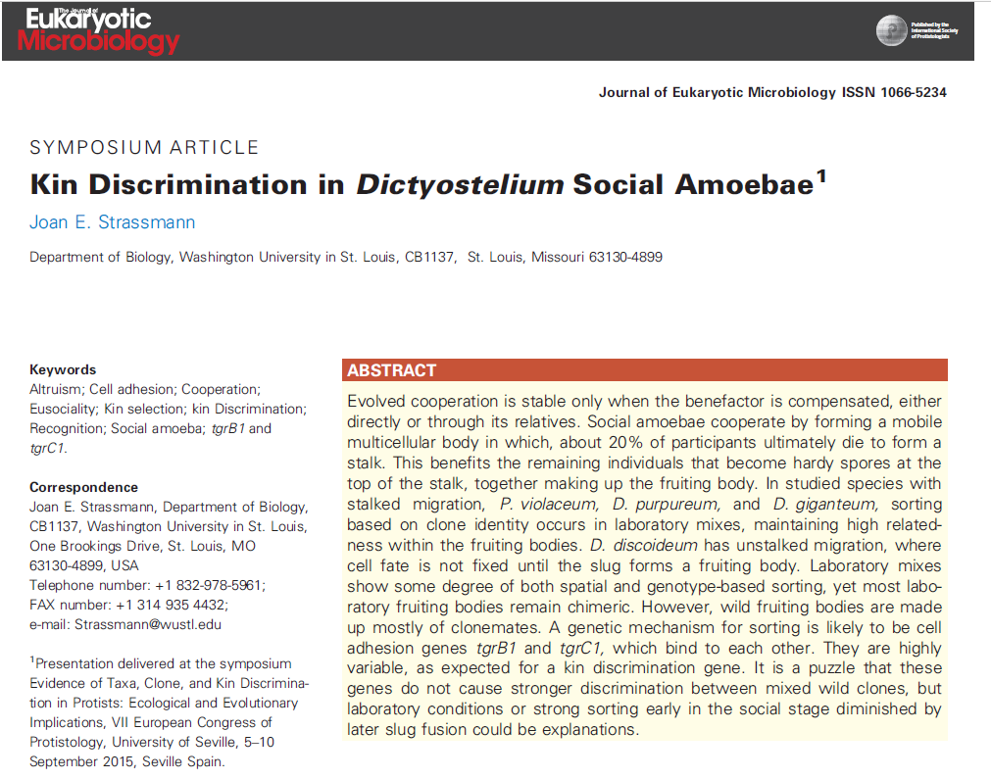

Slide 18
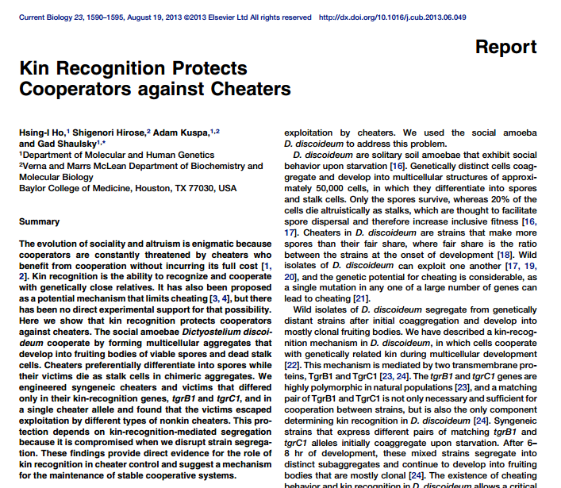
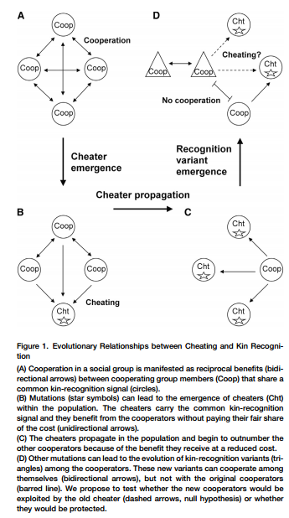

Slide 19
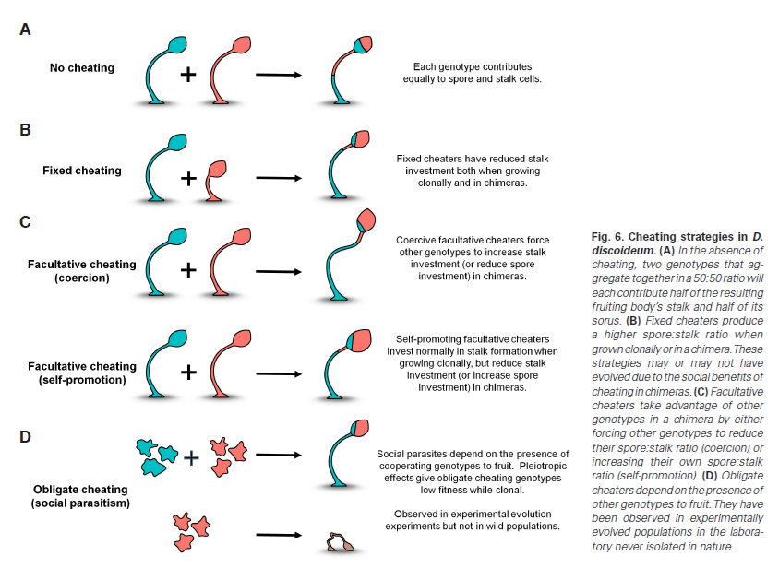

Slide 20
PNAS 109: 1595-1600 (2012)

Slide 21
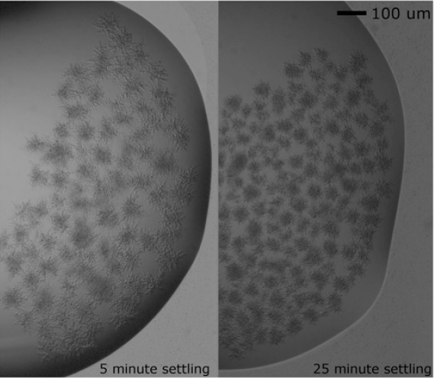
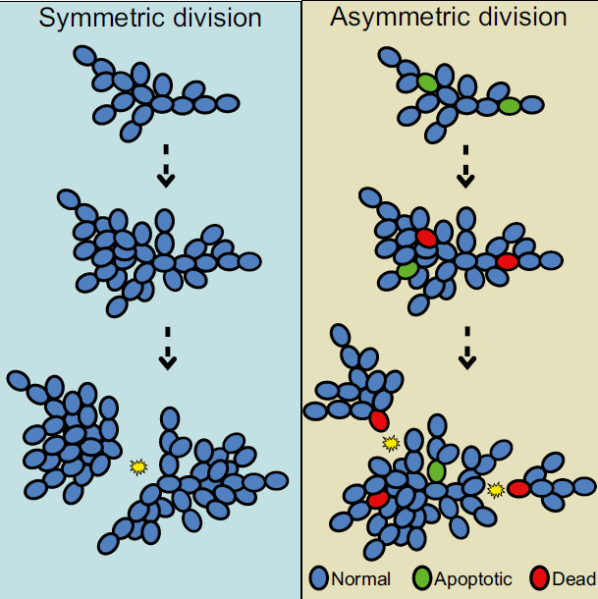
PNAS 109: 1595-1600 (2012)
http://www.pnas.org/content/suppl/2012/01/11/1115323109.DCSupplemental/pnas.201115323SI.pdf#nameddest=SF3

Slide 22
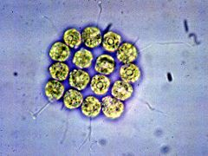
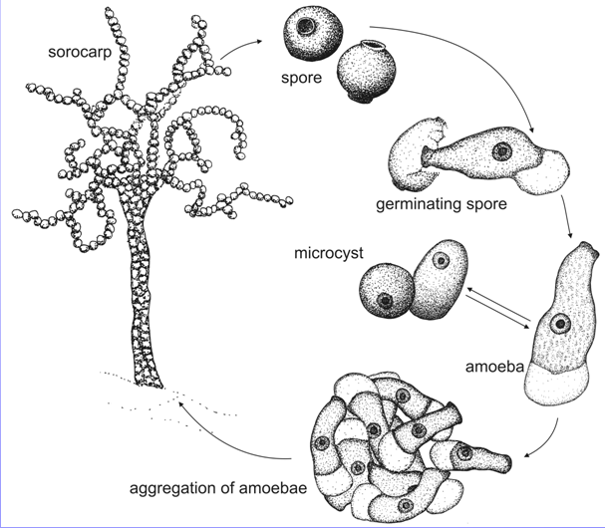
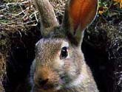
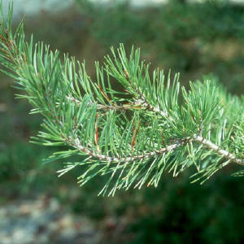
“water”
colonial, clonal
Multicellularity
“land”
aggregative

Slide 23
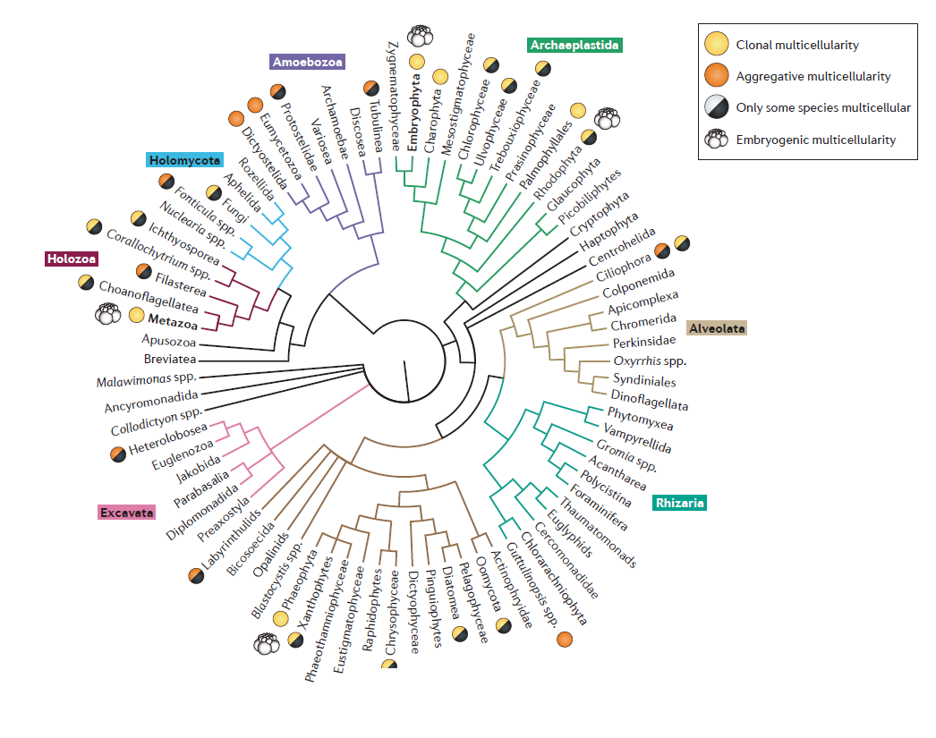

Slide 24
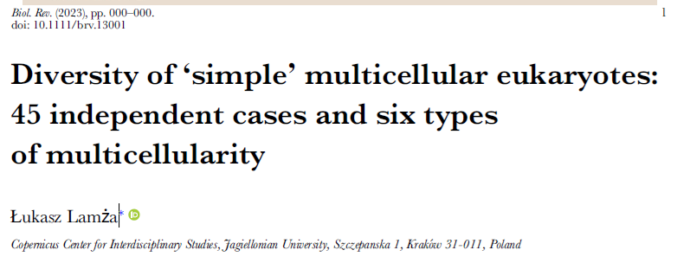
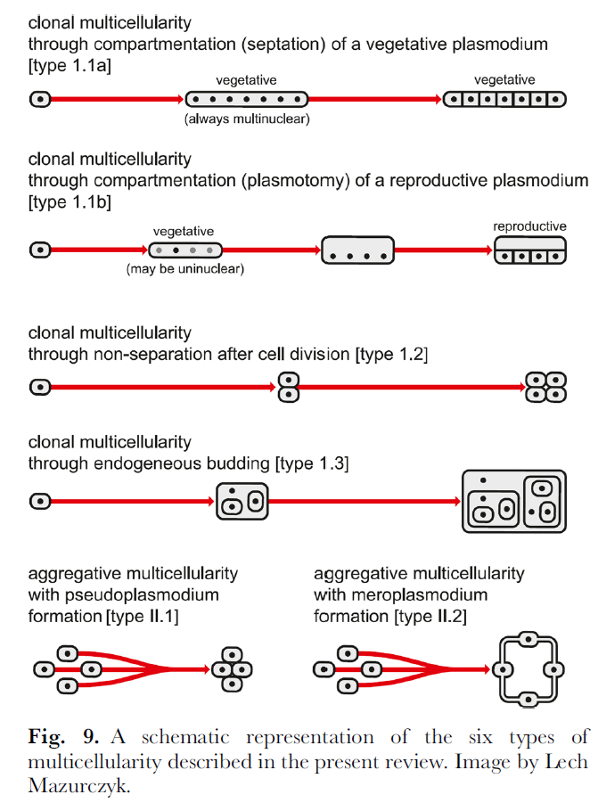
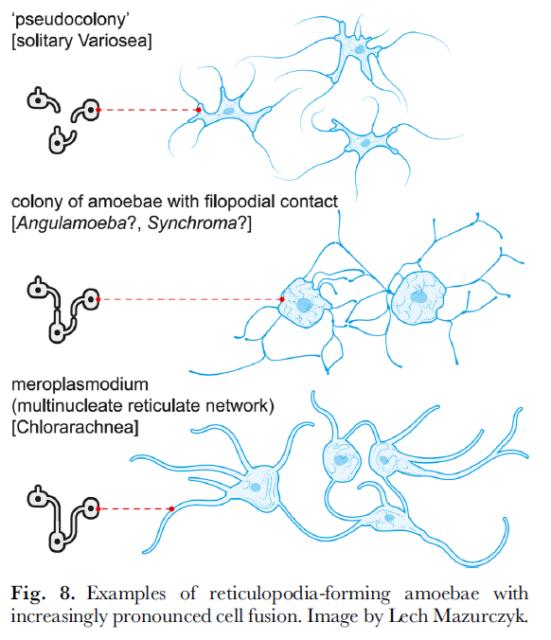
HOMEWORK

Slide 25
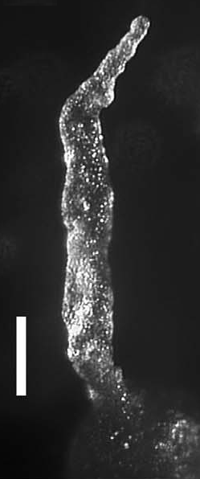
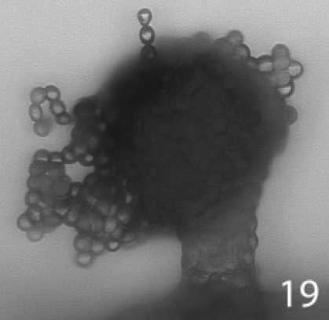
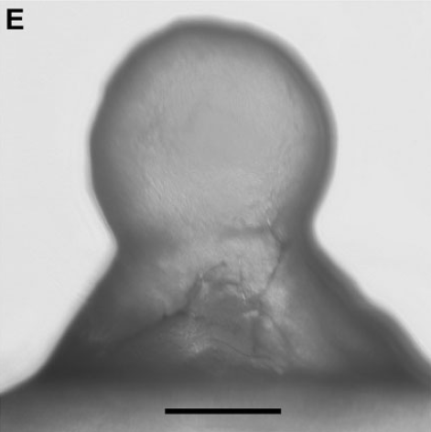
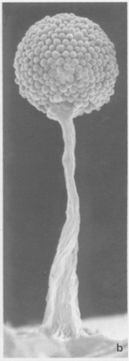
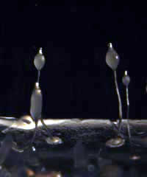
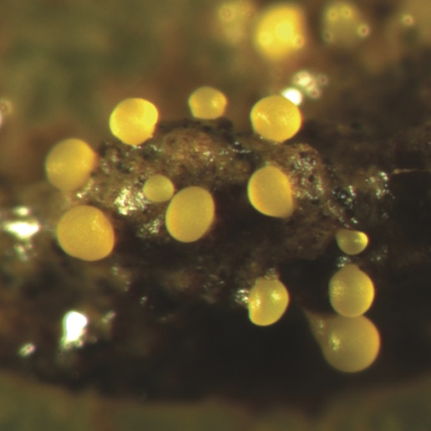
Aggregative multicellularity (“land”)
Acrasis
Fonticula
Sorogena
Copromyxa
Dictyostelium
Myxococcus

Slide 26
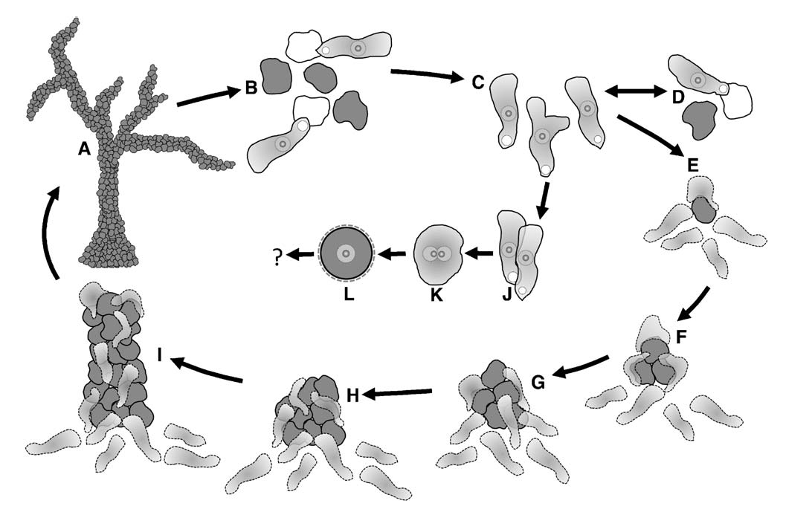
Copromyxa (Amoebozoa: Tubulinea)
Brown MW et al. (2011) Protist 162: 277-287

Slide 27
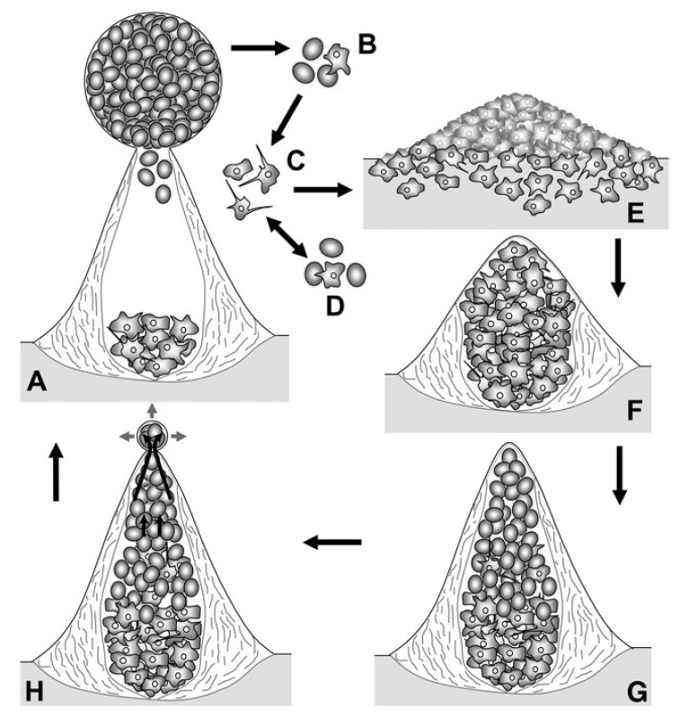
Fonticula (Obazoa: Opisthokonta)
Brown MW et al. (2009) Mol Biol Evol 26: 2699-2709

Slide 28
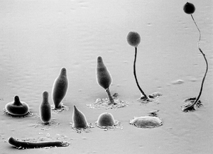
Dictyostelium discoideum

Slide 31
Myxamoebae aggregation
CMF (conditioned medium factor) – signal of starving
cAMP – the most versatile molecule in dicty, cell polarization, attraction, etc.
CAR1 – cAMP receptor, asociation with G-proteins
PDE - phosphodiesterase
PDI – inhibitor of phosphodiesterase (formation of pacemakers)
CF – counting factor
ACTIVATION- ADAPTATION of the system

Slide 32
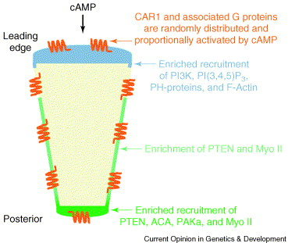
Polarization of myxamoebae
Kimmel AR & Firtel RA (1996) Curr Opin Genet Dev 14: 540-549

Slide 33
Asghar A et al. (2012) Protist 163: 25-37
cAMP

Slide 34
Myxamoebae aggregation
CMF (conditioned medium factor) – signal of starving
cAMP – the most versatile molecule in dicty, cell polarization, attraction, etc.
CAR1 – cAMP receptor, asociation with G-proteiny
PDE - phosphodiesterase
PDI – inhibitor of phosphodiesterase (formation of pacemakers)
CF – counting factor
ACTIVATION- ADAPTATION of the system

Slide 35
cAMP pulses

Slide 36
Brock DA & Gomer RH (1999) Genes Dev 13: 1960-1969
Counting factor

Slide 38
Jermyn K et al. (1996) Development 122: 753-760

Slide 39
Cell differentiation
Do the first cells start the differentiation program randomly?
cAMP triggers PSP cells differentiation
DIF-1 id produced by PSP cells
DIF-1 induces PST-0 cells differentiation
PST-A cells have a different trigger of differentiation
DIF-1 inhibits PSP differentiation
DIF-1

Slide 40
Cell differentiation
Do the first cells start the differentiation program randomly?
cAMP triggers PSP cells differentiation
DIF-1 id produced by PSP cells
DIF-1 induces PST-0 cells differentiation
PST-A cells have a different trigger of differentiation
DIF-1 inhibits PSP differentiation
DIF-1

Slide 41
Chatwood A & Thompson CRL (2011) Develop Growth Differ 53: 558-566

Slide 42
Slug
Williams JG (2006) EMBO Rep 7: 694-698

Slide 44
Culmination
Fruiting body
(sorocarp)
NH₃
Jermyn K et al. (1996) Development 122: 753-760

Slide 45
Dictyostelium has a sexual cycle, which also involves cell aggregation.
Homework: Signalling and sex in the social amoebozoans
http://onlinelibrary.wiley.com/doi/10.1111/j.1469-185X.2011.00200.x/abstract

Slide 46
Dictyostelium - summary

Slide 47
Acytostelium subglobosum

Slide 48
Volvox carteri – “water” multicellularity

Slide 49
Volvox carteri
+- closely related to the unicellular Chlamydomonas
Coenobial
1000 – 4000 somatic cells a 16 gonidia
The interior of the sphere is filled with a structured ECM
Multicellular during the most of the life cycle (both asexual and sexual)

Slide 50
Multicellularity of Volvox carteri
Cell differentiation (mostly terminal)
Self-sacrifice of most cells
Unicellular forms – only gametes and zygote
Chemical and mechanical communication within the colony
Migration of cells during the ontogenesis of the coenobium („embryogenic“ multicellularity)
Coenobium is polarized – the gonidia are at the back

Slide 52
Herron MD et al. (2009) PNAS 106: 3254-3258

Slide 53
Asexual cycle

Slide 54
Cell differentiation in V. carteri
A minumum model
glsA and hsp70A trigger assymetric divisions in 16 cells of the 32-cell embryo, diverting the axis of cytokinesis
regA prevents dedifferenciation and immortality of somatic cells
lag triggers differentiation of gonidia
Expression of lag id dependent on cell size – larger than 8 μm after 6th division
regA⁻ glsA⁻ mutants survive in the lab ☺
Schmitt R (2001) Jpn J Protozool 34: 7-12
Klein B et al. (2017) BMC Biol 15:111

Slide 55
Embryonal inversion
Kirk DL (2001) Develop Biol 238: 213-223

Slide 56
Volvox globator

Slide 58
Embryonal inversion

Slide 59
Hatching of young coenobia
Fukada K et al. (2006) Plant Cell 18: 2554-2566

Slide 60
Sexual cycle

Slide 61
Sexual cycle

Slide 62
Sexual pheromone and pherophorins
V. carteri lives in temporary ponds, only zygote survives the droughts
Need of sudden and synchronized trigger of the sexual cycle
Sexual pheromone (glycoprotein) – works at 62 molecules/ml !!!
Produces during heat stress, sometimes spontaneously
Amplification of the signal in spermatozooids
Unique mechanism of signal transduction within the coenobium

