Slide 1
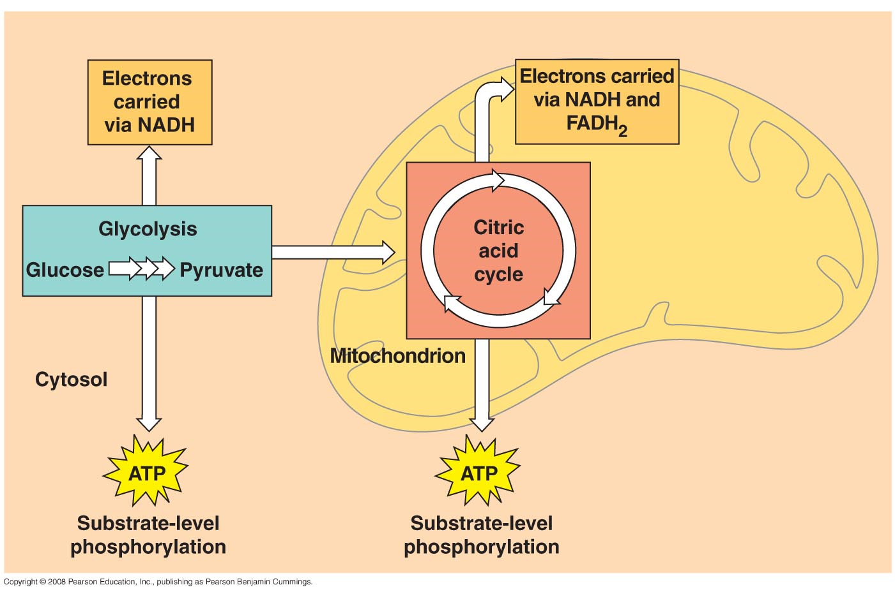
Energy metabolism

Slide 2
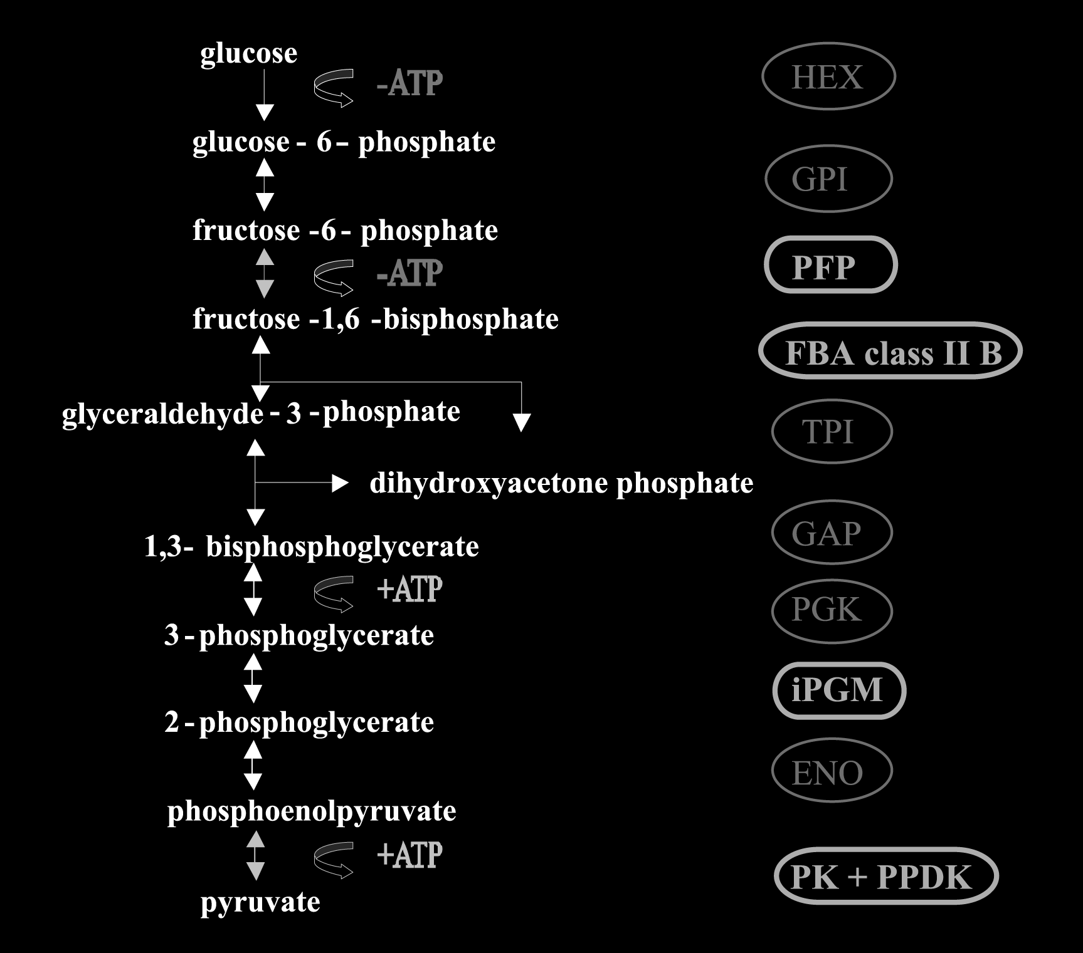
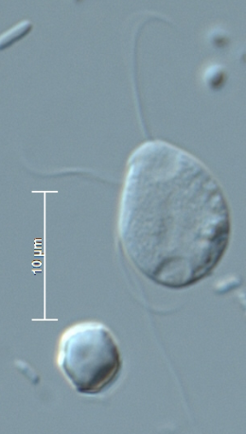
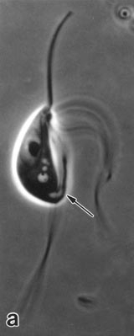
Glycolysis (EMP*, pathway) – Preaxostyla
* Embden-Meyerhof-Parnas
PPi
pyrophosfate-fructose 6-phosphate phosphotransferase
PPi
pyruvate ortophosphate dikinase
Liapounova et al. 2006,
Stechmann et al. 2006

Slide 3
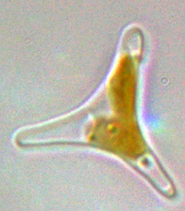
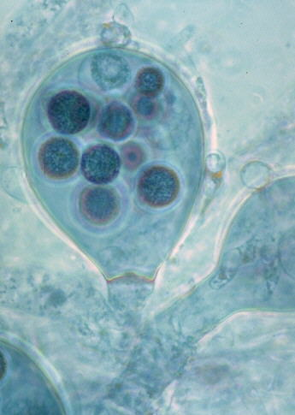
Glycolysis – diatoms and oomycetes
Nakayama et al. 2012

Slide 4
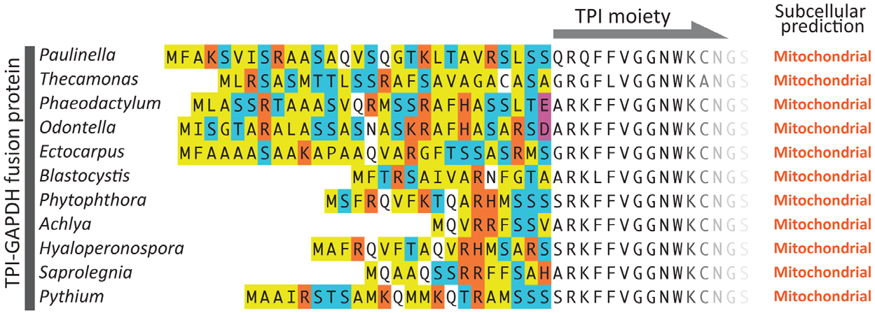
Glycolysis – mitochondrial localisation
Nakayama et al. 2012

Slide 5
Phytophthora
(PGK, PGM, PK)
Glycolysis – mitochondrial localisation
Blastocystis (PGK)
Phaedactylum (PGM)
Barulos et al 2018
Barulos et al 2018
Abrahamian et al 2017

Slide 6
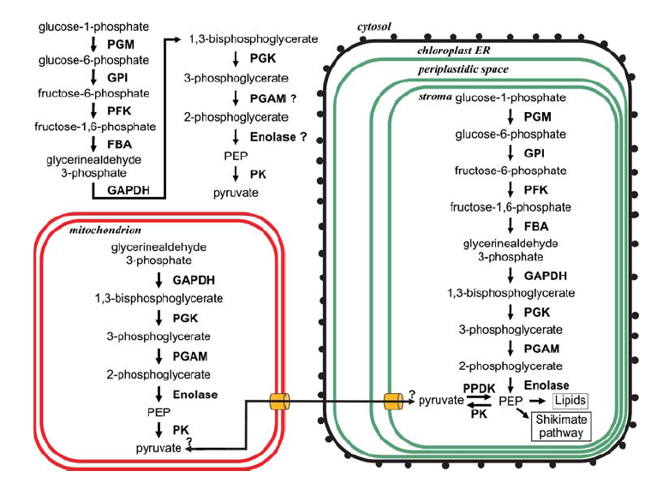
Glycolysis – mitochondrial localisation
Glycolysis in Phaeodactylum tricornutum
Kroth et al. 2008

Slide 7
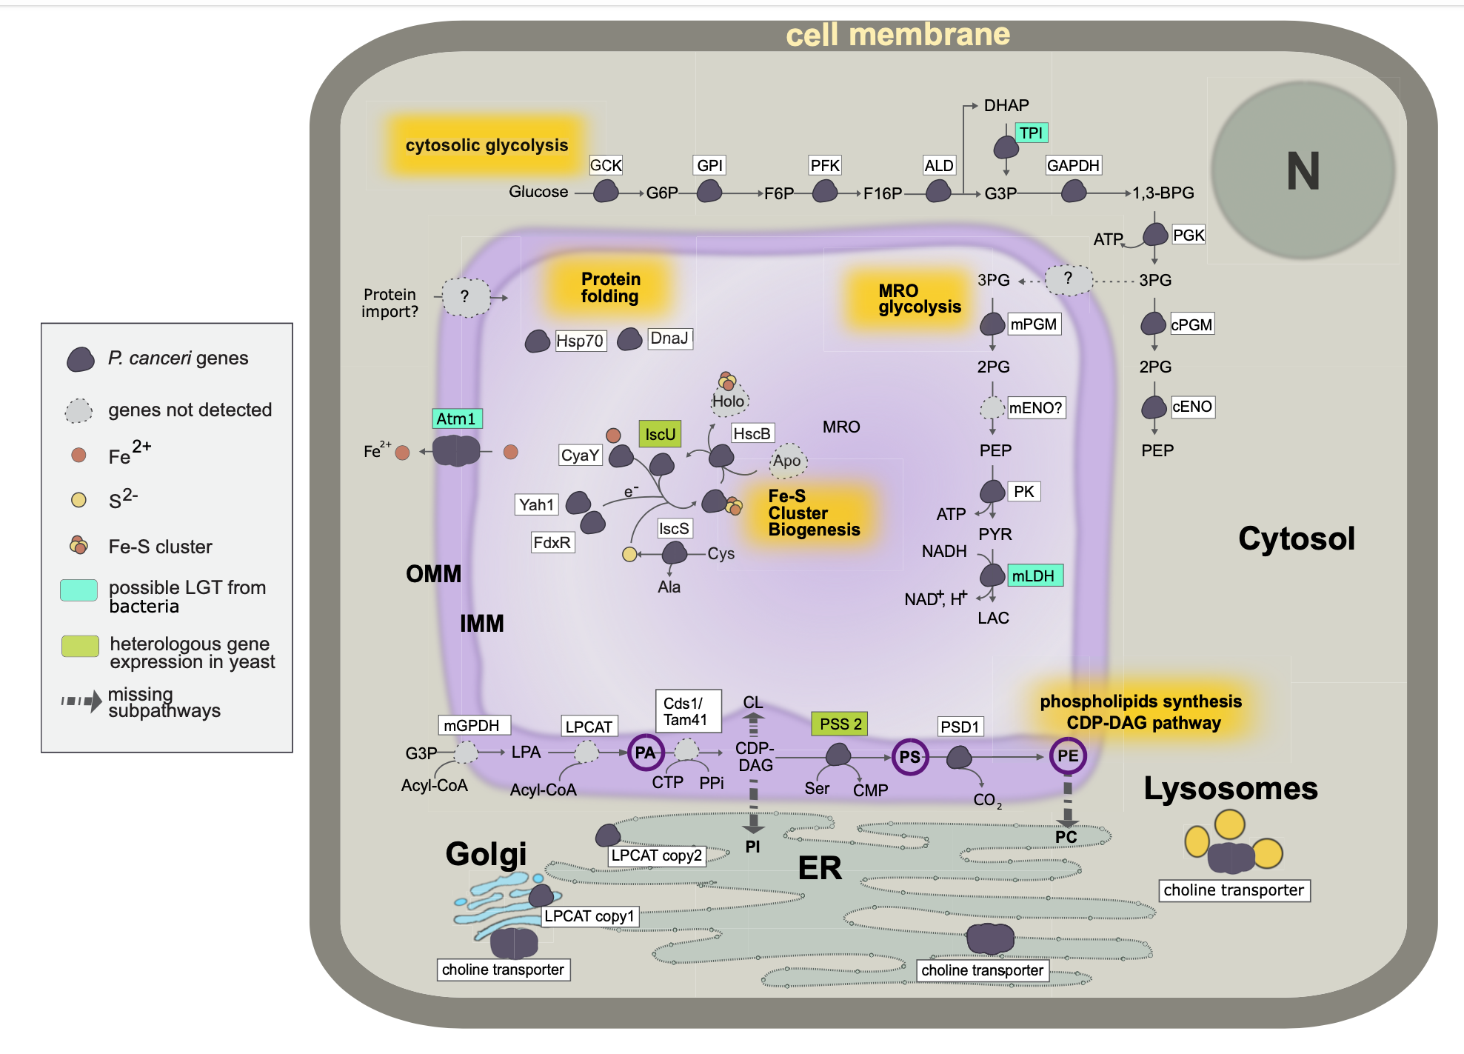
Glycolysis – mitochondrial localisation
Ioana Onuț -
Brännström et al. 2023

Slide 8
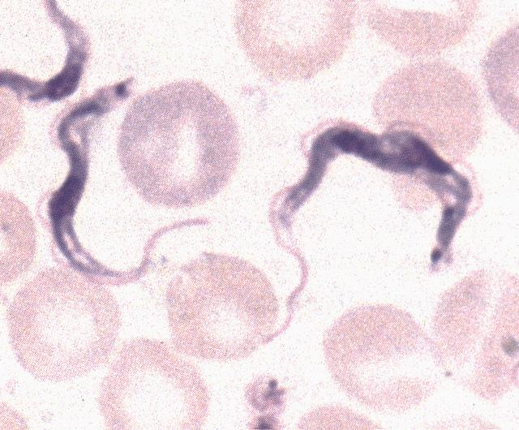
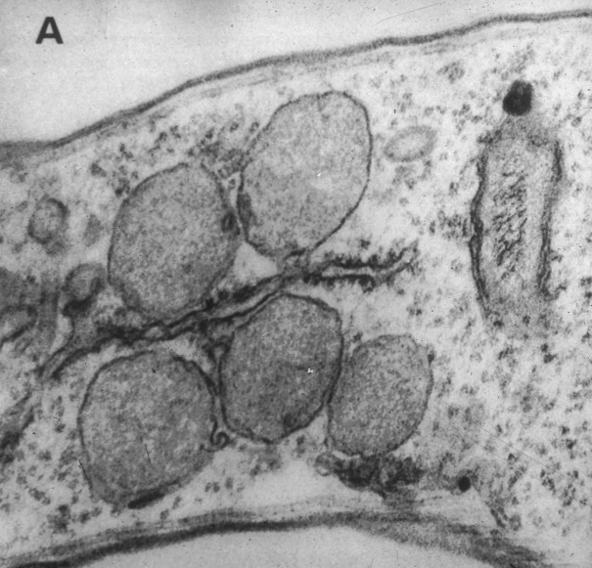
Glycolysis (EMP pathway) – Kinetoplastids
GLYCOSOME
+NADH

Slide 9
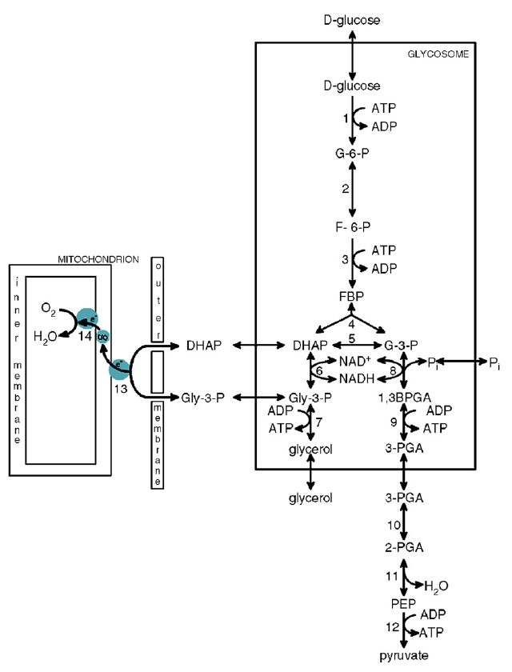

Glycosome
Why to compartmentalise glycolysis?
Higher speed
Better regulation
Haanstra et al. 2008, PNAS

Slide 10
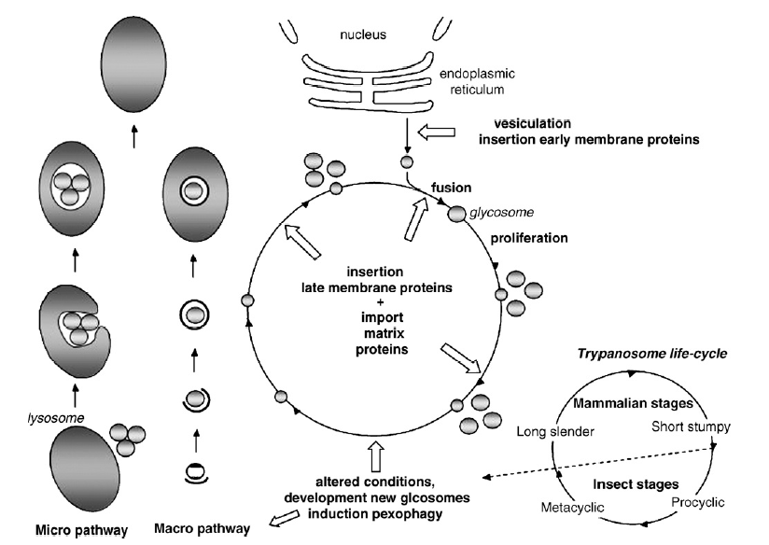
Trypanosomes–autophagy of glycosomes
Michels PAM 2006, BBA
The biochemical processes and protein composition of glycosomes undergo changes during transformation of trypanosomes from blood stage to the procyclic stage.

Slide 11
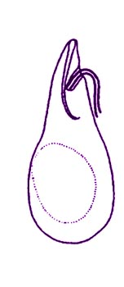
Diplonema – glycosomes
Glycolitic enzymes were localized to the peroxisome of Diplonema papilatum.
Morales et al. 2016 Proc. R. Soc. B

Slide 12
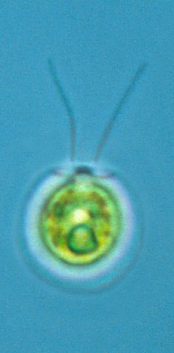
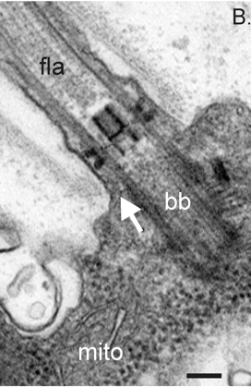
Glycolysis (EMP pathway)– Chlamydomonas
PLASTID
Also these enzymes have been found in the flagellar proteome
Enolase is a structural component of protein complex in the central pair of axonemal microtubules
Mitchell BF, 2005 Mol Biol Cell
Notes:
Eukaryotic cilia and flagella are long, thin organelles, and diffusion from the cytoplasm may not be able to support the high ATP concentrations needed for dynein motor activity. We discovered enzyme activities in the Chlamydomonas reinhardtii flagellum that catalyze three steps of the lower half of glycolysis (phosphoglycerate mutase, enolase, and pyruvate kinase). These enzymes can generate one ATP molecule for every substrate molecule consumed. Flagellar fractionation shows that enolase is at least partially associated with the axoneme, whereas phosphoglycerate mutase and pyruvate kinase primarily reside in the detergent-soluble (membrane + matrix) compartments. We further show that axonemal enolase is a subunit of the CPC1 central pair complex and that reduced flagellar enolase levels in the cpc1 mutant correlate with the reduced flagellar ATP concentrations and reduced in vivo beat frequencies reported previously in the cpc1 strain. We conclude that in situ ATP synthesis throughout the flagellar compartment is essential for normal flagellar motility.

Slide 13
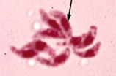
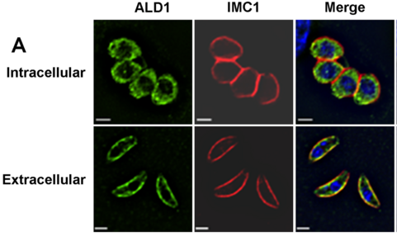
Glykolýza (EMP dráha) - Toxoplasma
Glykolytické enzymy (HK, ALD, GAPDH, PK a LDH) extracelulární a pronikající Toxoplasmy jsou lokalizolvány u povrchu. U intracelulárního stádia se přesouvají dovnitř buňky.
Přesun je regulován koncentrací K⁺ ve vnějším prostředí parazita (vyšší uvnitř hostitelské buňky). Pokles K⁺ vně vyvolá růst konc. Ca2⁺ v buňce toxoplasmy.
Pomel 2008, PLoS ONE
Notes:
The subcellular location of the myc-tagged glucose transporter GT1 in intracellular and extracellular Toxoplasma tachyzoites was determined by immunofluorescence microscopy using antibodies to the myc-epitope (green) and to the membrane skeleton protein IMC1 (red). Overlays of DIC and DAPI fluorescence images are shown on the right. Bars = 2 µm.

Slide 14
Enterocytozoon – eukaryote without glycolysis
Boakye 2018

Slide 15


Slide 16
Energy metabolism
http://www.youtube.com/watch?v=xbJ0nbzt5Kw&feature=related

Slide 17
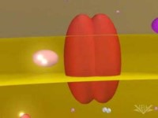

Slide 18
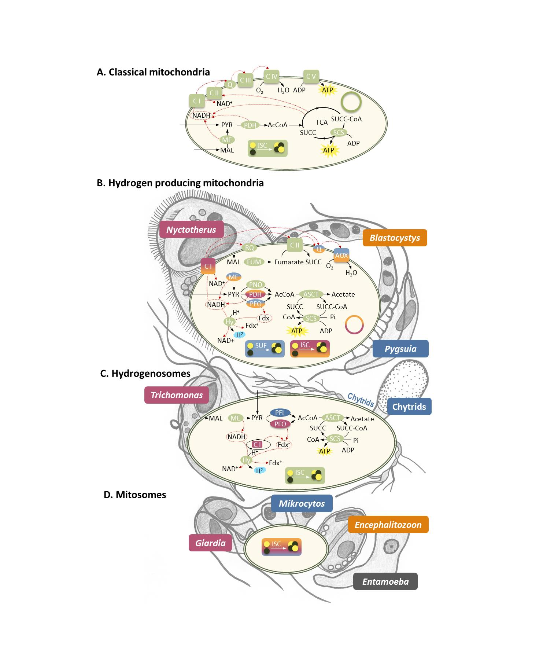
Classical mitochondrion

Slide 19
Mitochondrial cristae
Topic of essay

Slide 20
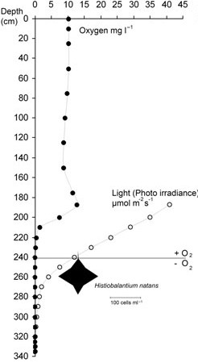
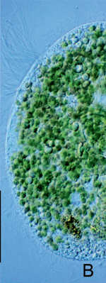
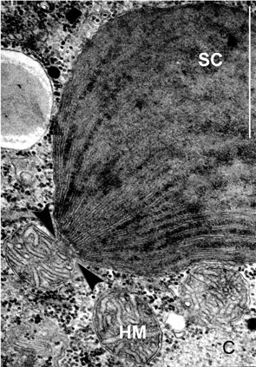
Stolen plastids as the source of oxygen
Ciliate Histiobalantium natans
Esteban et al. 2009

Slide 21
Alternative acceptors of e⁻ - NO₃⁻
Kampl et al. 2015

Slide 22
Alternativní akceptory e⁻ - NO₃⁻
Kampl et al. 2015

Slide 23
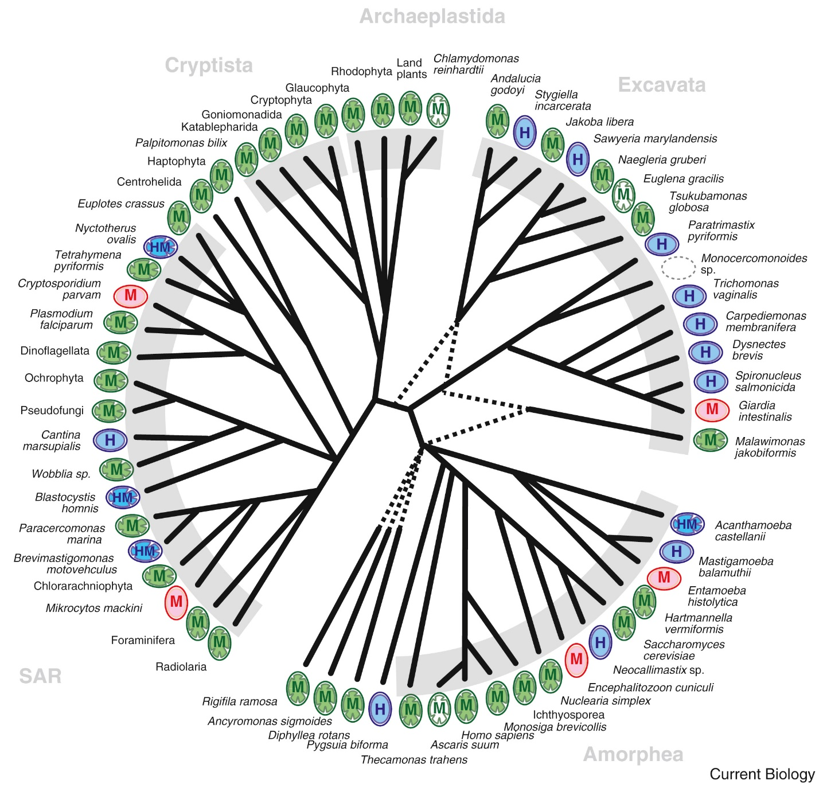
Distribution of anaerobic derivate of mitochondrion
Roger et al. 2017

Slide 24
Blastocystis
PNO

Slide 25
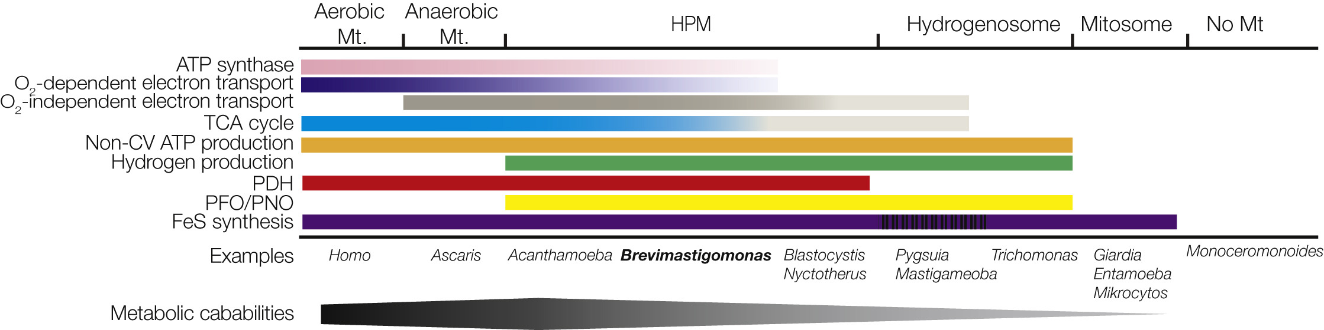
Brevimastigomonas motovehiculus
Transformation of classical mitochondron into anaerobic mitochondrion. Very reduced and probably nonfunctional complexes III and IV. ATP synthase present.
Topic of essay
Gawryluk et al. 2016

Slide 26
Blastocystis
PNO
PNO

Slide 27
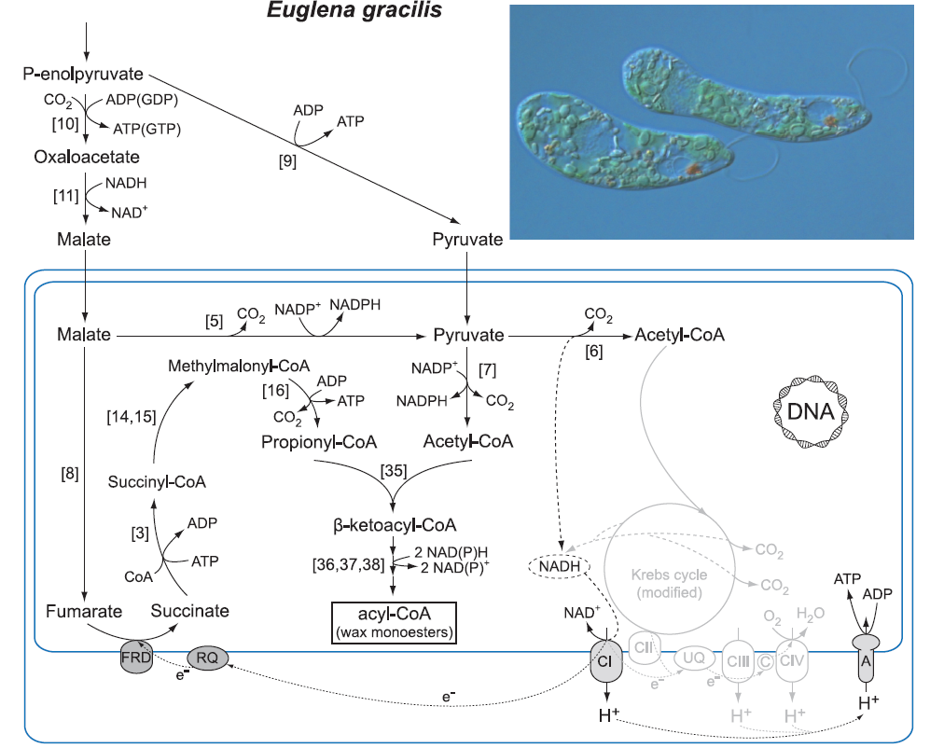
Bifurkace malátu
Oxidativní větev
Reduktivní větev
Elektrony uloženy v inertních voscích

Slide 28
Blastocystis
PNO

Slide 29
UQ (ubiquinone) methyl transferase - RquA
Topic of essay
Stair et al. 2018, eLife

Slide 30
MRO metabolism of cilliates
Topic of essay

Slide 31
Blastocystis
PNO
Mi-ichi 2015, PNAS

Slide 32
Blastocystis
PNO
Mi-ichi 2015, PNAS

Slide 33
Oxymonads – loss of mitochondrion
Loss of 1C metabolism
Karnkowska et al. unpublished

Slide 34
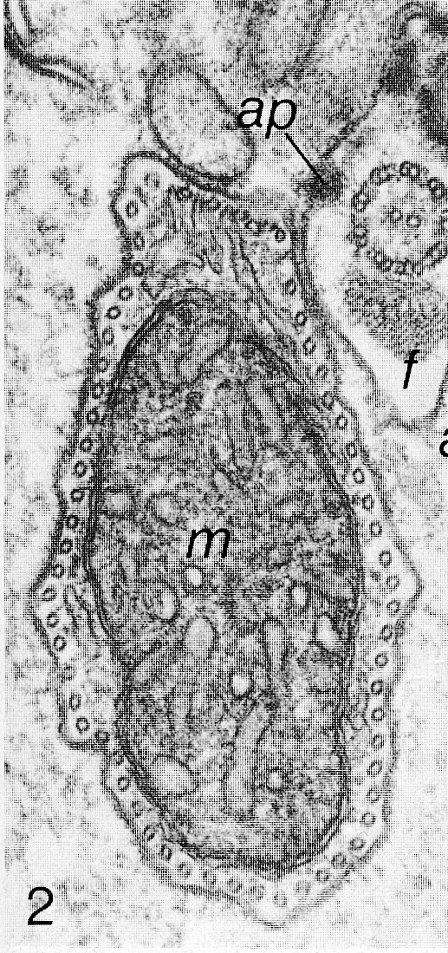
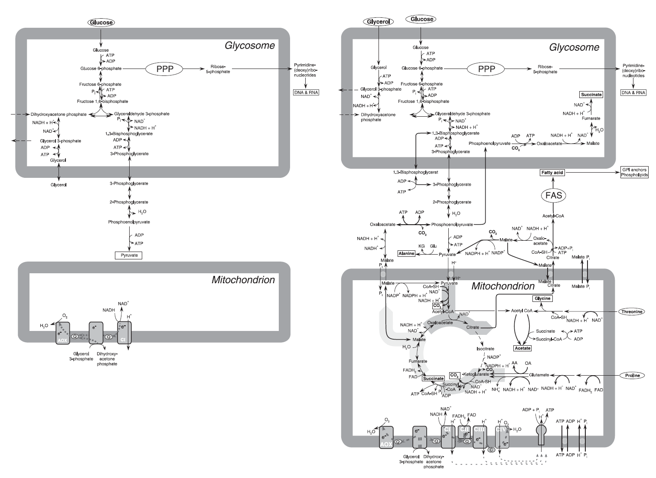
Trypanosomes – vector stage

Slide 35
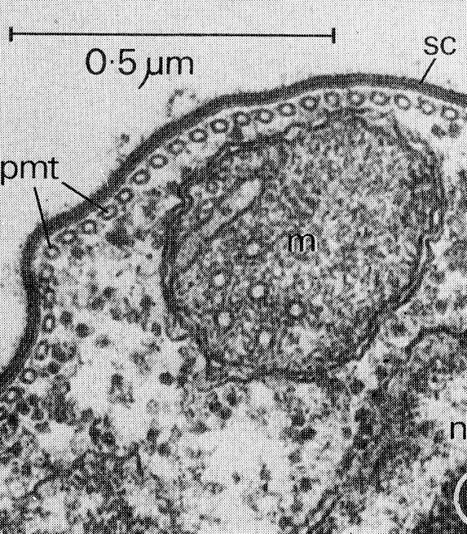
Trypanosomes – bloodstream form

Slide 36
Trypanosomes – bloodstream form
Zíková et al. 2017, PLoS Pathogens

Slide 37
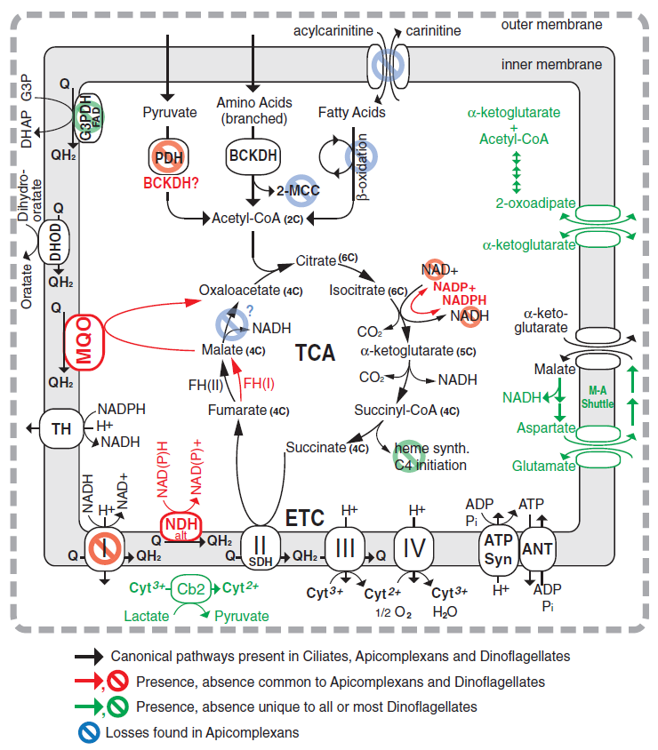
Alveolates
Ciliates
Dinoflagellata
Apicomplexa
Topic of essay:
Mitochondrion of chromerida
Danne et al. 2012

Slide 38
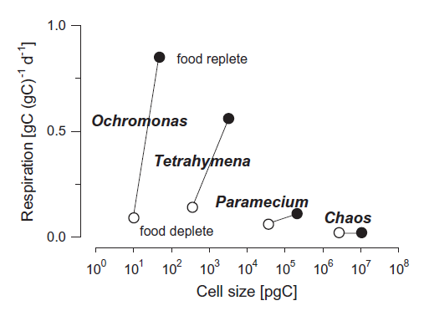
Metabolic speed in protists
It is highly dependent on the physiological state of the cell. Starving cells become smaller and their metabolism slows down significantly.

Slide 39
END

