Slide 1
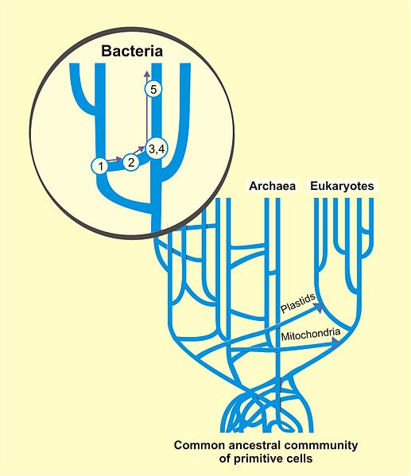
Horisontal (Lateral) gene transfer
Genes in flux

Slide 2
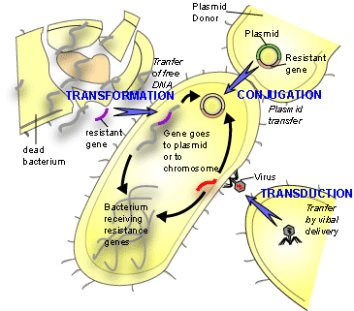
Mechanisms of HGT
Bacteria: conjugation, transformation, transduction
(Gene Transfer Agents), nanotubes, stress vesicles
nanotubes
vesicles

Slide 3
Mechanisms of HGT in eukaryotes
Endosymbiotic gene
transfer (EGT)
Sibbald et al 2020
Notes:
Většina zistených případů HGT u eukaryot se týká protist (především fagotrofných a těch, kteří hostí endosymbionty). Množství bakteriálních genů v genomu koreluje se životním stylem protist a způsobem získávání potravy

Slide 4
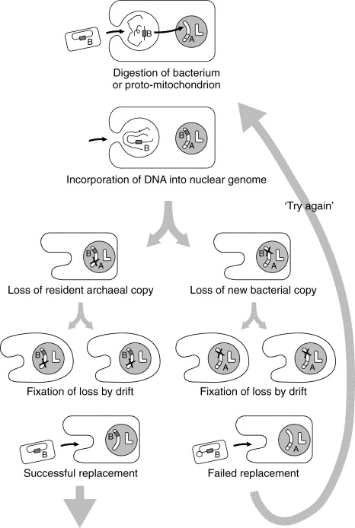
You are what you eat
Doolittle, 1988

Slide 5
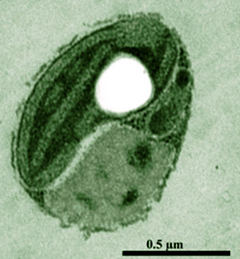
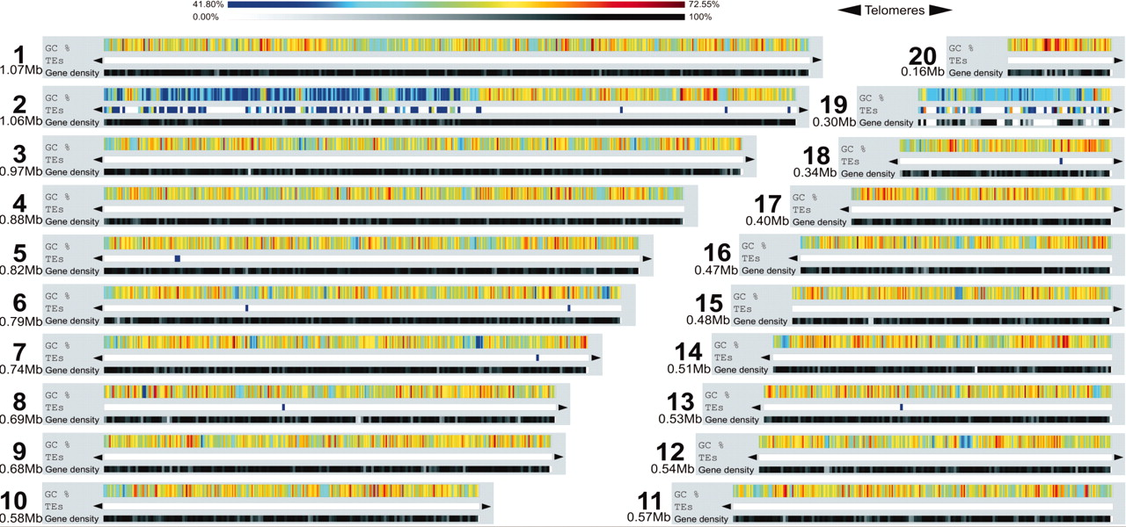
How to detect HGT
Aberant GC content or codon usage
Example: in green alga Ostreococcus tauri genes on chromosome 19 come from HGT
Derelle et al. 2006 (PNAS)
Notes:
O. tauri je najmenší volne žijúci nesymbiotický eukaryot, morská zelená riasa.

Slide 6
How to detect HGT
Phylogenetics
beware of:
Contamination
Differential loss of genes
Presence of paralogues
Cote-L’Heureux et al. 2022
Notes:
Metody molekulárnej fylogenetiky a biologie nám umožňujú charakterizovať typy mobilných genetických elementov a tiež identifikovať pradávne transfery, ktoré prispeli k evolúcii genómov. Fylogeneze organizmu nesedí s fylogenezí daného genu. Fylogenetický strom pre glutamin syntázu hodil entamébu do príbuznosti s rozsivkou Thalassiosira a mezi bakterie, to samé pro trichomonádu. Někdy je ale těžké rozlišit HGT od bakteriální kontaminace, hlavně u genomů protist ze smíšených kultur. Při detekci HGT v genomech protist může pomoct srovnat genomové data s transkriptomem anebo podezrelé geny vizualizovat pomocí FISH.

Slide 7
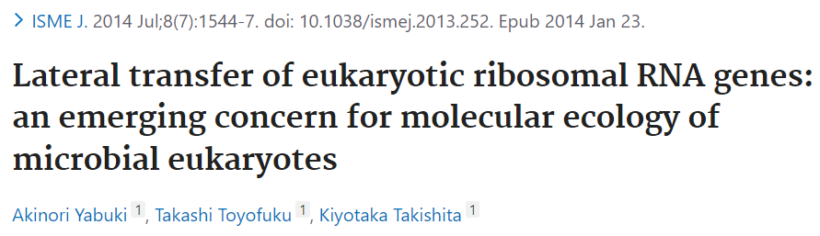
Hypothesis of complexity
HGT is more common in operational (metabolic) genes
Informational genes (transcription and translaction) are rarely affected by HGT because they have higher connectivity – are components of complex systems and interact with many proteins, form complexes. Their transfer to foreign environment is more complicated
Perkinsid to Ciliophrys
Notes:
HGT sa nevyhla ani centrálnej dráhe metabolizmu, glykolýze, ktorá je mozaikou intra- i interdoménových transferov.
S týmto súvisí hypotéza komplexity. Genové produkty, ktoré fungujú jako súčasť zložitých komlpexov a prenášajú horšie. To, aby vo finále právne zapadli do zložitého mechanizmu génovej expresie, predstavuje vačší problém jako v prípade génových produktov, ktoré majú iba pár interakčných partnerov. Zdá sa však, že žiaden gen nie je imúnny voči presunu. Myslelo sa, že sa netýka tiež génov pre proteíny hrajúce kľúčové úlohy v bunke. Opak je ale pravdou. Napr. originálny a-tubulin Andalucie bol nahradený génom z externého zdroja (v strome sadla k diplomonádam a parabasalidom, pritom je to jakobid). Gény pre amonoacyl tRNA-syntetázy sú náchylné k HGT. Napr. tyrosylS získali opistokonta z archebaktérií. AlanylS a prolylS diplomonád a parabasalidov je tiež archebakteriálneho povodu. K ďalšiemu presunu alanylS došlo medzi parabasalidmi a líniou nálevníkov a entamébou pravdepodobne u voľne žijúcich príbuzných parabazalidov a entaméby.

Slide 8
Directions of HGT
Prokaryota → Prokaryota (frequent, spread of antibiotic resistence led to discovery of HGT)
Eukaryota → Prokaryota (rare, limited by introns; e.g. genes for pro tubulin and aktin in bacteria)
Prokaryota → Eukaryota (e.g. endosymbiotic gene transfer)
Viruses Eukaryota
Eukaryota → Eukaryota (less common; more frequent in fungi)

Slide 9
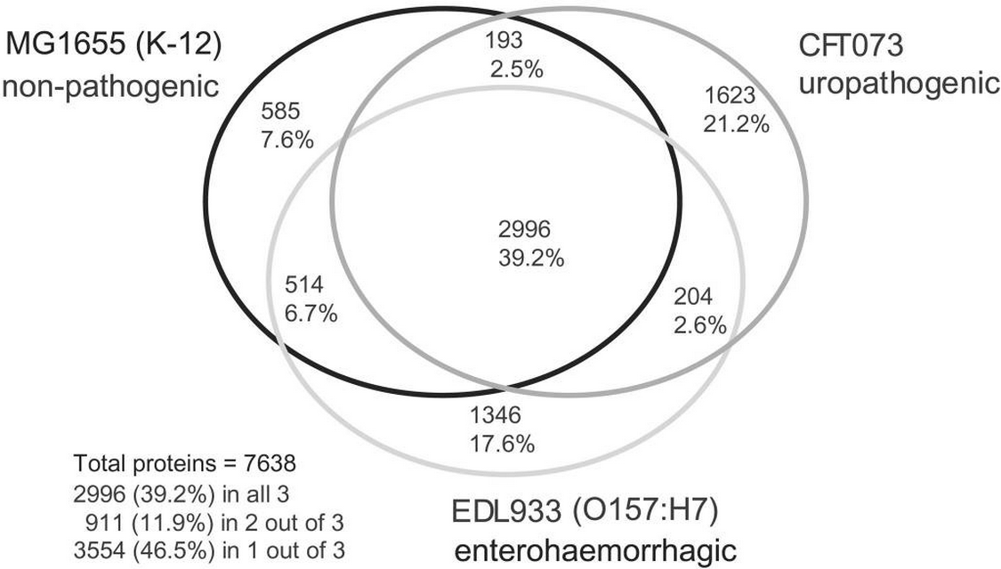
Comparison of genomes of E. coli strains
Welch a kol. 2009

Slide 10
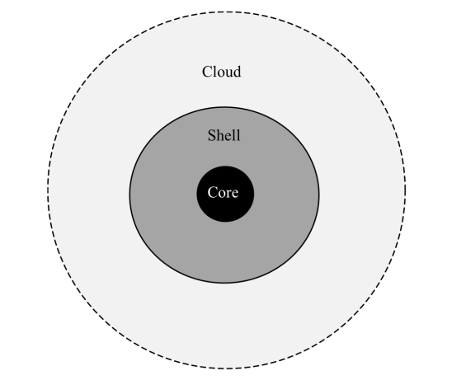
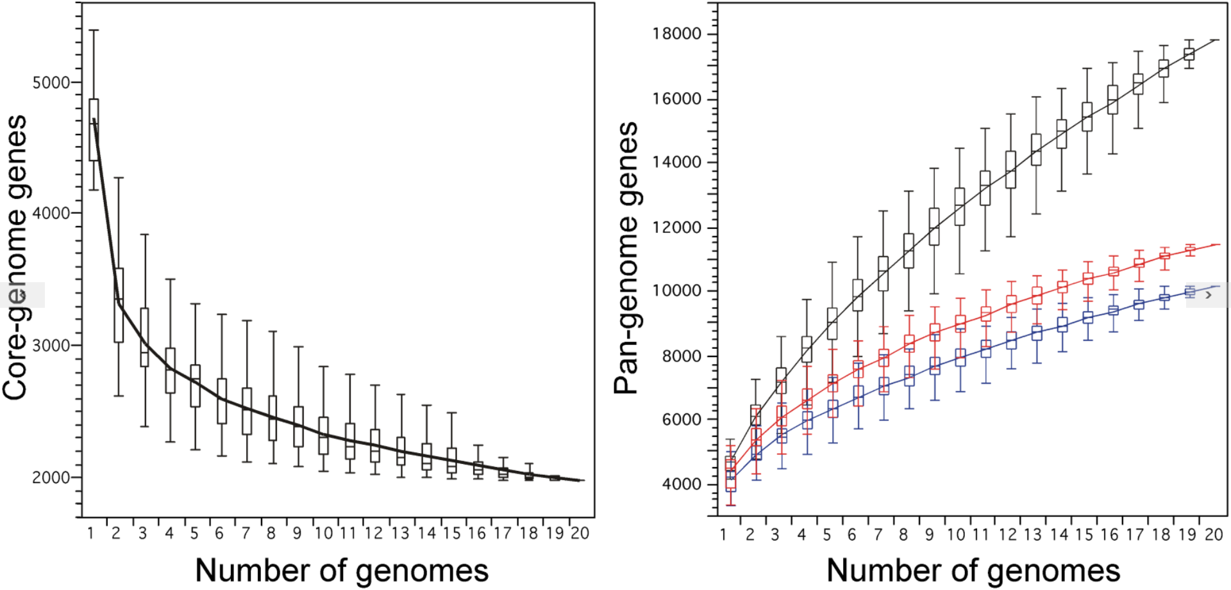
Pangenomes of prokaryotes
Touchon a kol. 2009

Slide 11
Directions of HGT
Prokaryota → Prokaryota (frequent, spread of antibiotic resistence led to discovery of HGT)
Eukaryota → Prokaryota (rare, limited by introns; e.g. genes for pro tubulin and aktin in bacteria)
Prokaryota → Eukaryota (e.g. endosymbiotic gene transfer)
Viruses Eukaryota
Eukaryota → Eukaryota (less common; more frequent in fungi)

Slide 12
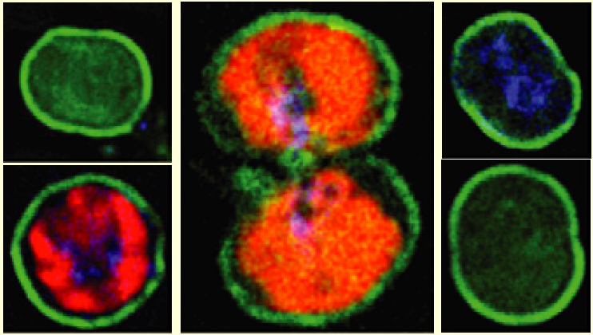
HGT from eukaryotes to prokaryotes
Alpha and beta tubulins, kinesin in Prosthecobacter dejongeii Actin and profilin in cyanobacterium Microcystis aeruginosa
Eukaryotic genes in genome of intracellular bacterium Legionella (source: water and soil amoebae)
Actin_FITC
Guljamow A et al. Curr Biol. 2007;17(17):R757-9
Notes:
Byly zaznamenané recentní transfery exkluzivně eukaryotických genů do bakterií. Tubulíny bakterií sice strukturně odlišné ale funkčně podobné (tvoří protofilamenty). Bakteriální aktin převzal stukturní roli v buňce bakterie (ochrana před zmenami salinity). Legionella získala sadu génov od améb, vnútri ktorých sa množí a od améb zrejme získala i návod, jako sa množiť v eukaryotických bunkách, vrátane ľudských.

Slide 13
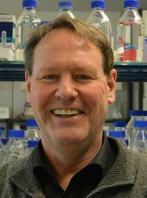
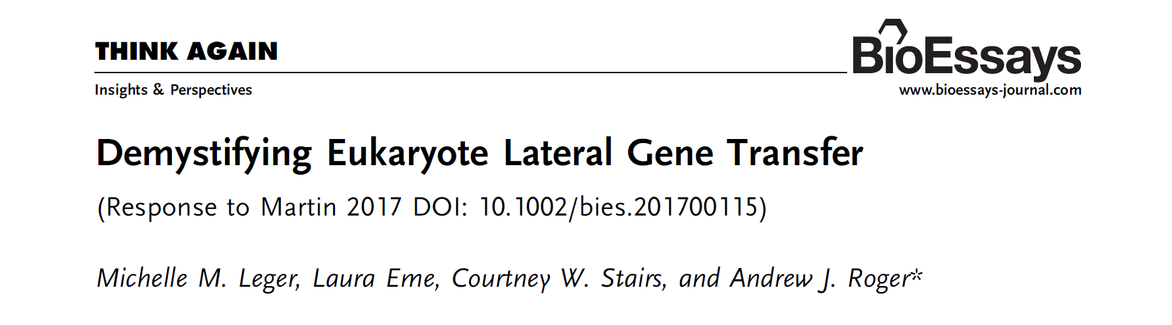
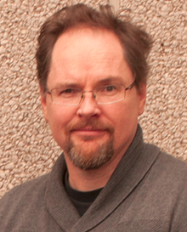
Does a eukaryotig HGT exist?

Slide 14
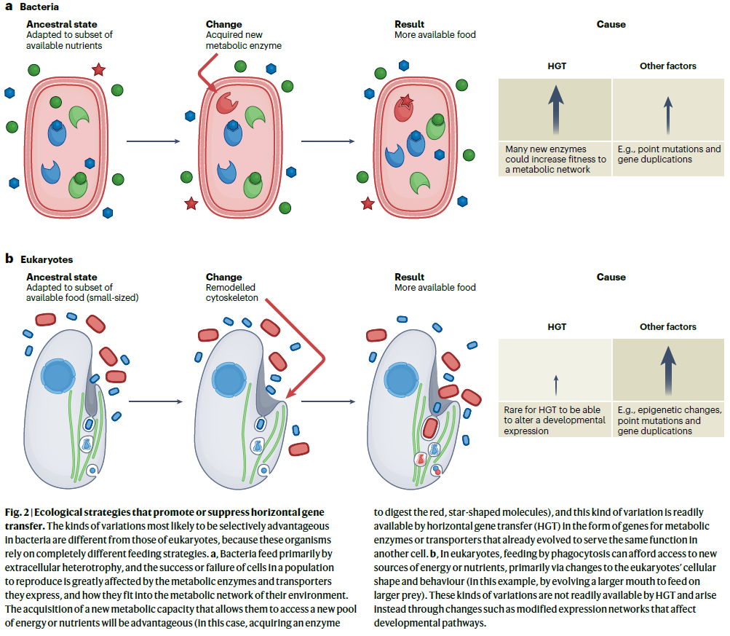
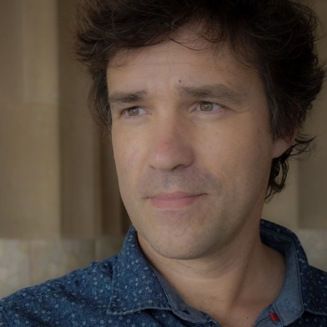
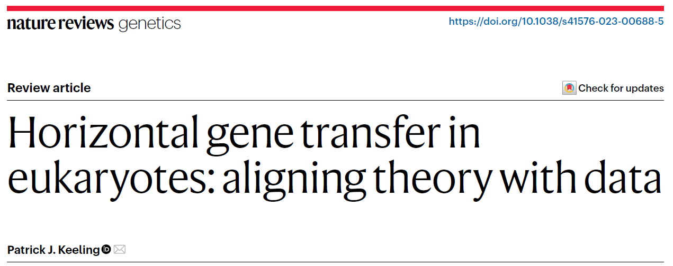
Does a eukaryotig HGT exist?
Topic of essay

Slide 15
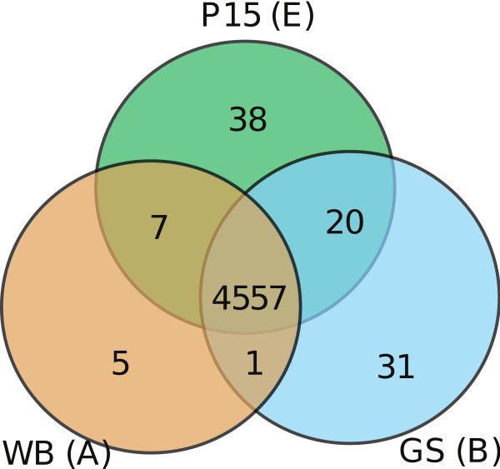
Pangenomes in eukaryotes?
Likely valid concept but the core fraction represent vast majority
Comparison of Giardia strains
Trypanosoma
Jackson a kol. 2010, PloS Negl. Trop. Diss.
Trypanosoma brucei brucei vs T. b. gambiense differ only in one well-supported gene
(putative iron-ascorbate oxidoreductase - Tb09.211.4990)
Jerlström-Hultqvist a kol. 2010, BMC Genomics

Slide 16
Pangenomes in eukaryotes?
More wider in fungi……………….... haptophyte Gephyrocapsa huxleyi…
The reference genome of strain CCMP1516 (141.7 MB) contains 30,569 genes. Approx. 1/3 was not detected in assemblies of other strains (graph below).
McCarthy and Fitzpatrick et al. 2019, Microbial genomics
Read et al. 2013, Nature

Slide 17
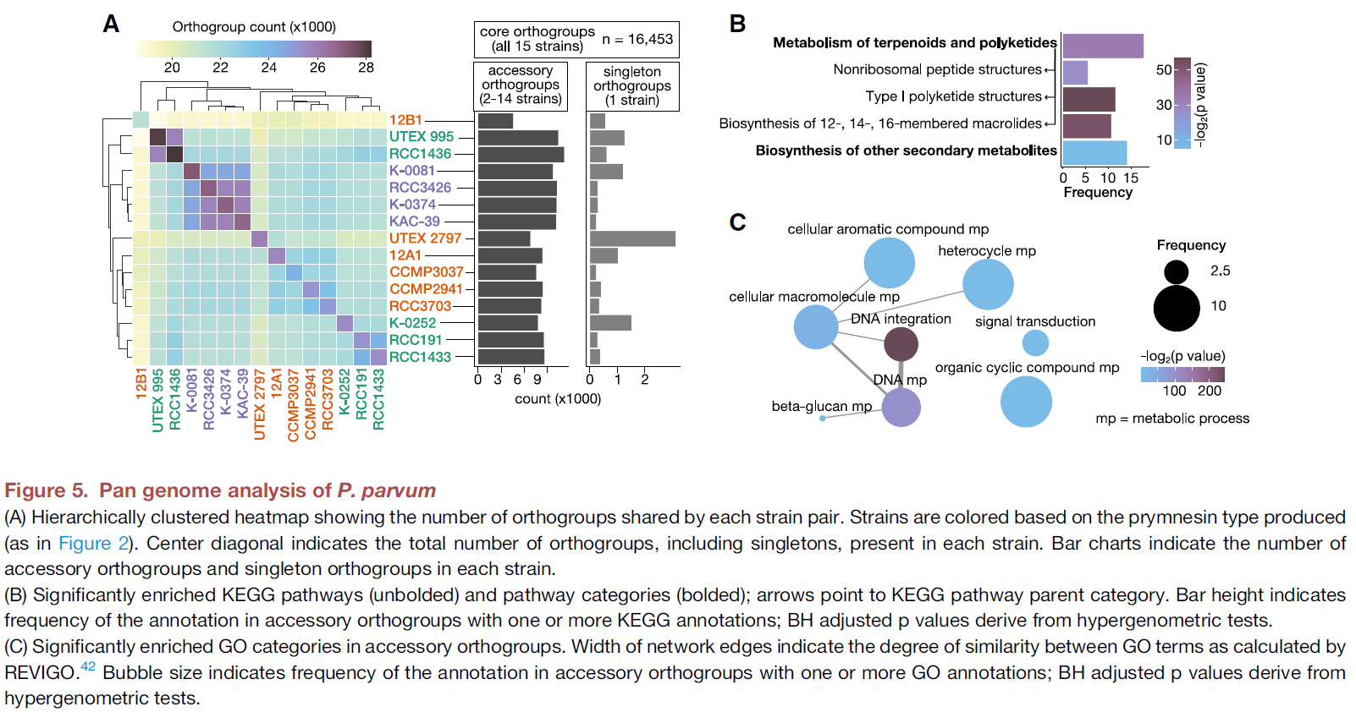
Pangenomes in eukaryotes?
…………….… and haptophyte Prymnesium parvum
Wisecaver et al. 2023

Slide 18
Directions of HGT
Prokaryota → Prokaryota (frequent, spread of antibiotic resistence led to discovery of HGT)
Eukaryota → Prokaryota (rare, limited by introns; e.g. genes for pro tubulin and aktin in bacteria)
Prokaryota → Eukaryota (e.g. endosymbiotic gene transfer)
Viruses Eukaryota
Eukaryota → Eukaryota (less common; more frequent in fungi)

Slide 19
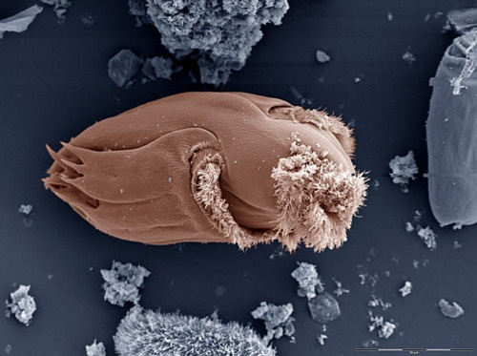
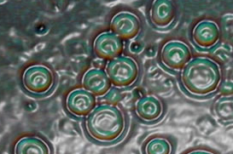
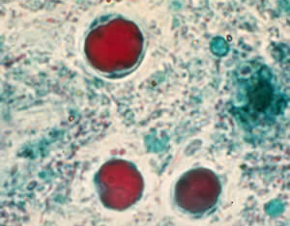
Adaptive function of bacterial genes
HGT is source of new adaptations
Ecologically specialised protists (anaerobic parasites, rumen ciliates, extremophiles) all have relatively number of HGT genes
But not only, marine diatom Phaedactylum tricornutum contains > 5% HGT genes.
Bachorový nálevník Ophryoscolex
Řasa Galdieria sulphuraria
Blastocystis hominis
Notes:
Geny pro fermentativní metabolizmus u anaerobů. D. discoideum získalo geny od půdních bakterií pro snadnější život v půdě (dipeptidázy pro degradaci stěn bakterií, proteiny pro transport železa anebo geny rezistence vůči půdním toxinům).

Slide 20
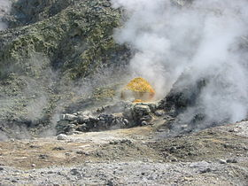
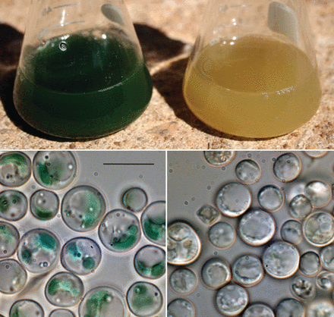
Galdieria sulphuraria
Extremophilic red alga (Cyanidiophyceae)
Flexible metabolism
Adaptation to extreme conditions also thanks to HGT (pH 0-4; temperature 56°C; high tolerance to toxic metals; HGT up to 5% genome)
Bacterial genes for various ion channels, membrane pumps
Less introns and higher GC content in these genes
Donors: extremophilic prokaryotes
Schönknecht et al. (2013)
Notes:
56°C je limit pro eukaryotický život. V těchto podínkách G. sulphuraria tvoří 90% eukaryotické biomasy. Horké sirné prameny, vulkanické oblasti. Bakteriální iontové kanály jí umožňují udržovat neutrální pH cytoplasmy, tolerovat vysokú salinitu a horko. HGT od extremofilních bakterií a archebakterií

Slide 21
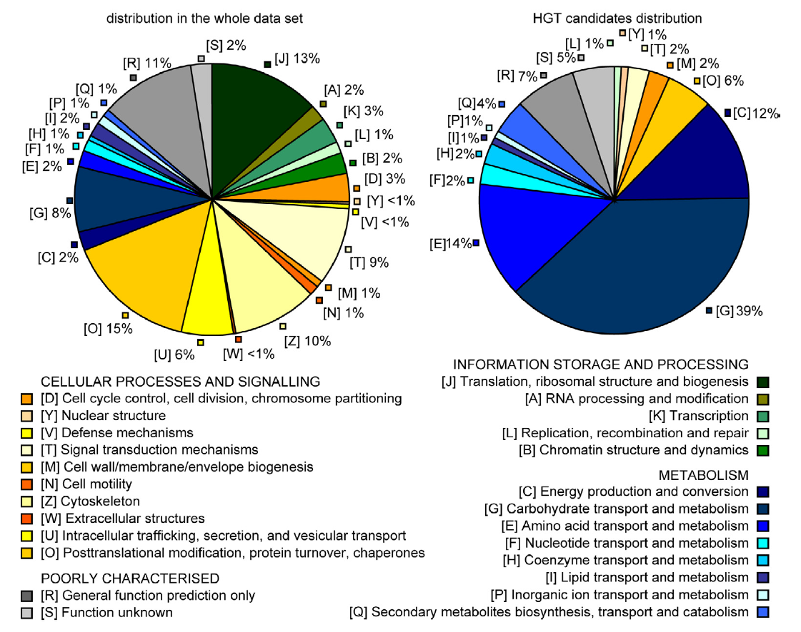
Bacterial genes in rumen ciliates
148 genů
Entodiniomorphida
(10 species)
Ricard 2006,
BMC genomics

Slide 22
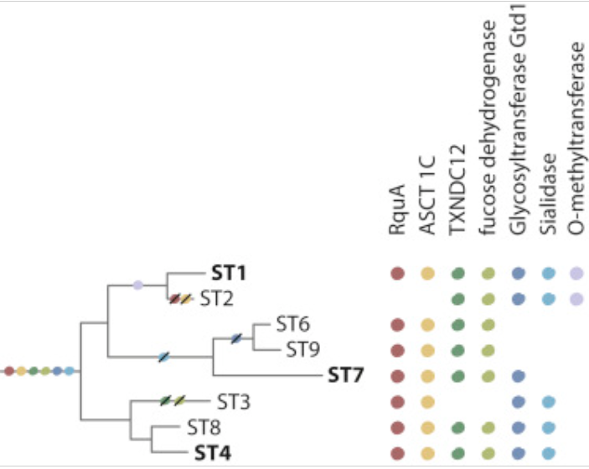
Topic of an essay

Slide 23
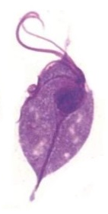
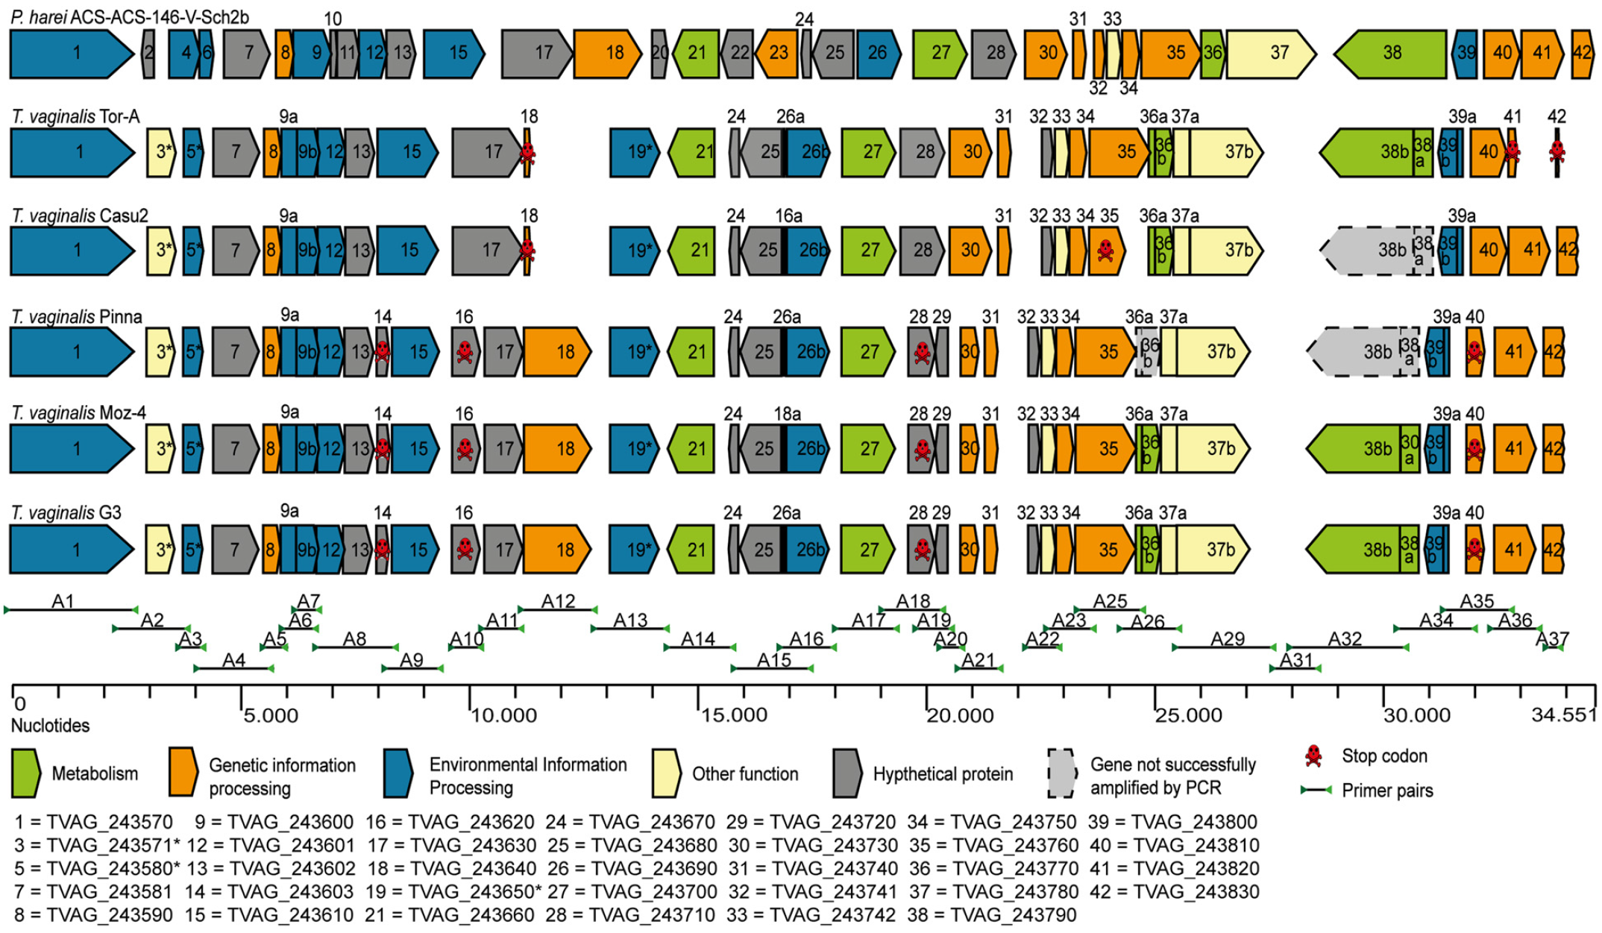
Trichomonas vaginalis Lateral gene transfer Fragment (TvLF)
Donor - Peptoniphilus harei
Strese et al. 2014
TvLF

Slide 24
Estimates of HGT gene counts originating in from prokaryotes
Etten 2020
Notes:
Počet kandidátů na HGT v genomech 12 parazitických protist varíruje od 3 do 149. Genomy Dictyostelium, Entamoeba a Leishmania mají nejvyšší poměr HGT ve vztahu k velikostí jejich genomů. Entamoeba a Dictyostelium aktivně fagocytují prokaryota, leishmanie se setkávají s bakteriemi ve střevě hmyzího přenašeče, co zvyšuje pravděpodobnost přenosu genů. Nejvyšší počet kandidátů na HGT celkově byl zjištěn u T. vaginalis.

Slide 25
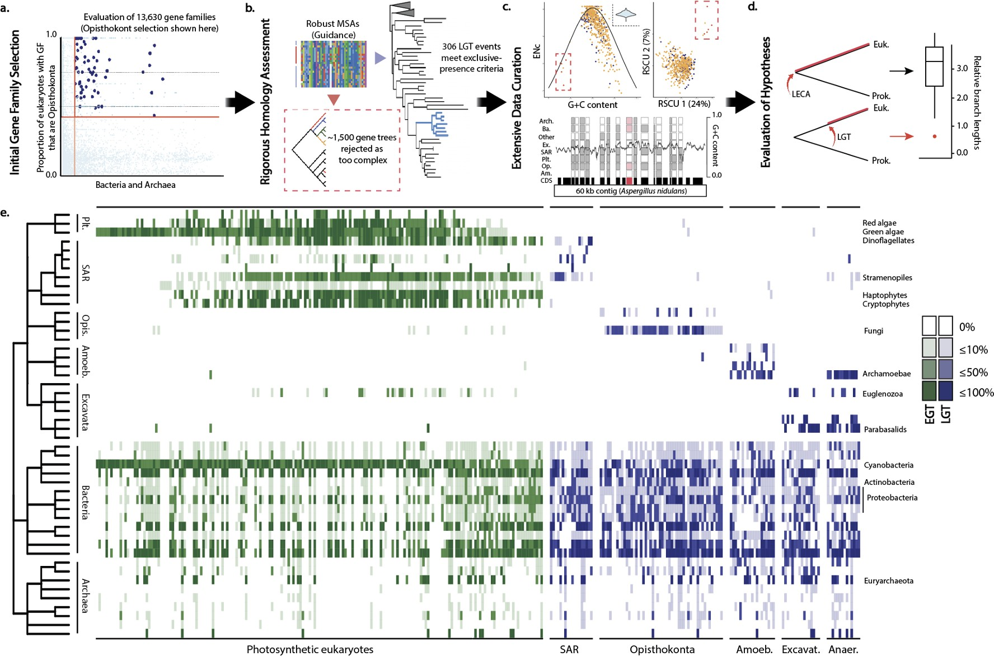
Estimates of HGT gene counts originating in from prokaryotes
306 clear examples of gene families undergoing HGT using a very strict methodology
from a total of 13 630 gene families (2.2%).
Cote-L’Heureux 2022

Slide 26
Directions of HGT
Prokaryota → Prokaryota (frequent, spread of antibiotic resistence led to discovery of HGT)
Eukaryota → Prokaryota (rare, limited by introns; e.g. genes for pro tubulin and aktin in bacteria)
Prokaryota → Eukaryota (e.g. endosymbiotic gene transfer)
Viruses Eukaryota
Eukaryota → Eukaryota (less common; more frequent in fungi)

Slide 27
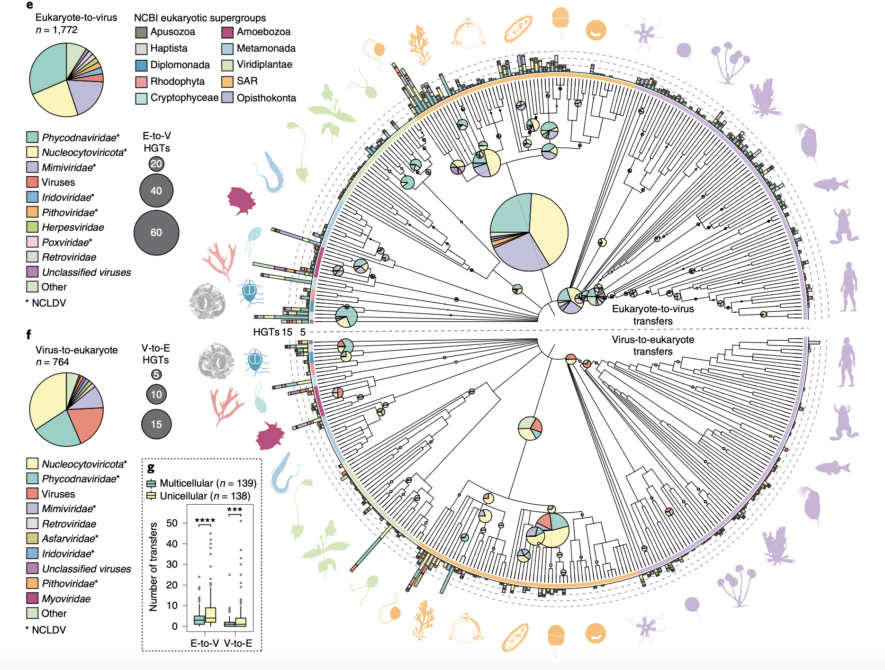
HGT between eukaryotes and viruses
Particularly to and from large nucleocytoplasmic large DNA viruses
Irwin et al. 2022

Slide 28
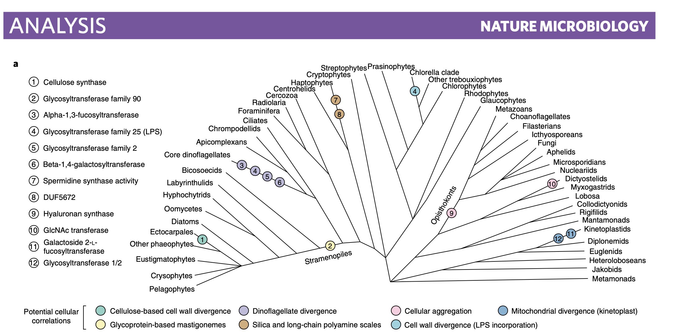
HGT between eukaryotes and viruses
Genes involved in nucleic acid binding and maintenance (DVNP) and enzymes modifying sugar surface molecules (see below)
Irwin et al. 2022

Slide 29
Directions of HGT
Prokaryota → Prokaryota (frequent, spread of antibiotic resistence led to discovery of HGT)
Eukaryota → Prokaryota (rare, limited by introns; e.g. genes for pro tubulin and aktin in bacteria)
Prokaryota → Eukaryota (e.g. endosymbiotic gene transfer)
Viruses Eukaryota
Eukaryota → Eukaryota (less common; more frequent in fungi)

Slide 30
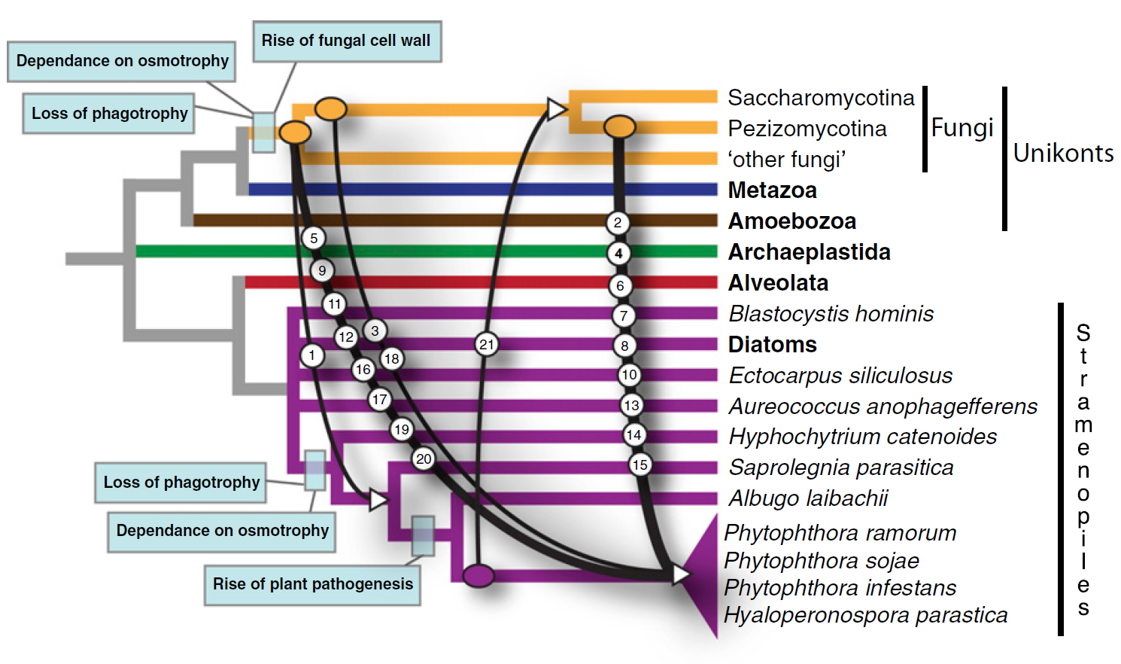
HGT of enzymes involved in plant parasitism between fungi and oomycetes
Richards a kol. 2011

Slide 31
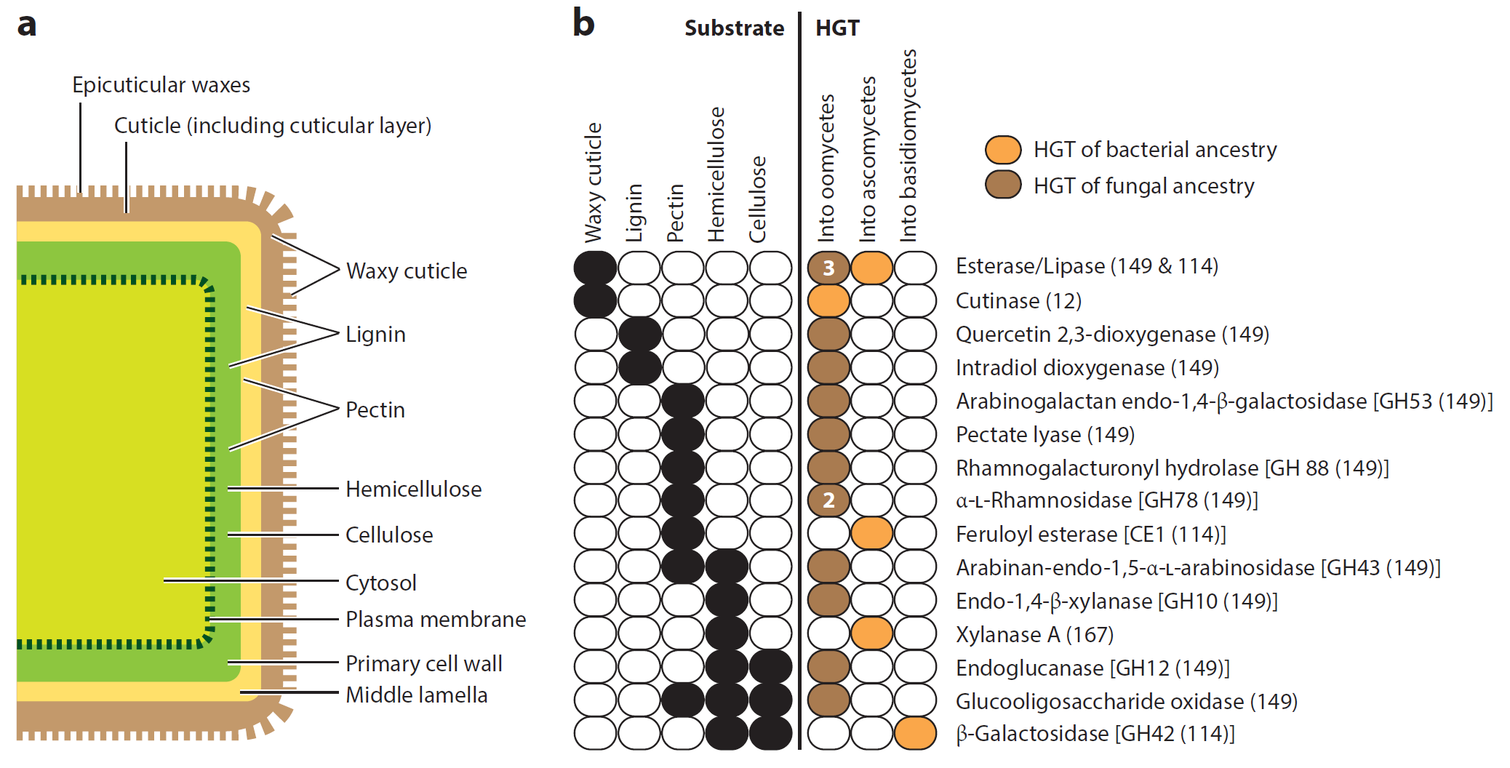
HGT namely enymes degrading the cell surface
Soanes a Richards 2014

Slide 32
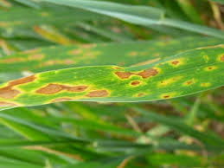
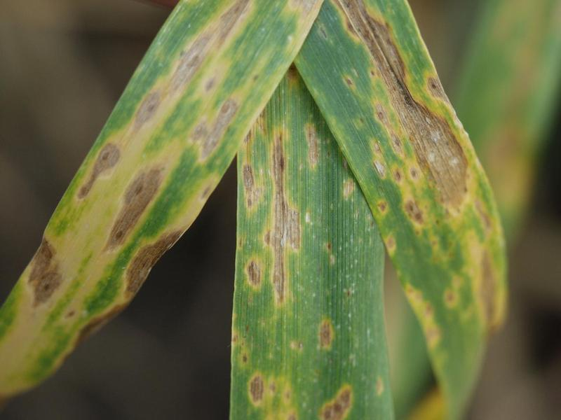
HGT and pathogen rise
Phaeosphaeria nodorum
Pyrenophora tritici-repentis
ToxA gen
(secretory toxin)
Friesen a kol. 2006, Nature Genetics

Slide 33
HGT between parasites and hosts
Corradi a kol. 2015

Slide 34
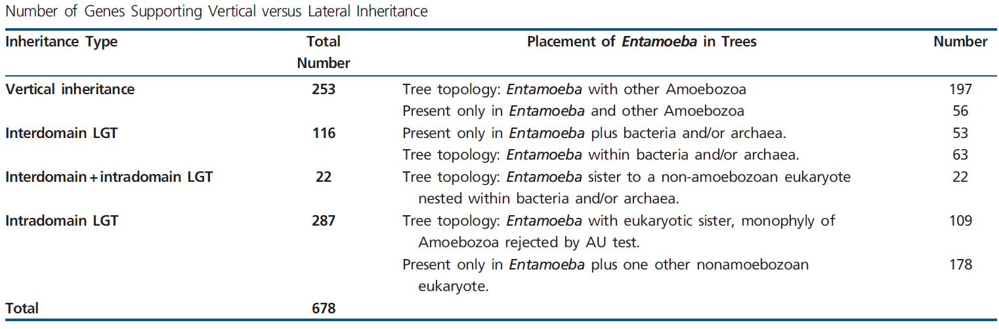
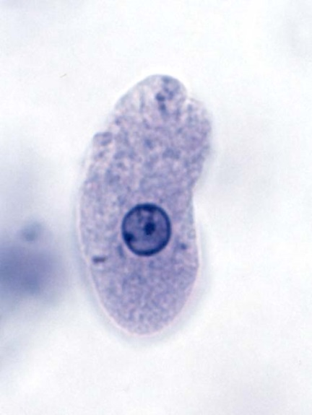

HGT within the anaerobic niche
BS > 80%
Grant a kol. 2014

Slide 35

PAUSE

Slide 36
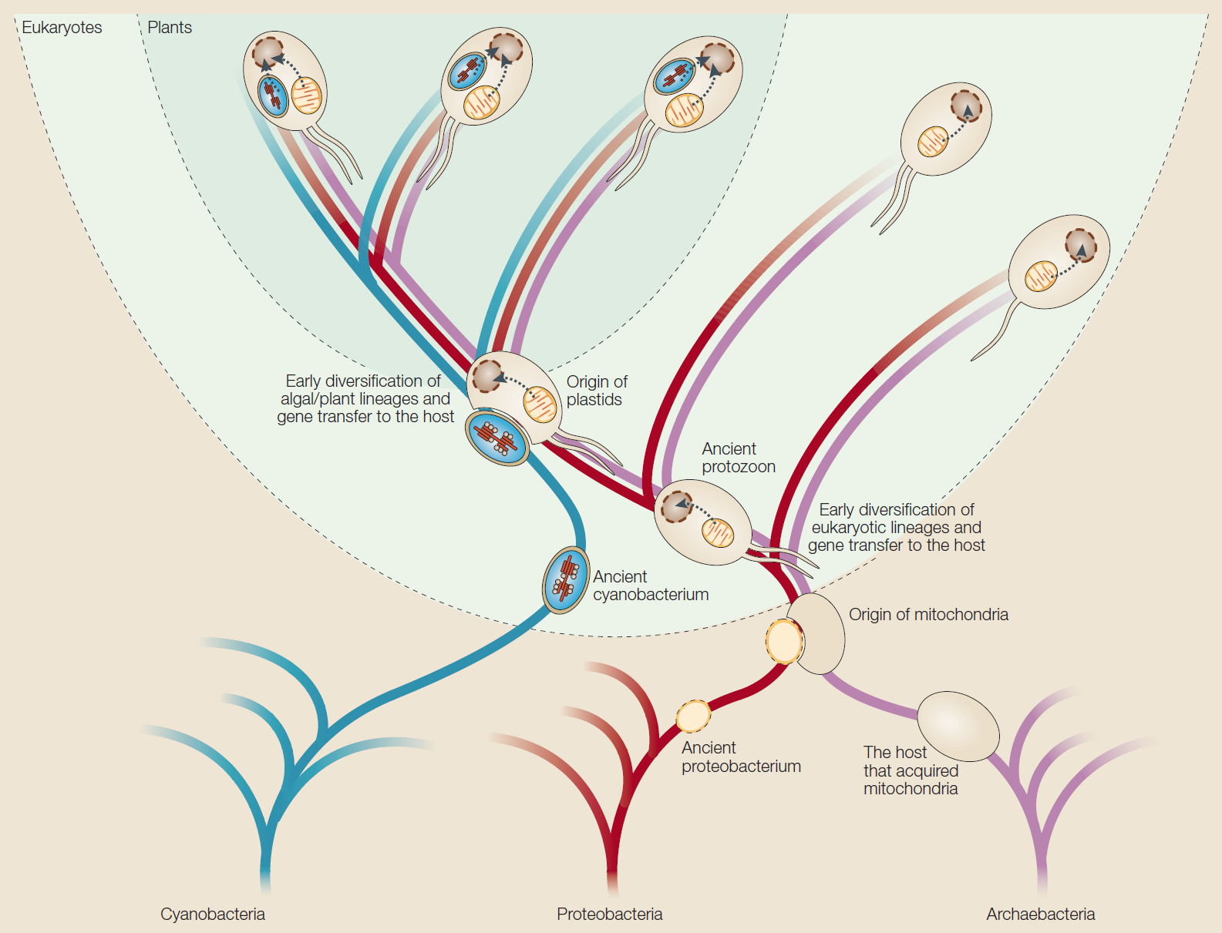
Endosymbiotic gene transfer
Timmis et al. (2004)
Notes:
Intracelulárni endosymbionti majú pôvod vo volne žijúcich prokaryotoch. Endosymbiózy dali vzniknúť dvom typicky eukaryotickým organelám a to mitochondriám a chloroplastom. MT vznikli a a-proteobaktérie a CP z cyanobaktérie. Obe endosymbiózy predstavujú kľúčové udalosti v procese eukaryogenézy. Existencia dvoch ďalších genetických kompartmentov okrem jadra činí eukaryotickú bunku jedinečnou.

Slide 37
Sizes and coding capacities of prokaryotic and organellar genomes
Cyanobakteria:
Synechocystis: 3573 kbp/ 3168 proteinů
Prochlorococcus marinus: 1660 kbp/ 1884
Nostoc punctiforme: 9000 kbp/ 7400
Algal plastids:
Porphyra purpurea: 191 kbp/ 200 proteinů
Cyanidium caldarium: 165 kbp/ 197
Guillardia theta: 122 kbp/ 148
Cyanophora paradoxa: 136 kbp/ 136
Odontella sinensis: 120 kbp/ 124
Euglena gracilis: 143 kbp/ 58
α-proteobakteria:
Caulobacter crescentus: 4017 kbp/ 3767 prot.
Mesorhizobium loti: 7596 kbp/ 7281
Bradyrhizobium japonicum: 9100 bp/ 8300
Protist mitochondria:
Andalucia godoyi: 68 kbp/ 68 proteinů
Malawimonas jakobiformis: 47 kbp/ 49
Naegleria gruberi: 50 kbp/ 46
Dictyostelium discoideum: 56 kbp/ 40
Plasmodium falciparum: 6 kbp/ 3
!Hydrogenosomy, mitosomy: 0 kbp/ 0
Timmis et al. (2004)
Notes:
Usídľovanie endosymbiontov sprevádzal masívny presun ich génov do hostitelského jadra. Niektoré MT genomy dosahujú skorej velkosti plasmidov jako prokaryotických genomov. Osekvenované plastidové genomy kódujú od 20 do 200 proteinov, MT genomy kódujú od 3 do 67 proteínov.

Slide 38
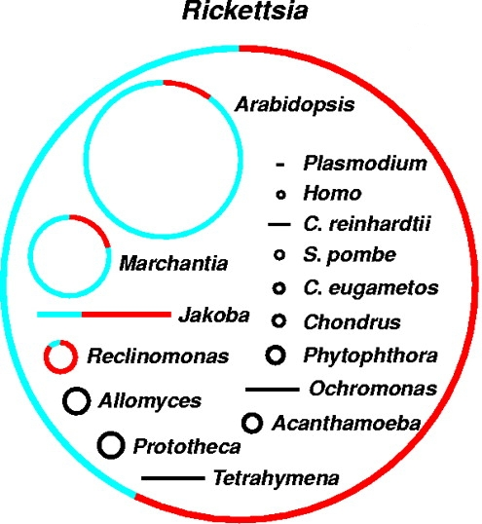
Mitochondrial genome
Underwent sheer reduction
Current α-proteobacteria
834 genes (parasitic Rickettsia), 4000 genes (Rhodospirillum)
Mitochondria
68-2 (0) genes, mostly 12-20
Andalucia
godoyi
Chromera
velia
Anaerobic homologues of mitochondria
Loss of genes –
Useless genes are flooded by mutations and gradually deleted.
Transfer to nucleus
(EGT) -
the process is ongoing 1 gene in 10⁵ generations in artificial system of in yeast S. cerevisiae.
In larger genomes are coding regions labeled red

Slide 39
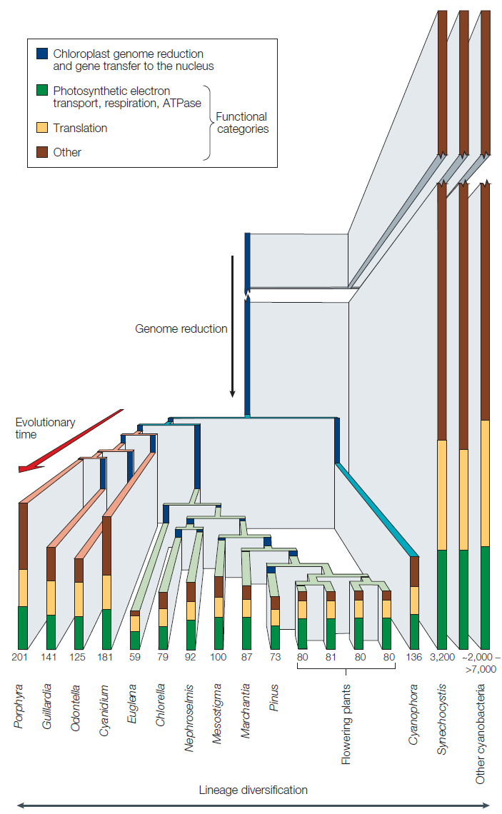
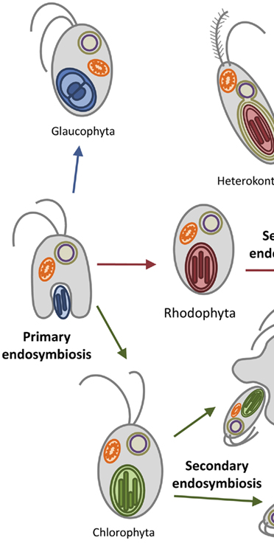
Plastid genome
Timmis et al. (2004)

Slide 40
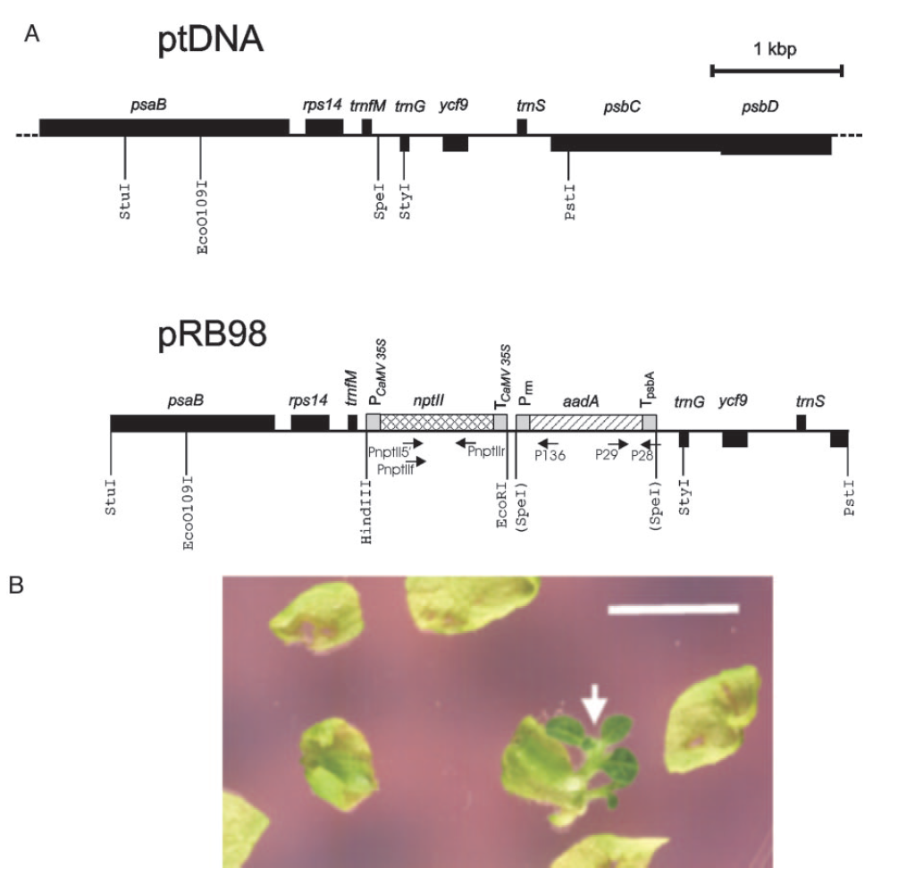
EGT is ongoing
Tobacco chloroplast
1 of 5 000 000 cells
(Stegemann a kol. 2003)
NUMT, NUPT
Yeast mitochondrion
~2 x 10⁻⁵ per generation (Thorsnes a Fox 1990)

Slide 41
NUMT, NUPT
More than 99% of individuals had at least one of 1,637 different NUMTs. De novo NUMTs were observed in the germline once in every 10⁴ births. (Weii et al 2022, Nature)
NUPTs
Makai 2015, PloS ONE

Slide 42
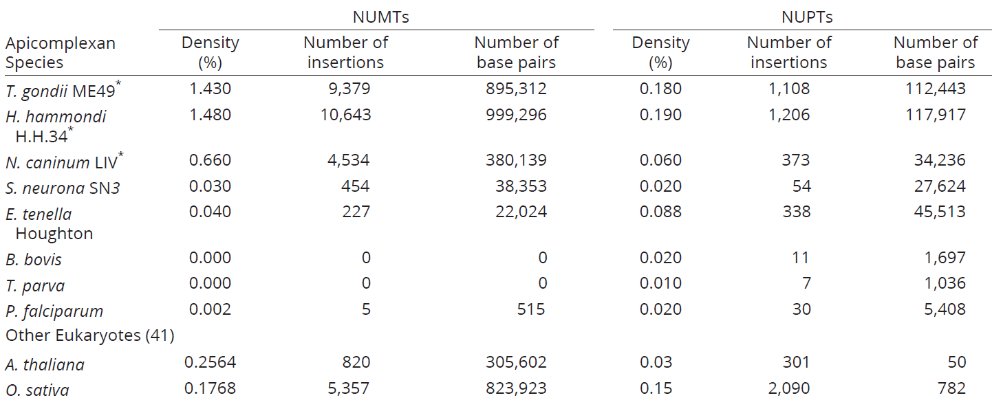
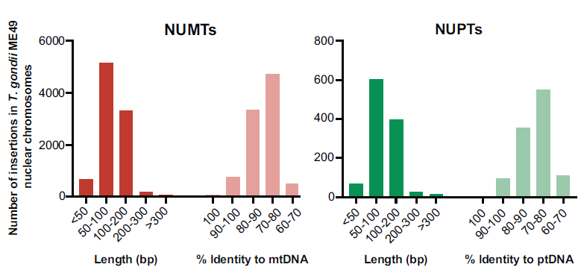
NUMTs and NUPTs (NUOTs) in coccidia
Most (>90%) of the NUOTs identified in T. gondii are 50–200 bp in length and approximately 60% of the identified NUOTs map to genic regions (introns and exons).
Namasivayam et al. 2023

Slide 43
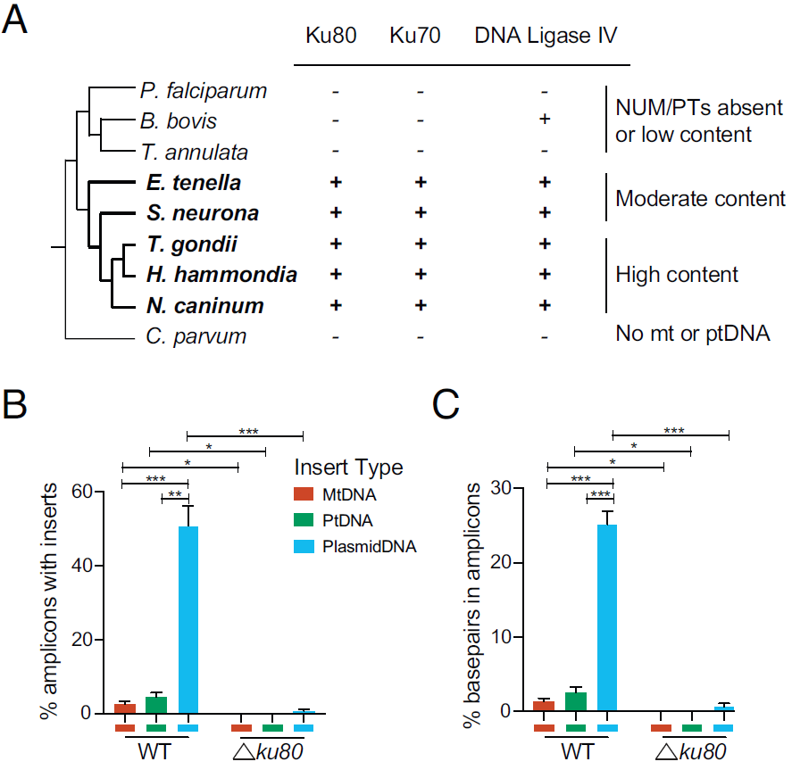
NUMT, NUPT in coccidia
It has been demonstrated that organellar DNA fragments can become integrated into the nuclear genome during double-strand break (DSB) repair via non-homologous end joining (NHEJ).
Apicomplexans that naturally lack the NHEJ machinery also contain very few organellar DNA fragments (A), suggesting that NHEJ is a prominent mechanism underlying NUOT integration in coccidian species.
CRISPR-Cas9 experiments with the knockdown of ku80 genes, involved in NHEJ, showed that less than 1% of the reads from the Δku80 parasites contained inserts, whereas such insertions were observed in ~58% of the amplicons from WT T. gondii (B, C). Most inserts were from CRISPR-Cas9
Plasmid, the organellar DNA followed.
Namasivayam et al. 2023

Slide 44
WHAT REMAINS IN THE mtGENOME?
Why Cox genes remain?
Difficult to import, risk of misstargeting
Regulatory role in situ (in the particular mitochondria)
Zíková et al. 2016

Slide 45
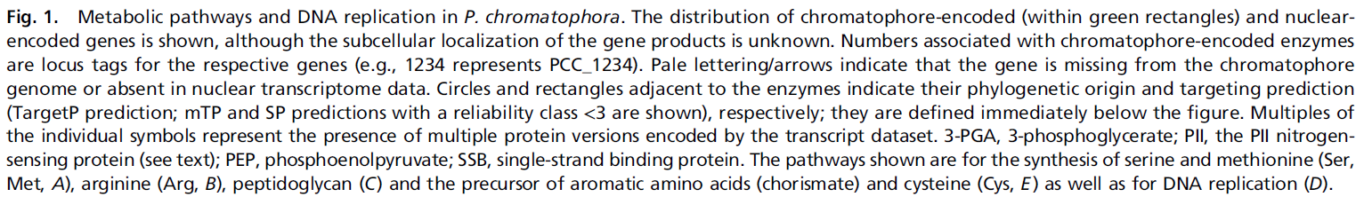
HGT compensates reduction of pl. genome
Nowack et al. 2016

Slide 46
HGT compensates reduction of pl. genome
Nowack et al. 2016

Slide 47
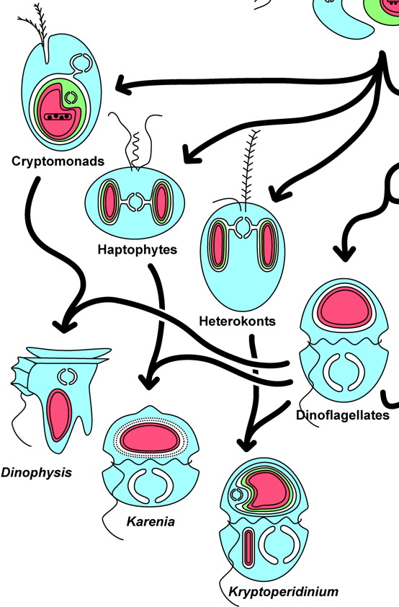
Gene content in plastid genome

Slide 48
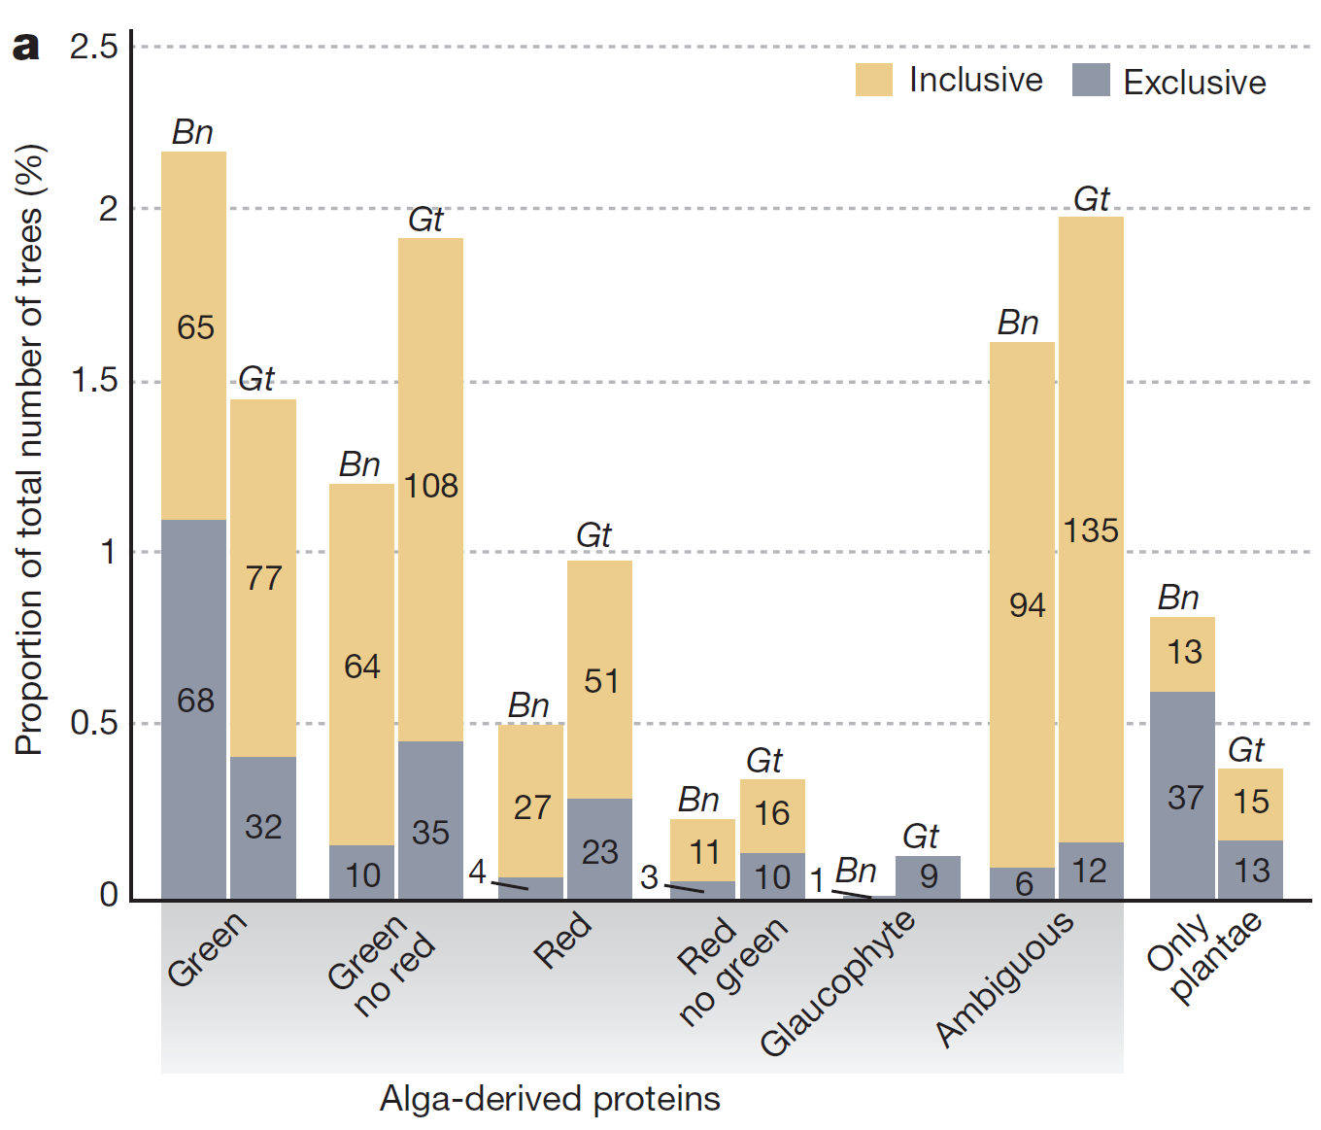

Shopping bag model
Origin of Bigeloviella natans (Bn) and Guillardia theta (Gt) proteins
Curtis a kol. 2012, Nature

Slide 49
Secondary plastids - euglenids
Phylogenetic origin of E. gracilis proteins
572/4087 = 14%
Ebenezer et al. 2019, BMC Biology

Slide 50
Secondary plastids- euglenids
Phylogenetic origin of E. gracilis plastid proteins
95/416 = 22%
Novak Vanclova et al. 2020 , New phytologist

Slide 51
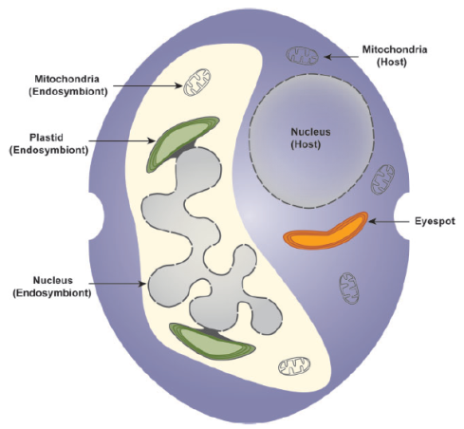
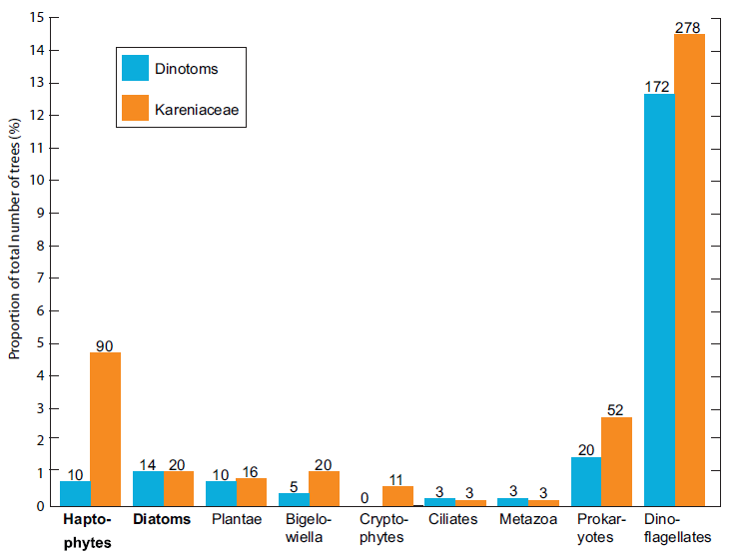
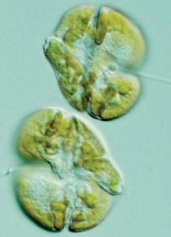
Terciary plastids - dinos
Burki a kol. 2014
5%
Taxonomic affinities in dinotoms and kareniaceans. A bar chart shows the proportion of genes corresponding to the sorted tree clusters and their inferred origin; bar height is relative to the total number of sorted trees for dinotoms and kareniaceans, and the raw counts of tree clusters are indicated on the bars. Trees not counted here include uninformative trees with respect to the sorting criteria.

Slide 52
Fraction of HGT gene in genomes
Tens of percents in bacteria
< 1% in protist genomes, not counting EGT
? % genes from primary endosymbioses, could be >10% (very hard to infer as these events are ancient)
<10% genes from secondary and higher endosymbioses

Slide 53


Literature
Topics of essays: Cases of HGT in protists
knihy Horizontal Gene Transfer (Genomes in Flux), 2009.
a Lateral Gene Transfer in Evolution, 2013.
Keeling PJ, Palmer JD. Horizontal gene transfer in eukaryotic evolution. Nat Rev Genet. 2008 Aug;9(8):605-18.
Alsmark C, Foster PG, Sicheritz-Ponten T, Nakjang S, Embley TM, Hirt RP. Patterns of prokaryotic lateral gene transfers affecting parasitic microbial eukaryotes. Genome Biol. 2013 Feb 25;14(2):R19.
Andersson JO. Gene transfer and diversification of microbial eukaryotes. Annu Rev Microbiol. 2009;63:177-93.

Slide 54
HGTs and evolutionary transitions
MICROSPORIDIA
Acquisition of ATP transporters in the cytoplasmic membrane of microsporidia =>Emergence of energy parasitism

