Slide 1
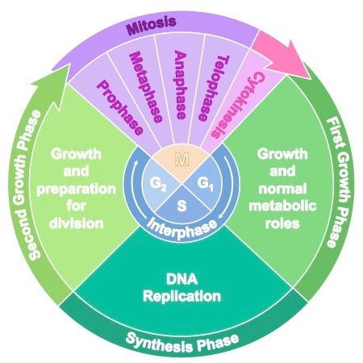
Cycles in protist cells
Life cycle
Cell cycle
Flagellar cycle
Sexual cycle
Parasexual cycle

Slide 2
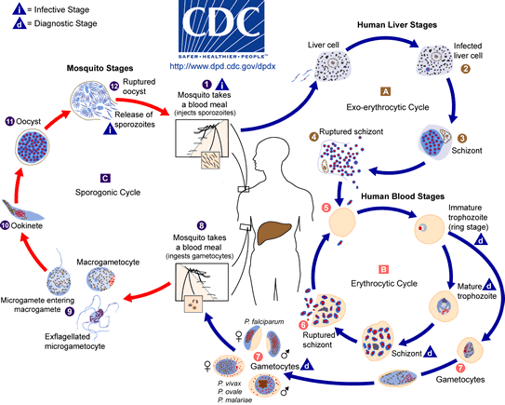
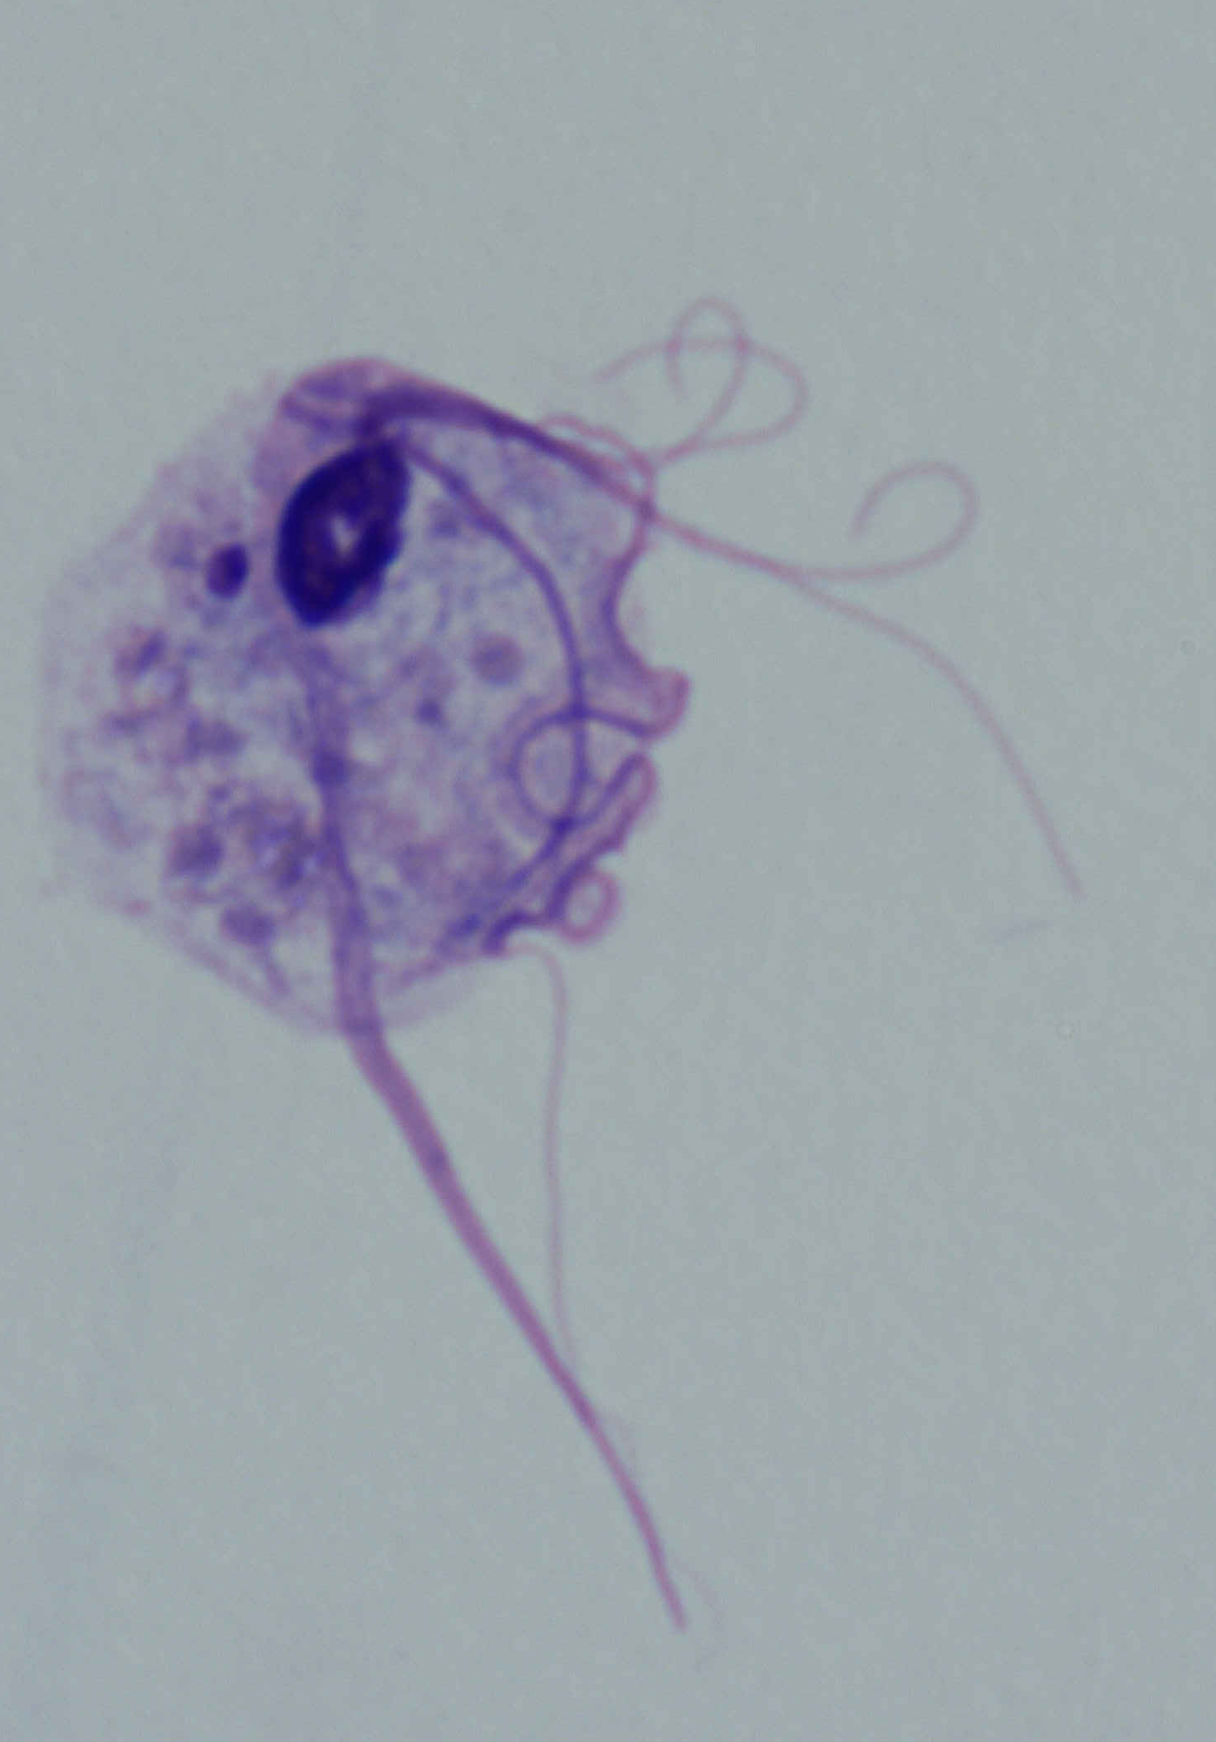
Life cycle
Cell differentiation occurs

Slide 3
Trichomonas tenax (Honigberg BM & Lee, 1959, Am J Hyg 69: 177-201)

Slide 4
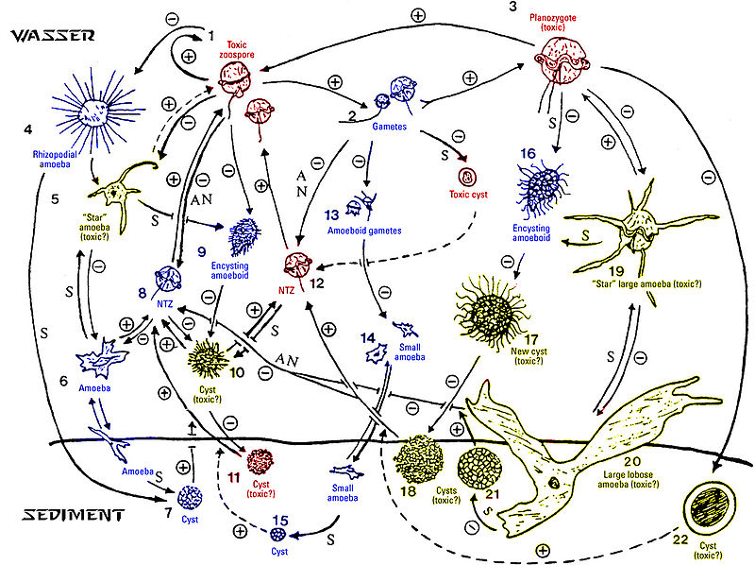
Pfiesteria piscicida

Slide 5
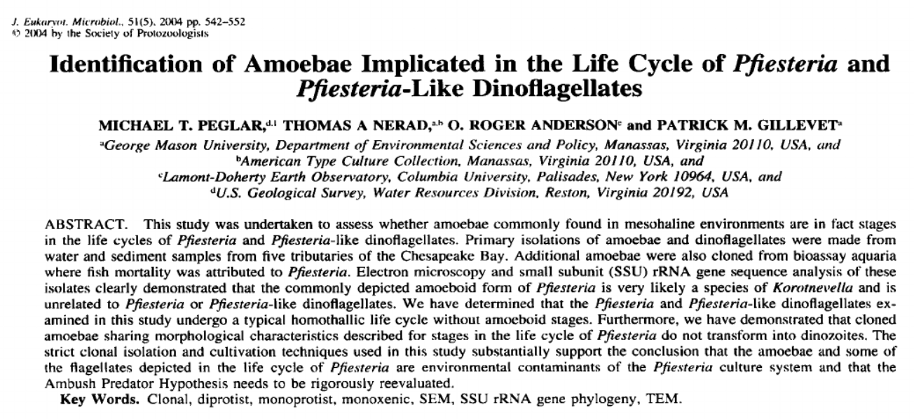
Pfiesteria piscicida

Slide 6
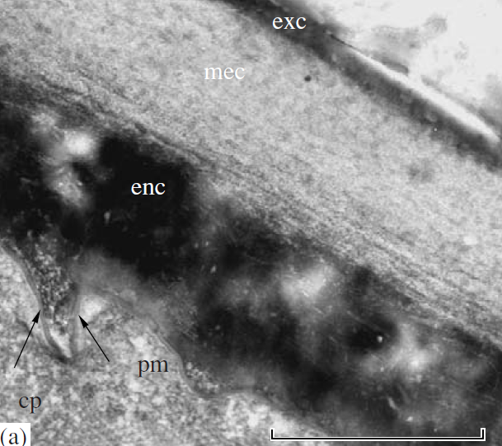
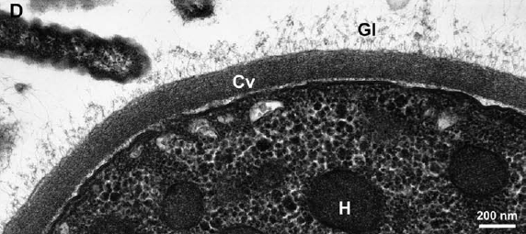
Cysts
An example of cell differentiation in unicellular organisms
Pelomyxa palustris
(Archamoebae)
Honigbergiella ruminantium
(Parabasalia)

Slide 7
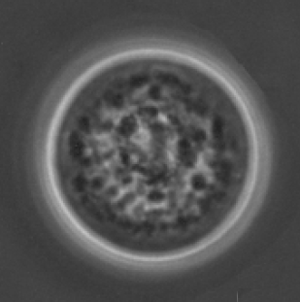
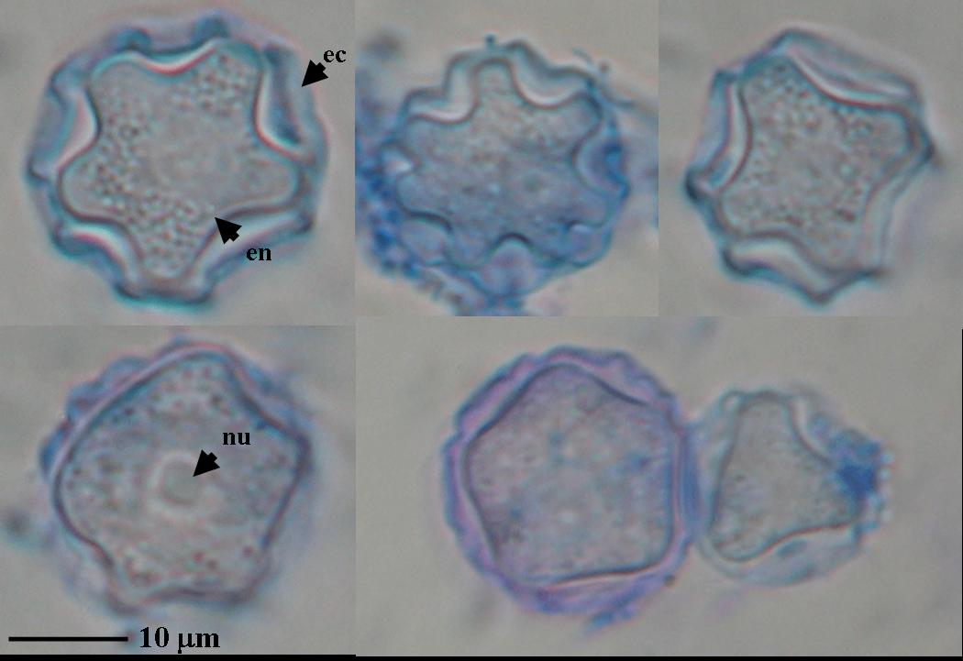
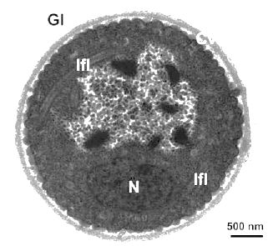
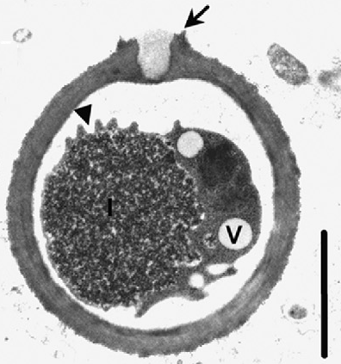
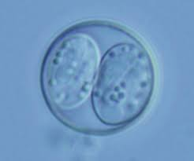
Solumitrus
(Heterolobosea)
Acanthamoeba
(Amoebozoa)
Toxoplasma
(Apicomplexa)
Honigbergiella
(Parabasalia)
Tulamoeba
(Heterolobosea)

Slide 8
The cyst stage
Survives unfavorable conditions (including that outside the host)
Sometimes multiplication within the cyst occurs
Cyst wall (ECM) is composed of polysaccharides, proteins, or their combinations
Cyst wall material is transported to the cell surface via Golgi vesicles
Cyst is formed in various phases of the life cycle
Various stimuli for encystation and excystation
Environmental pool of cysts, recolonization after favorable conditions are restored (in laboratory cultures as well)

Slide 9
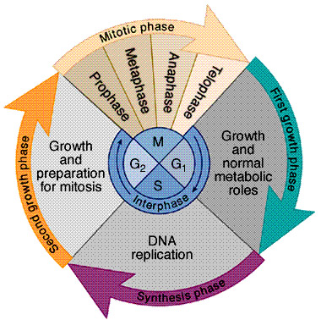
Cell cycle
Complex regulation, reacts to both outer and inner stimuli (cyklins, CDK, MAPK…)
Checkpoints (G₁/S, G₂/M, Met/Ana)
Some checkpoint are missing in some protists
Synchronization of the cell cycle for research purposes

Slide 10
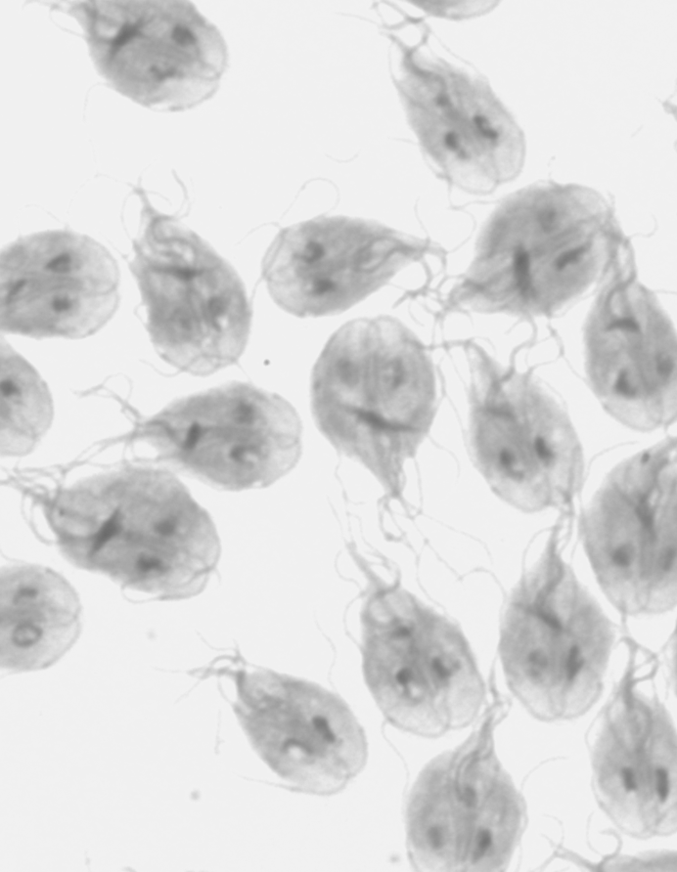
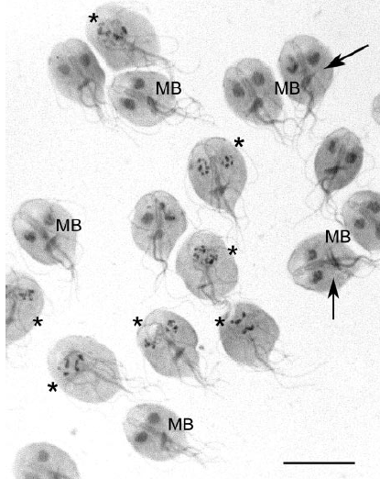
“half-synchronized” Giardia
Nohýnková E et al. (2006) Eukaryot Cell 5: 753-761

Slide 11
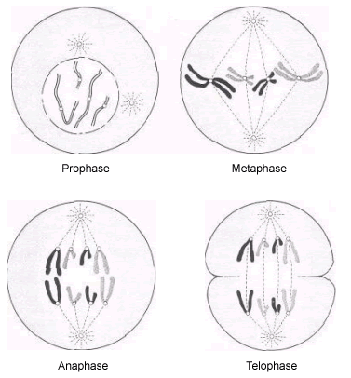
Mitosis

Slide 12
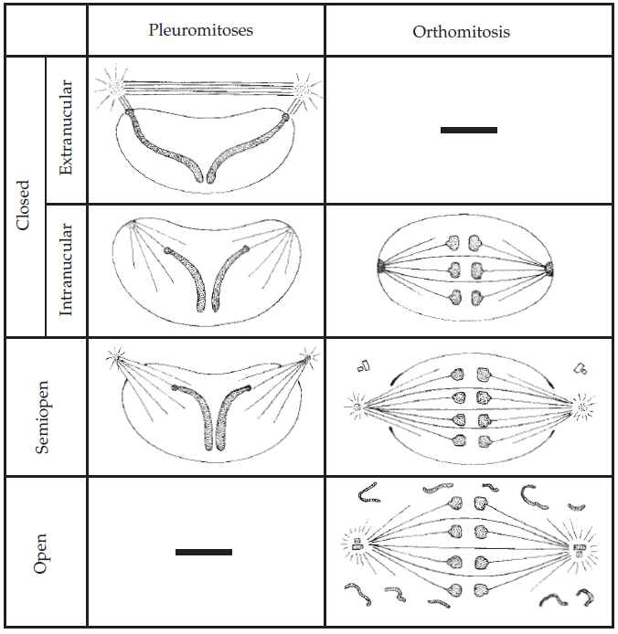
Mitóza
Parabasalia
Dinoflagellata
Euglenozoa
Foraminifera
Ciliophora MiN
Apicomplexa
Giardia
Stramenopiles

Slide 13
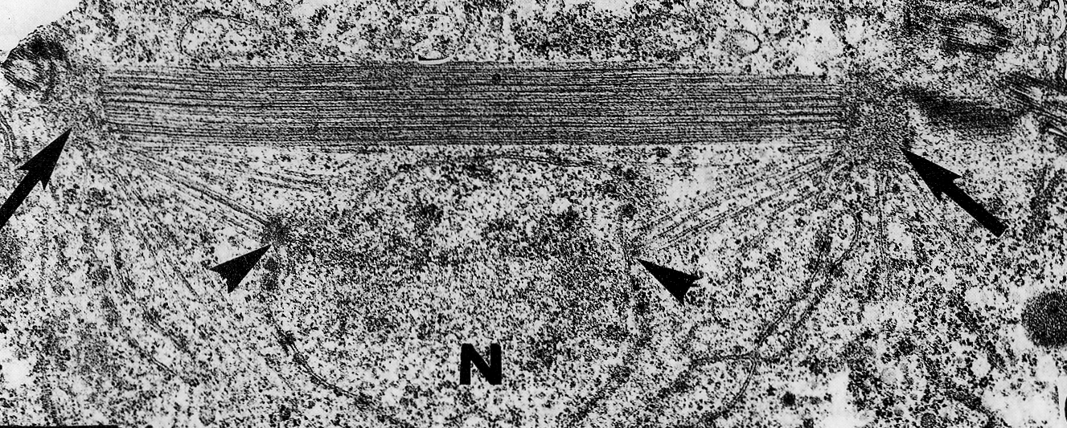

Slide 14
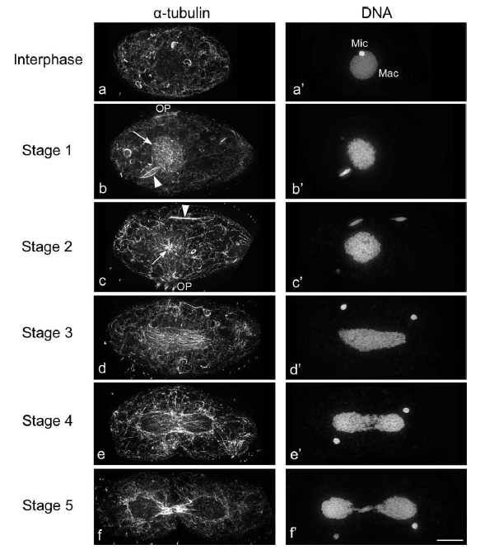
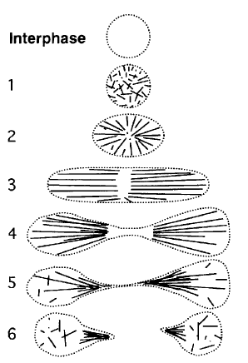
“Amitosis”
Kushida Y et al. (2011) Cytoskeleton 68: 68-89

Slide 15
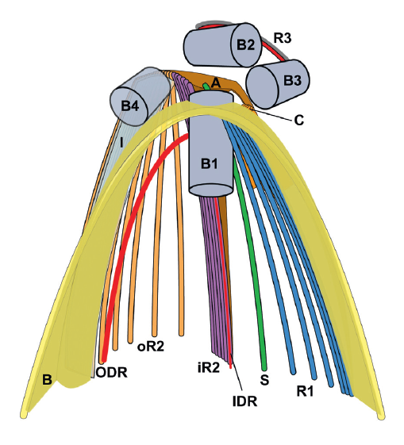
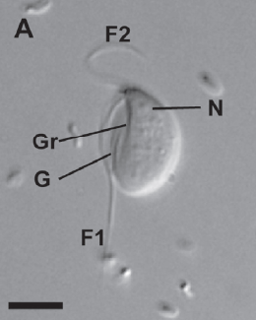
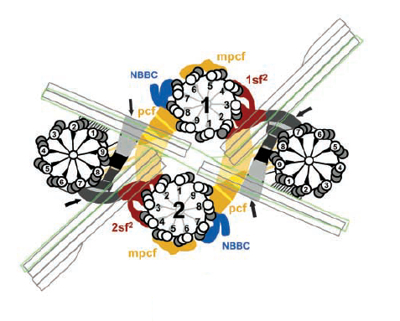
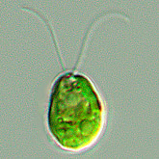
Flagellar cycle
(eukaryotic cells are chiral!)
Kipferlia (Excavata: Metamonada)
Chlamydomonas (Archaeplastida: Viridiplantae)

Slide 16
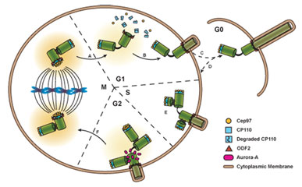
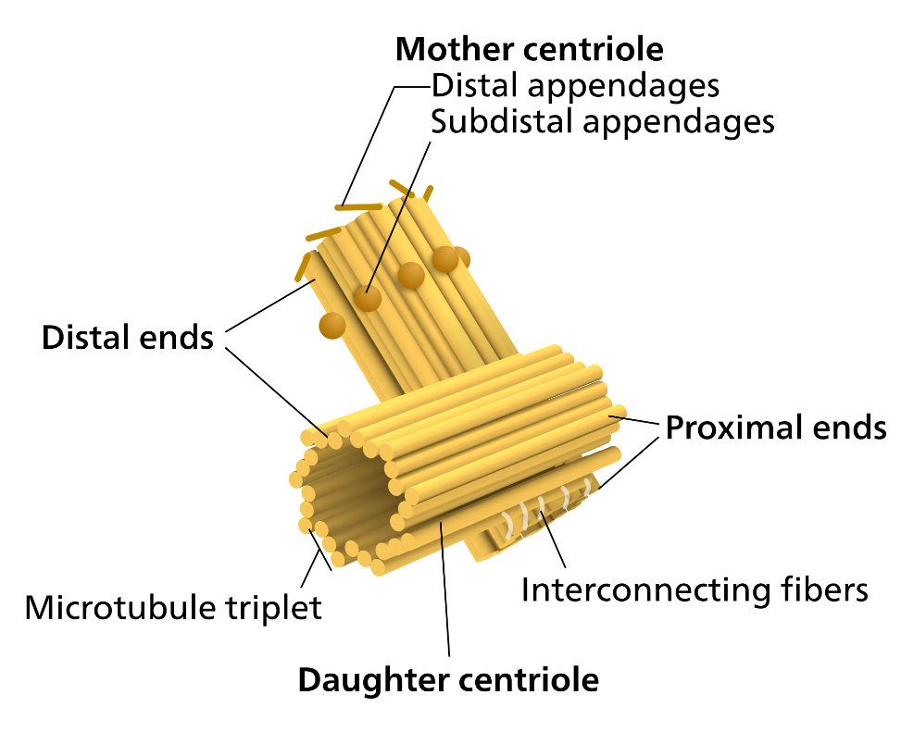

Slide 17
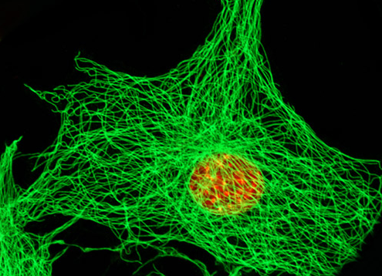
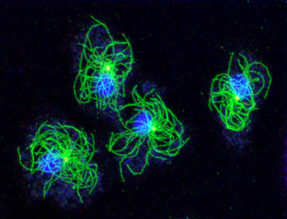
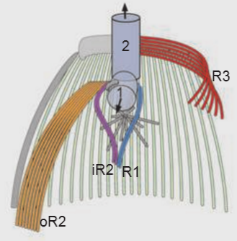
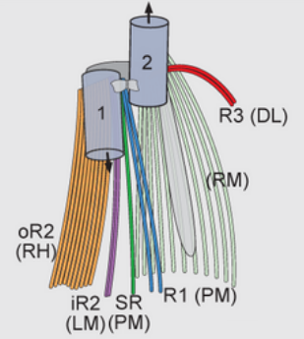
http://fluoview.magnet.fsu.edu/gallery/cells/gelu/gelularge1.html
http://dictybase.org/Multimedia/Graef/Dicty_tubulin_centrosomS1.jpg
Metazoa Amoebozoa
Apusozoa Amoebozoa
Yubuki & Leander (2013)

Slide 18
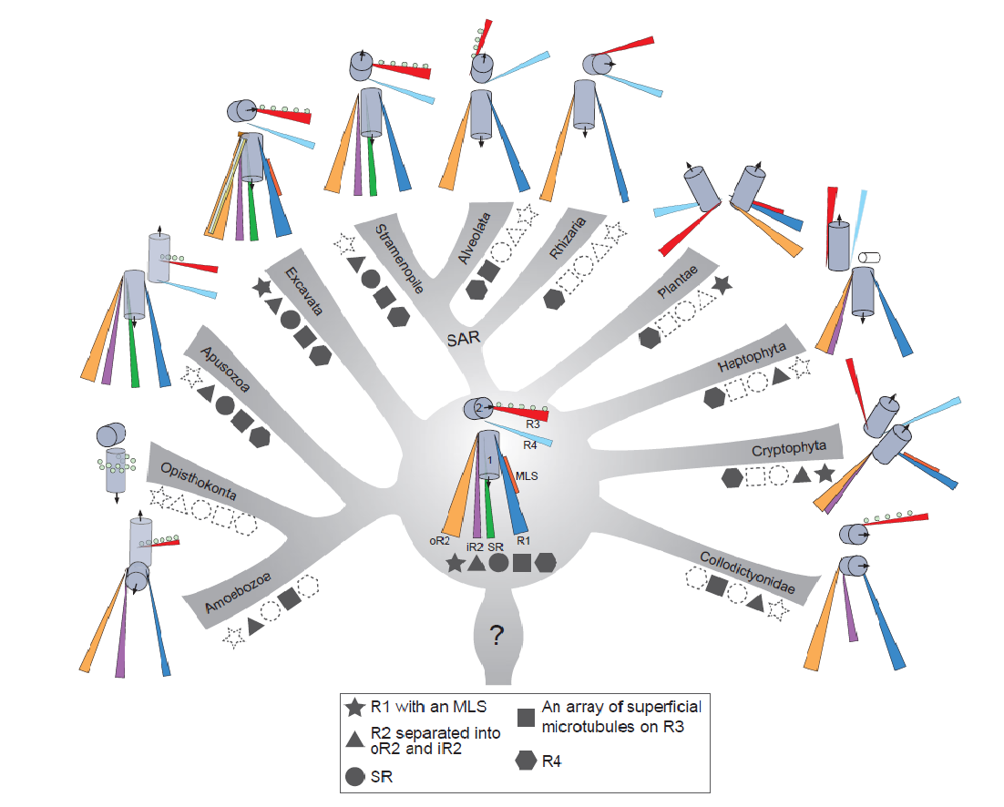
Evolution of microtubule organizing centers across the tree of eukaryotes
The Plant Journal
Volume 75, Issue 2, pages 230-244, 22 MAR 2013 DOI: 10.1111/tpj.12145
http://onlinelibrary.wiley.com/doi/10.1111/tpj.12145/full#tpj12145-fig-0007
Notes:
Illustrations of the inferred ancestral traits for the flagellar apparatus in all 11 eukaryotic groups mapped onto a modern molecular phylogenetic context. The five traits mapped onto the tree are represented by different shapes: microtubule root 1 (R1) with a multilayered structure (MLS), R2 involved with phagotrophy, R3 with an array of superficial microtubules, a singlet root (SR) that helps support the ventral feeding groove and R4. Solid shapes refer to the presence of a trait; dashed outlines of shapes refer to the loss of a trait. The inferred ancestral flagellar apparatus for the most recent ancestor of eukaryotes is best represented by the traits found in typical excavates. The most recent common ancestor of the Apusozoa, Opisthokonta and Amoebozoa lost an MLS on R1; R4 was lost in the most recent common ancestor of the Opisthokonta and Amoebozoa. An MLS on R1 was also lost in the most recent common ancestor of the SAR (Stramenopiles, Alveolata and Rhizaria) clade.
© This slide is made available for non-commercial use only. Please note that permission may be required for re-use of images in which the copyright is owned by a third party.

Slide 19
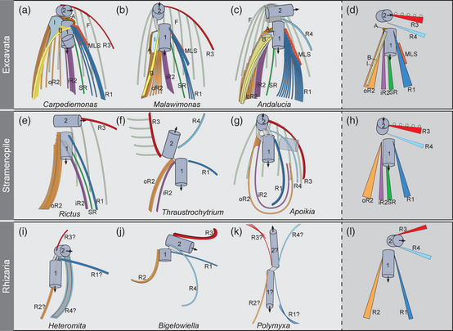

Slide 20
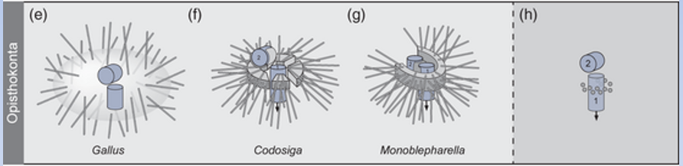
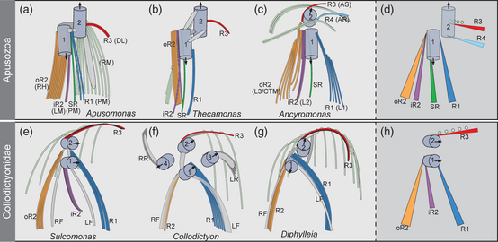

Slide 21
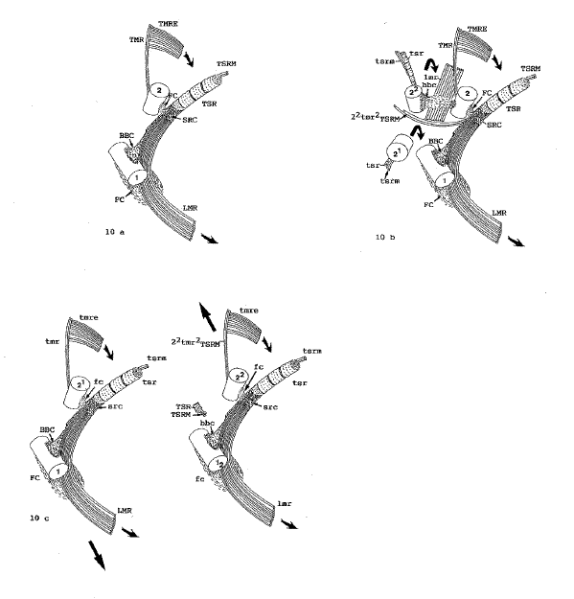
Heimann K et al. (1995)
Phycologia 34: 323-335
Prorocentrum

Slide 22
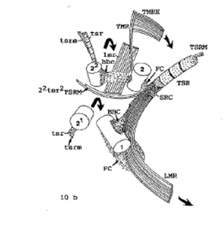
Heimann K et al. (1995)
Phycologia 34: 323-335
Prorocentrum

Slide 23
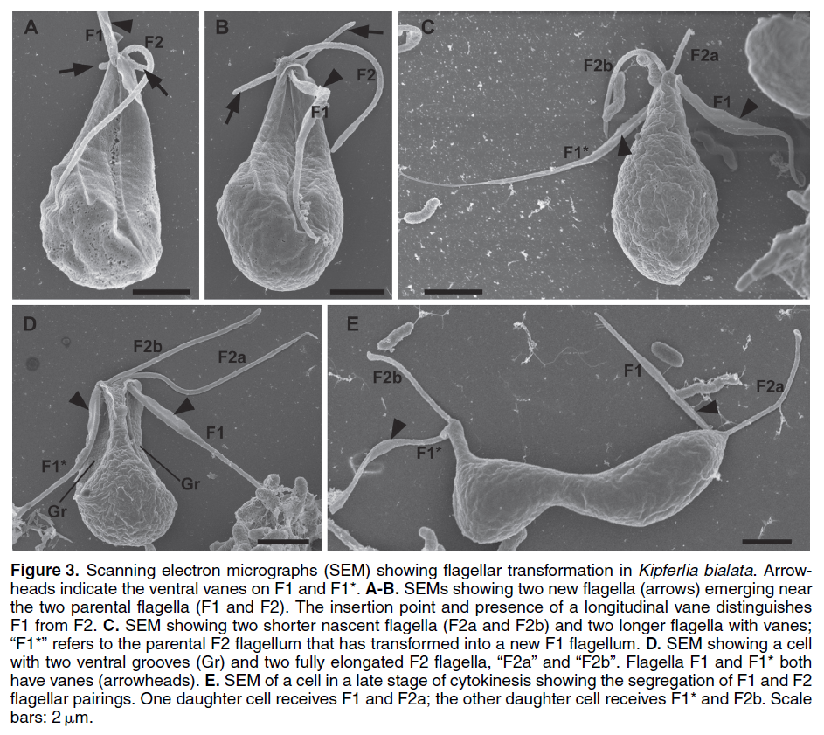
Yubuki N et al. (2013) Protist 164: 423-439

Slide 24
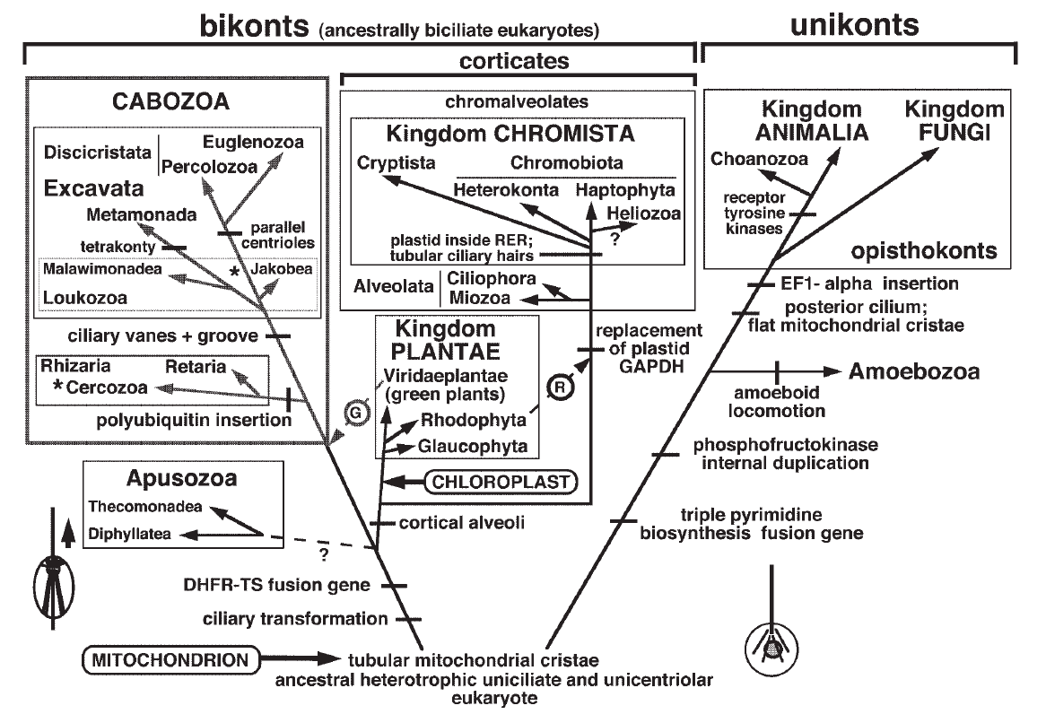
Ciliary/flagellar transformation
Cavalier-Smith T (2003) Eur J Protistol 39: 338-348

Slide 25
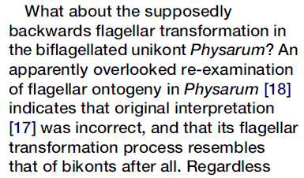
Roger AJ, Simpson AGB (2009) Curr Biol 19: R165-R167

Slide 26
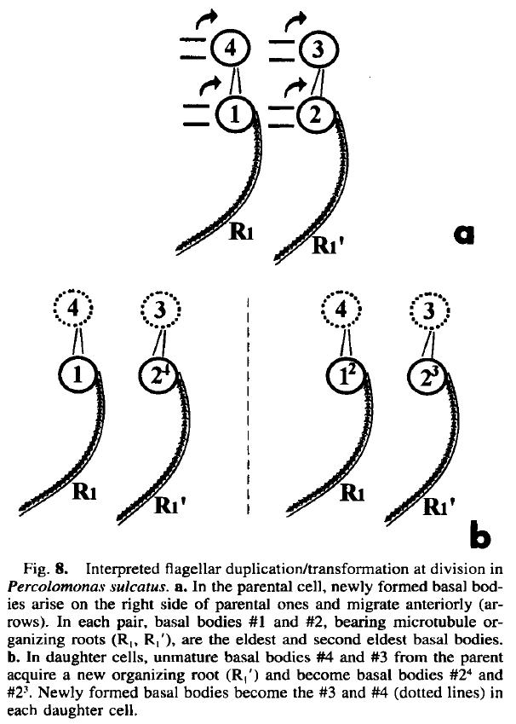
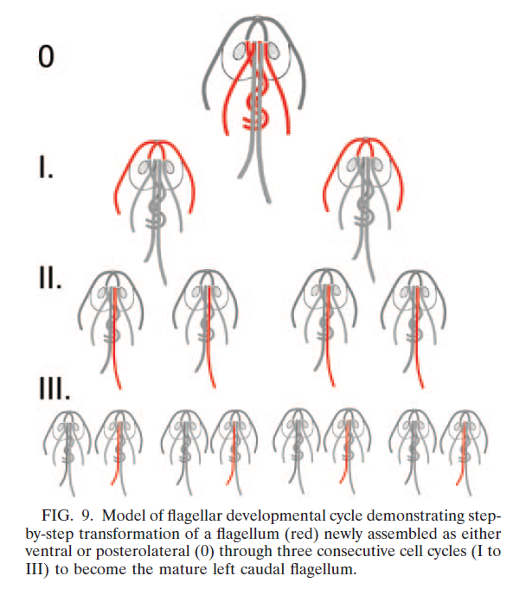
Ciliary/flagellar transformation
Brugerolle G & Simpson AGB (2004)
J Eukaryot Microbiol 51: 96-107
Nohýnková E et al. (2006) Eukaryot Cell 5: 753-761

Slide 27
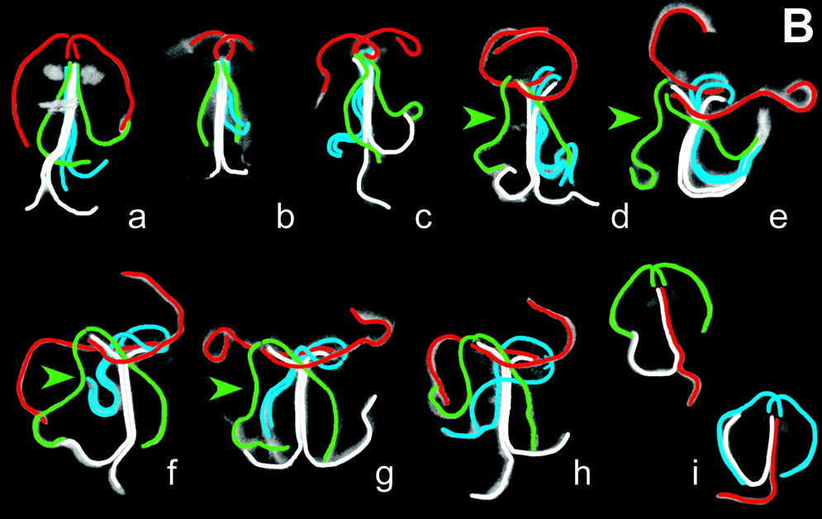
Giardia intestinalis
Nohýnková E et al. (2006) Eukaryot Cell 5: 753-761

Slide 28
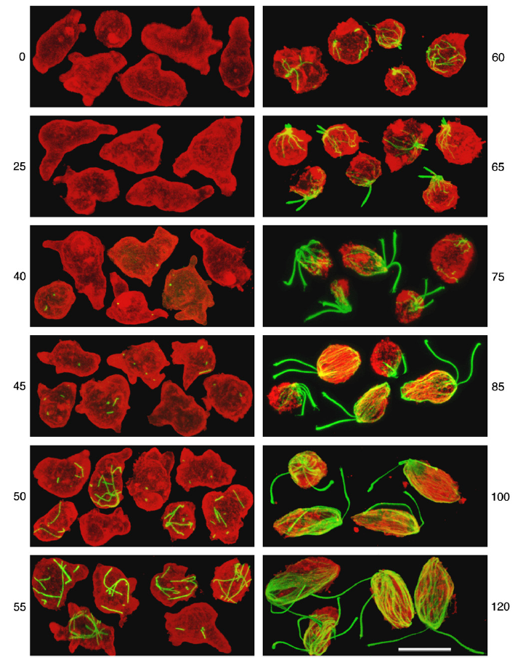
Naegleria pringsheimi
Walsh CJ (2007) Eur J Cell Biol 86: 85-98

Slide 29
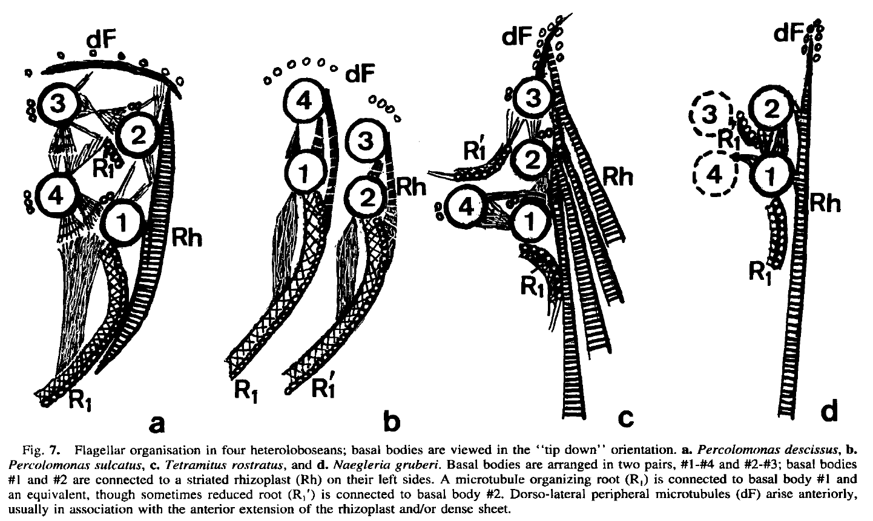
Brugerolle G & Simpson AGB (2004) J Eukaryot Microbiol 51: 96-107

Slide 30
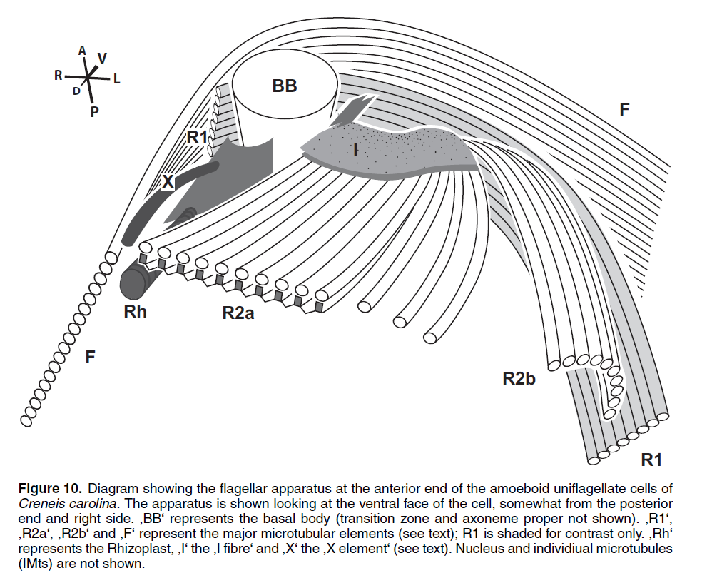
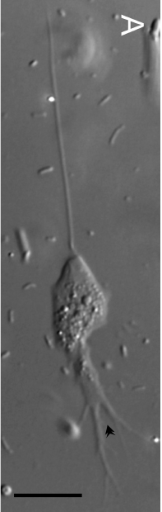
Creneis carolina (Excavata: Heterolobosea)
Pánek T et al. (2014) Protist 165: 542-567

Slide 31
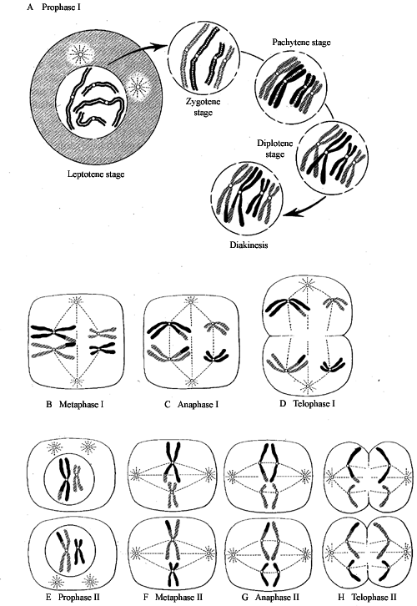
Sexual process
An important novelty of eukaryotes (it was already present in LECA)
Meiosis and syngamy, alternation of haploid and diploid (or x and 2x) phases (different length of those in different organisms)
Both advantageous and disadvantageous
Is sex ubiquitos? … no, but almost

Slide 32
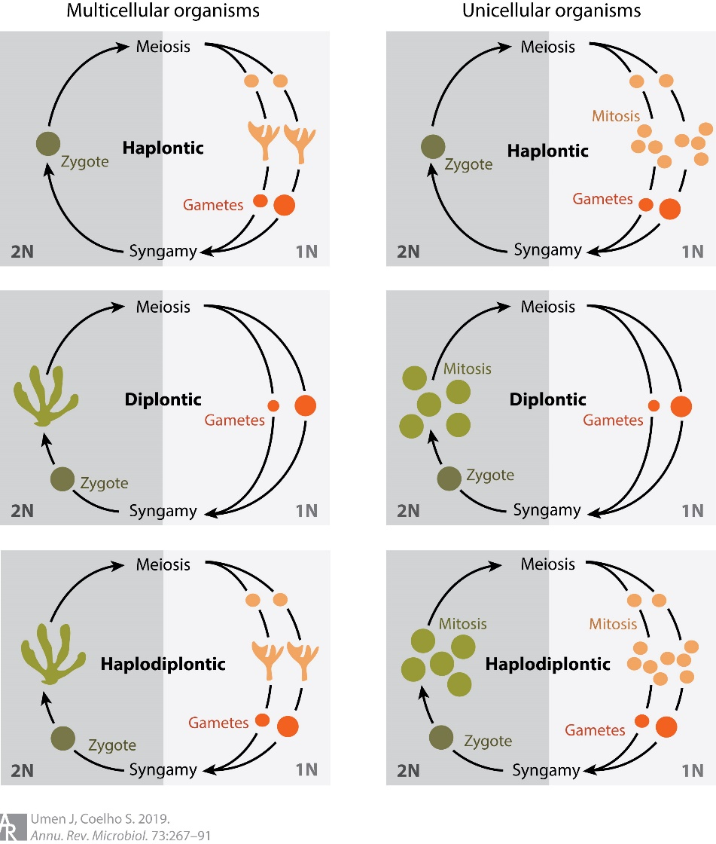
Sexual process
An important novelty of eukaryotes (it was already present in LECA)
Meiosis and syngamy, alternation of haploid and diploid (or x and 2x) phases (different length of those in different organisms)
Both advantageous and disadvantageous
Is sex ubiquitos? … no, but almost

Slide 33
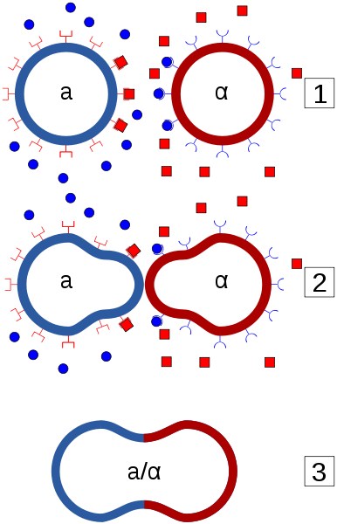
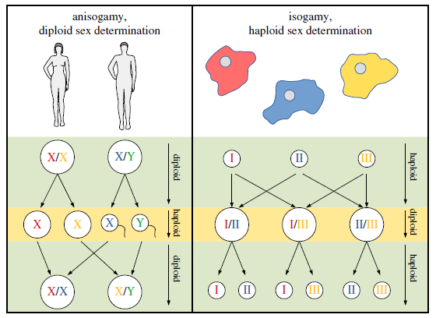
Mating types (pohlavní typy)

Slide 34



Isogamy vs. anisogamy (vs. oogamy)

Slide 35


Isogamy vs. anisogamy (vs. oogamy)
Eimeria

Slide 36



Sex determination

Slide 37

Saccharomyces cerevisiae
http://en.wikipedia.org/wiki/Yeast

Slide 38


Herskowitz I (1988) Microbiol Rev 52: 536-553

Slide 39

Haber JE (1998) Annu Rev Genet 32: 561-599

Slide 40


Blepharisma japonicum (Ciliophora)
Sugiura M et al. (2010) Eur J Protistol 46: 143-149

Slide 41

Blepharisma japonicum
Sugiura M et al. (2010) Eur J Protistol 46: 143-149

Slide 42


Slide 43




Paramecium aurelia Tetrahymena thermophila

Slide 44



Chlamydomonas reinhardtii
-
+
„activated mating structure“
Goodenough et al. 2007

Slide 45

Heredity of the plastid genome in C. reinhardtii
Joo et al. 2023

Slide 46

Heredity of the plastid genome in C. reinhardtii
Joo et al. 2023

Slide 47

Heredity of the mitochondrial genome in C. reinhardtii
Aoyama et al. 2006

Slide 48


Počty pohlavních typů – proč mít jen dvě pohlaví? (a viz autosterilita u rostlin)
Není to jen o schopnosti syngamie, ale i o rozeznání pohlavního feromonu (je-li)
kvasinka S.c. nálevník Euplotes octocarinatus

Slide 49


Slide 50

Schizophyllum commune (klanolístka obecná)

Slide 51

Parasexual process (in various yeasts)

Slide 52

Asexuals
Only a few known truly asexual lineages (Bdelloidea, Glomeromycota), precisely according to estimates
Absence of recombination
Linkage disequilibrium
High level of heterozygosity
Asexuals can be diversified as well – Meselson effect

Slide 53

Andersson JO (2012) Trends Parasitol 28: 46-52

Slide 54

Butlin R (2002) Nat Rev Genet 3: 311-317

Slide 55

Pouchkina-Stantcheva NN et al. (2007) Science 318: 268-271

Slide 56
Obligatory sex
In many protist lineages
Often linked to other essential processes
diatoms – frustule size restoration
ciliates – macronucleus restoration
Apicomplexa – transmission between the hosts
Volvox carteri – only zygote survives drought
Zygote is often the only resistant form
Gametes/zygote may be dispersive

Slide 57

Asexual cycle of diatoms

Slide 58

Cherpunov VA & Mann DG (2003)
Phycol Res 51: 1-12
Licmophora communis

Slide 59



Ciliates, macronucleus, senescence, conjugation, maturation

Slide 60
Ciliates, macronucleus, senescence, conjugation, maturation

Slide 61



Plasmodium

Slide 62

Sexual process inVolvox carteri

Slide 63
Cryptic sex
How to recognize it?
Probably in most „asexuals“
Sex is still unknown in many protist lineages
Even a rare recombination is enough…

Slide 64

Cryptic sex
How to recognize it?
Probably in most „asexuals“, in fact
Sex is still unknown in many protist lineages
Even a rare recombination is enough…

Slide 65

Homework
PNAS 112:8827-8834 (2015)

Slide 66



Tibayrenc M et al. (1991) PNAS 88: 5129-5133

Slide 67

How to recognize sex…
Napříč eukaryoty vytipováno 29 genů účastnících se specificky meiózy
Trichomonas vaginalis jich má v genomu 27
Giardia intestinalis 21
Jiná vytipovaná sada má 19 genů
choanoflageláti jich mají 18
Ovšem stále to není důkaz meiózy ani rekombinace…

Slide 68

How to recognize sex…
Napříč eukaryoty vytipováno 29 genů účastnících se specificky meiózy
Trichomonas vaginalis jich má v genomu 27
Giardia intestinalis 21
Jiná vytipovaná sada má 19 genů
choanoflageláti jich mají 18
Ovšem stále to není důkaz meiózy ani rekombinace…

Slide 69

How to detect the sexual process…
Ramesh MA et al. (2005) Curr Biol 15: 185-191

Slide 70

Speijer D et al. (2015) PNAS 112:8827-8834

Slide 71

Assemblages of Giardia intestinalis

Slide 72

Giardia intestinalis
Tůmová P et al. (2007) Chromosoma 116: 65-78

Slide 73


Giardia
Cooper MA et al. (2007) Curr Biol 17: 1984-1988

Slide 74


Already between assemb.
A and B
Low heterozygosity level
Cooper MA et al. (2007) Curr Biol 17: 1984-1988

Slide 75

Giardia
Poxleitner MK et al. (2008)
Science 319: 1530-1533

Slide 76
Andersson JO (2012) Trends Parasitol 28: 46-52

Slide 77


Slide 78

Parabasalia

Slide 79


Slide 80


Trypanosoma
Hide G (2008) Trends Parasitol 24: 425-428

Slide 81


Slide 82

Peacock L et al. (2011) PNAS 108: 3671-3676

Slide 83


Peacock L et al. (2011) PNAS 108: 3671
Peacock L et al. (2014) Curr Biol 24: 181

